Slide 1

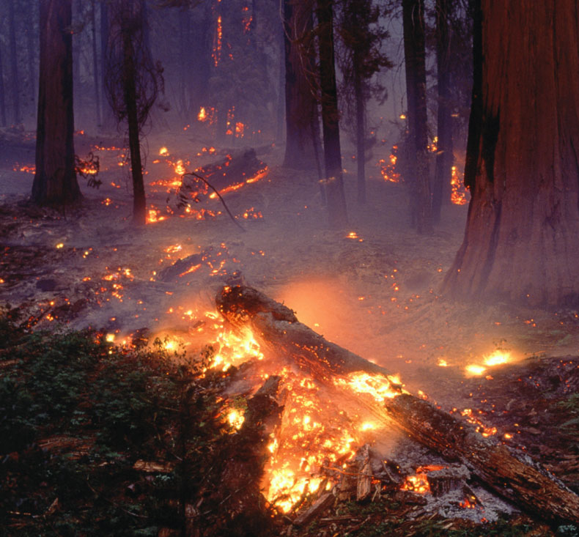
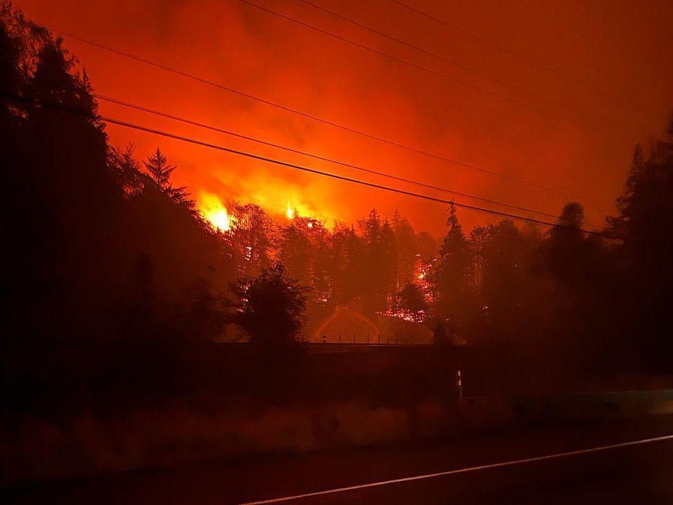
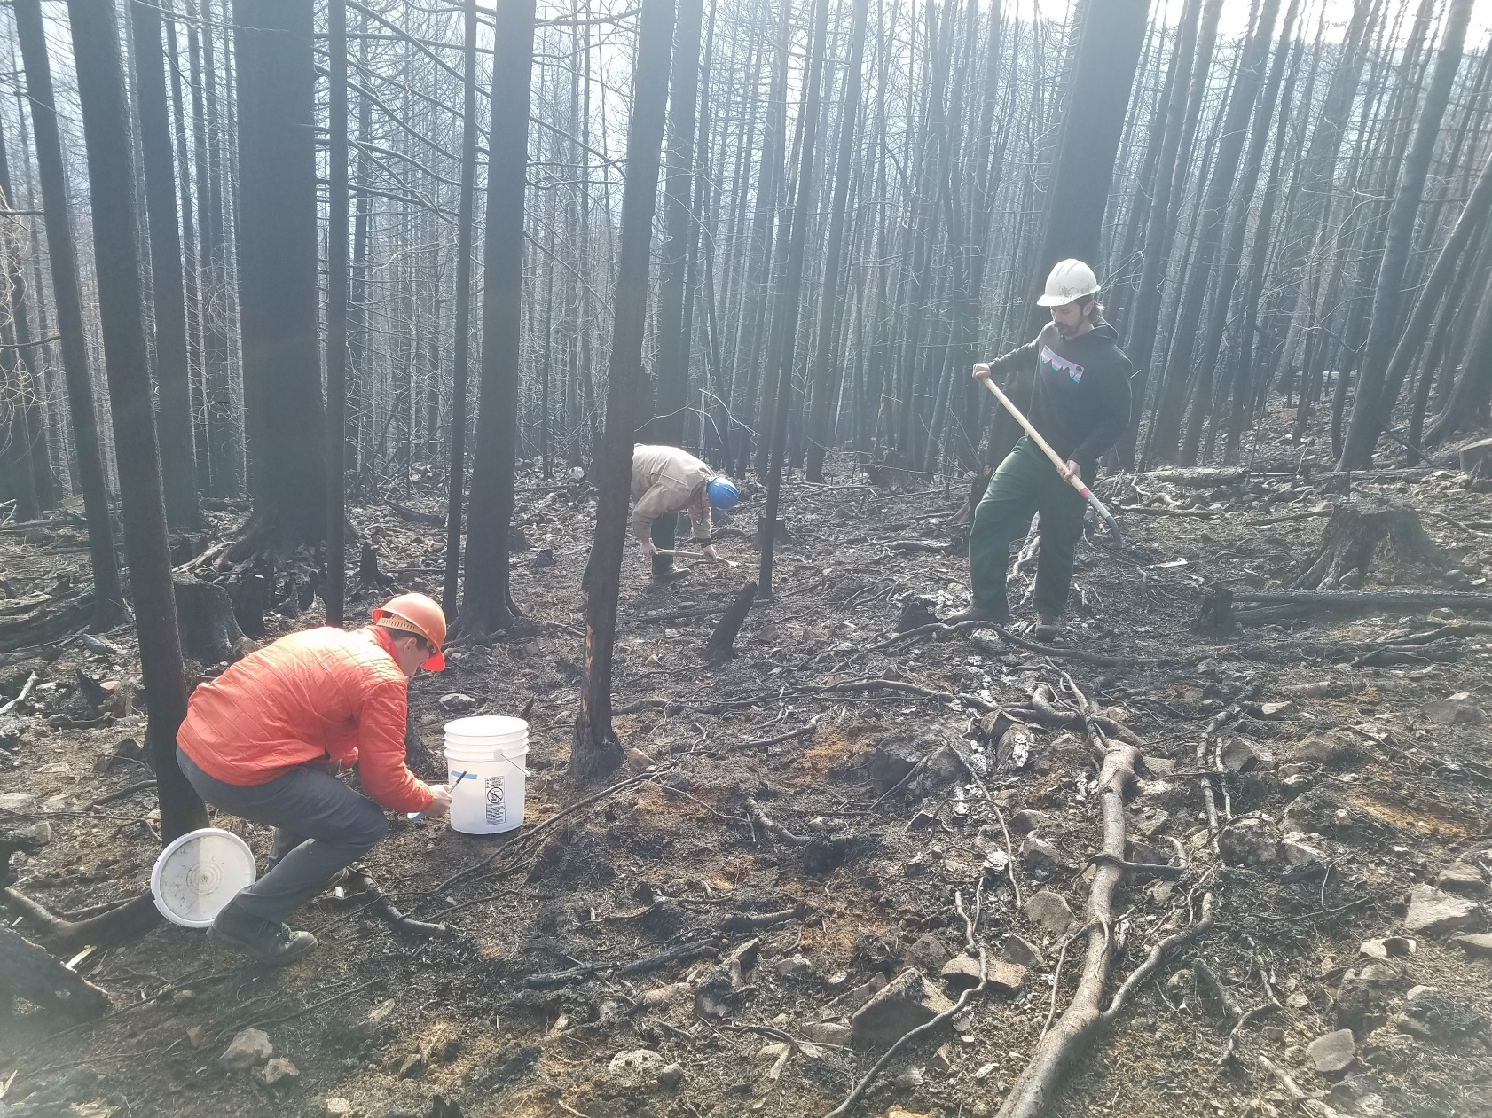




Utilization of Advanced Organics Characterization Methods to Understand Treatability to Wildfire Events
PNWS-AWWA 2025 Conference | Boise, ID
Lynn Stephens
(206) 749-2893
LStephens@BrwnCald.com
Sierra Johnson
(303) 239-5472
SJohnson2@BrwnCald.com

Slide 2

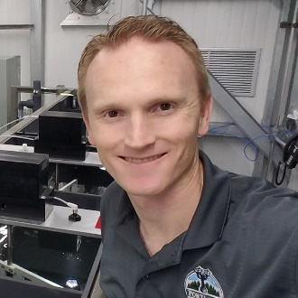
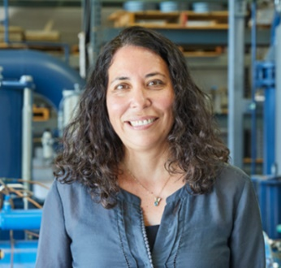



WRF 5168 Acknowledgements:
Sierra Johnson, PE
Mac Gifford, PhD, PE
Yone Akagi
Brown and Caldwell
Mia Vijanderan
Christopher Jones, PhD
Damon Roth, PE
Denise Funk, PE
Daniel Wolgemuth
Martha Wells, PhD, EnviroChem Services
Portland Water Bureau
Mojtaba Azadiaghdam, PhD
Tom Krause
Humberto Piedra-Ruiz, PE
Paul Wild
Lyda Hakes, PE
University of Waterloo
Monica Emelko, PhD, PEng
Soosan Bahramian
Seattle Public Utilities
Metro Vancouver

Slide 3
Agenda
Project Drivers
WRF 5168 Study Objectives and Research Approach
Bench- and Pilot-scale Findings
Advanced Organics Characterization
Summary of Findings

Slide 4
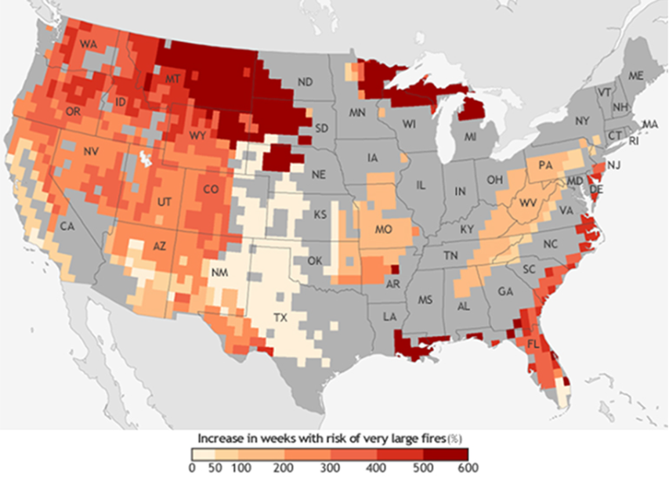
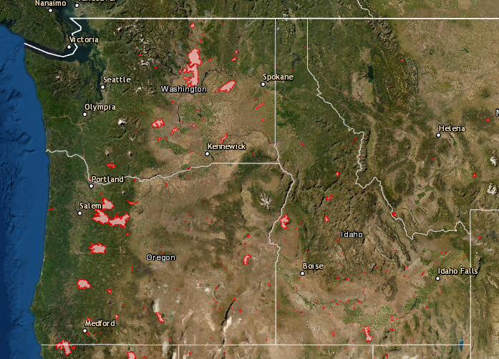
Warming temperatures projected to increase wildfires
Over 5M acres burned in WA, OR, & CA in 2020
Source: NOAA Climate.gov map, based on data from Barbero et al. 2015
Notes:
Research shows that changes in climate create warmer, drier conditions, increased drought, and a longer fire season — all of which work to amplify wildfire risk. many regions not historically fire-prone, are beginning to experience wildfires including areas of the western cascades. Across the United States (U.S.), “very large fire weeks” periods are anticipated to increase by mid-century (2041–2070) as shown in the graphic compared to the recent past (1971–2000)
2020 most active wildfire season in history and over 5M acres burned
One such fire occurred adjacent to the City of Portland’s watershed, the Riverside Fire and burned over 138,000 acres in the Mt. Hood National Forest. The Portland Water Bureau collected ash from the fire and that fire was the impetus for this project’s beginning.

Slide 5
WRF 5168 Study Objectives
Learn operational treatment insights on responding to degraded raw water quality like those that could happen after a wildfire
Pilot-scale and side-by-side comparisons of treatment strategies, specifically comparing conventional treatment with pre-ozonation and biofiltration compared to conventional treatment with pre-chlorination and filtration
Demonstrate how the designed treatment processes provide resilience to continue to meet water quality goals through a period of degraded source water quality representative of those that follow a wildfire
Provide design and operational recommendations that can be made in treatment and monitoring

Slide 6
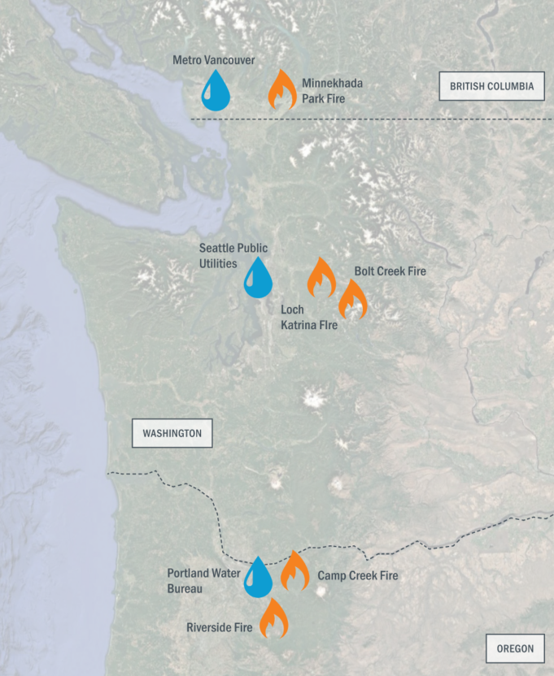
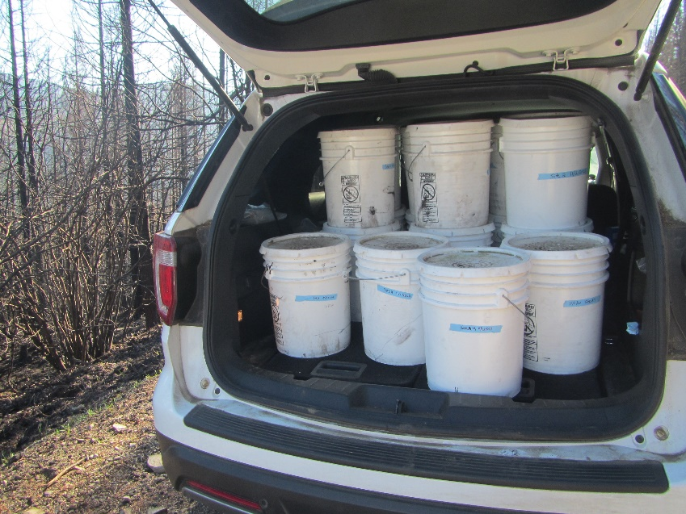
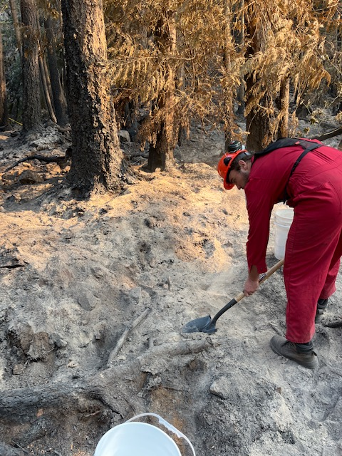
Ash Harvesting from
5 Fires
~ 500 gallons of ash collected
Notes:
Collected ash from 5 different fires in the PNW
The Riverside Fire in 2020 that spurred the initiation of this project.
MV and SPU collected ash in 2022
Active fire in the watershed in 2023 as a part of this study

Slide 7
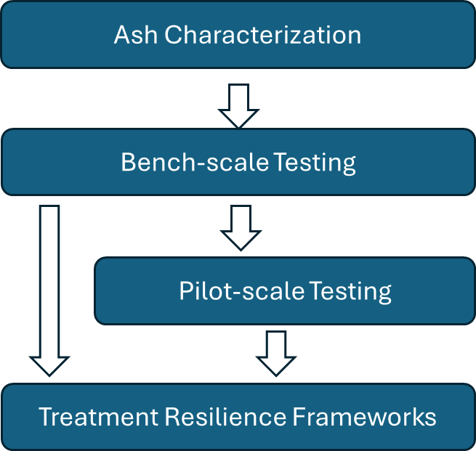
WRF 5158 Project Approach
Advanced Organic Characterizations
Notes:
Ash: dose, mix, settling
Informed
Bench: pre-oxidation, coagulants, PAC, and SDS testing
Informed
Pilot
Recommendations for monitoring and operational adjustments, as well as treatment processes that provide enhanced resiliency

Slide 8
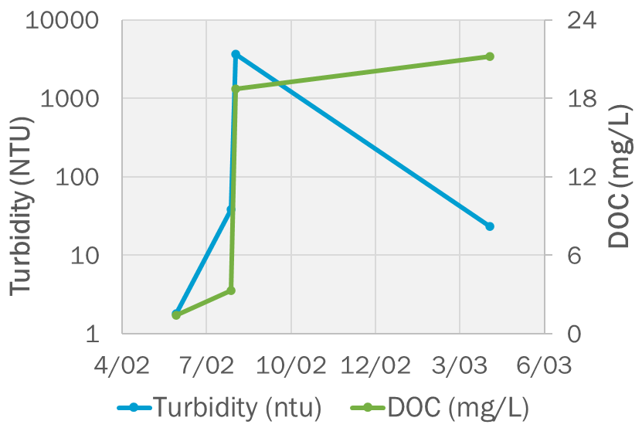

Advanced Organics Characterization
Other utilities have experienced raw water organics increasing post-fire
Research to understand components of organic matter assessed through bulk measurements, such as TOC/DOC
Research Questions?
  Are there other techniques that can be used to better understand the organic composition?
  What components are removed through treatment?
  How do components impact DBP formation?
Durango, CO saw sustained elevated organics following Missionary Ridge Fire
Source: Clark, 2014. Second Water Plant Feasibility Study
Notes:
Organic levels greatly influence coagulation (coagulant dose and the amount of solids generated) and distribution system DBPs

Slide 9
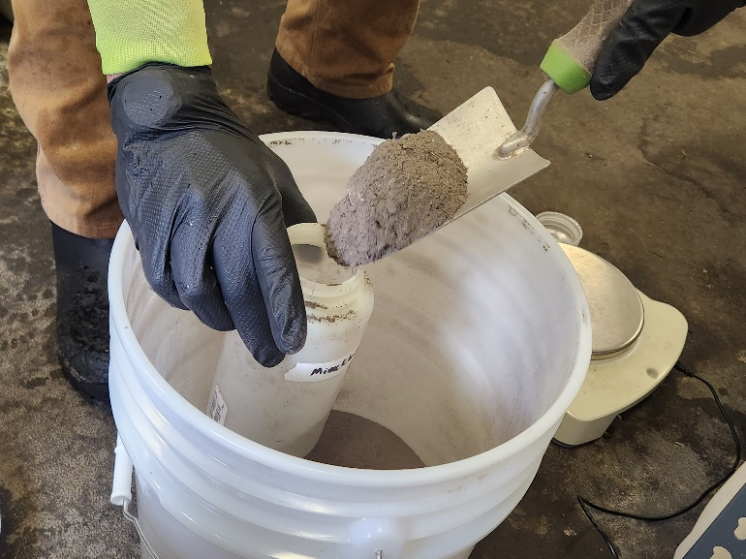
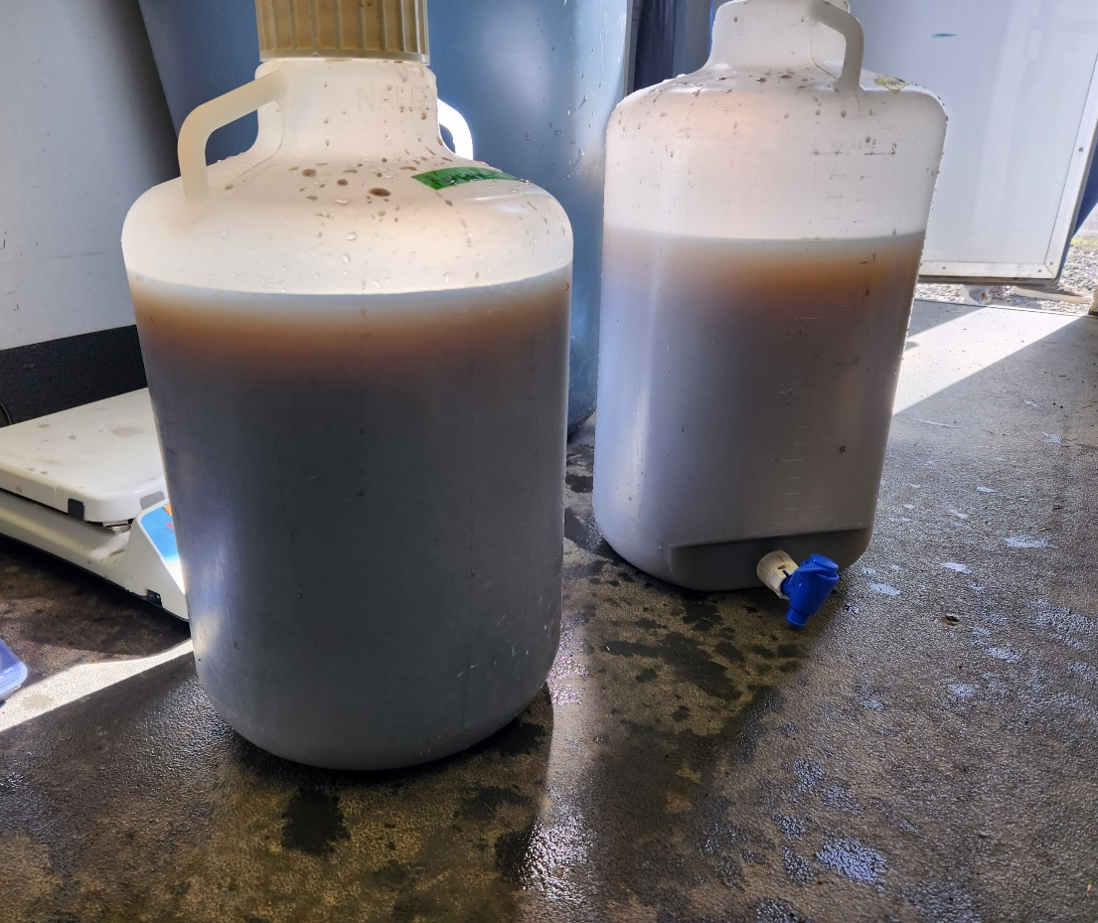
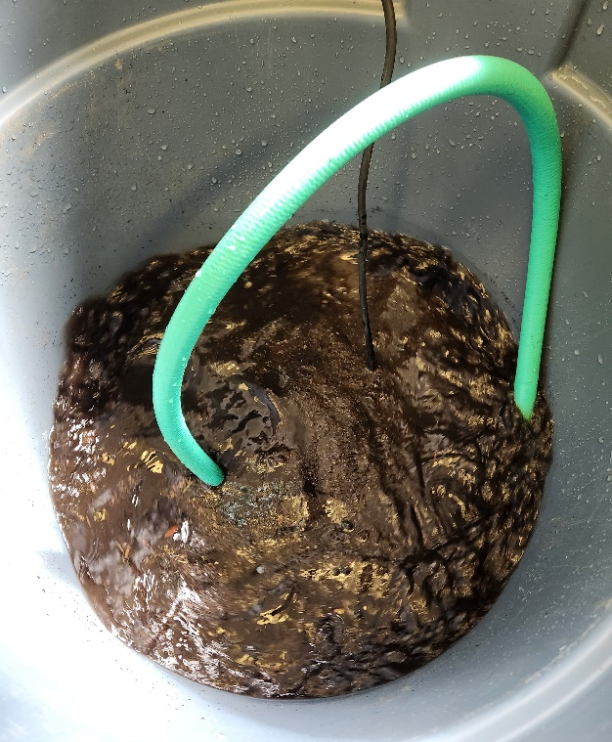
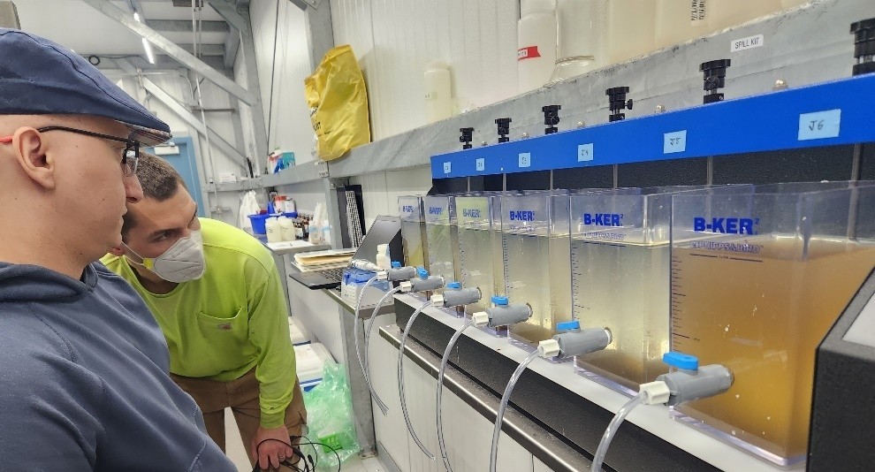
Bench-scale Testing

Slide 10
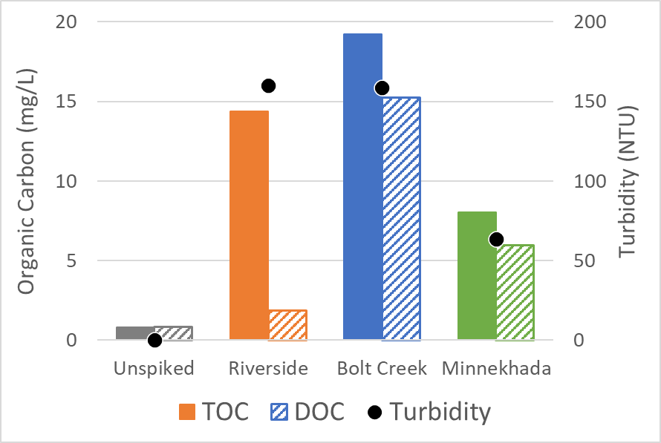
Increased Organics/Turbidity in Wildfire Scenarios
Turbidity increased by two orders of magnitude
Organics shifted from completely dissolved to a particulate portion
Riverside the highest particulate portion
Bolt Creek had the highest dissolved organics
Notes:
Unspiked – Bull Run raw water

Slide 11
Fire characteristics matter
Riverside Fire
Bolt Creek Fire

Slide 12
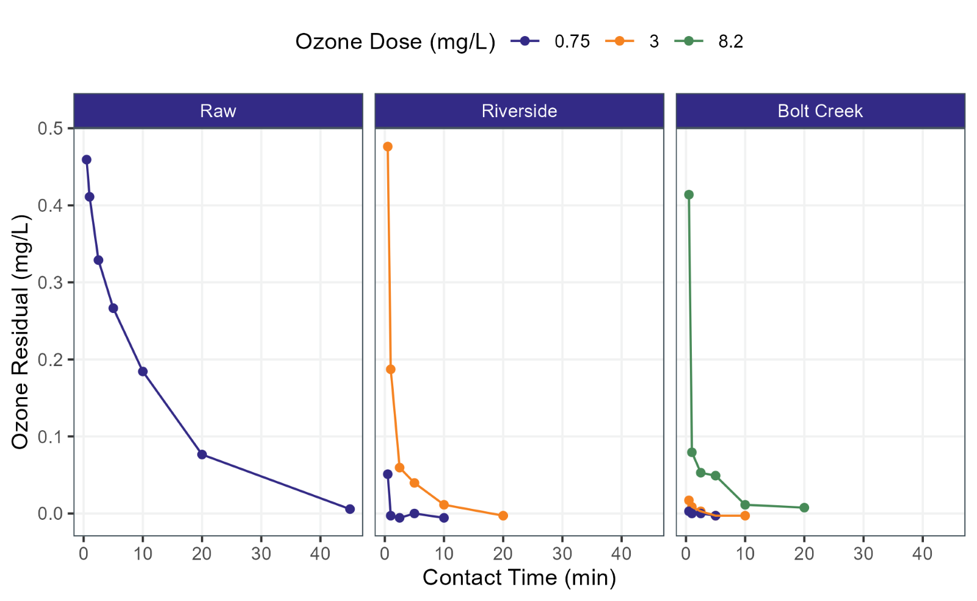
Wildfire ash exhibited immediate ozone decay
Bull Run raw water exhibited typical ozone demand and decay
Ozone quickly consumed in wildfire-impacted water
Bench testing at 0.75 and 3 mg/L typical of full-scale
Bromate was not detected.
Notes:
Our O3:TOC ratio (@ 3 mg/L dose)
Bolt Creek = 0.31
Riverside = 1.9
However, due to high ozone demand exhibited by the Bolt Creek samples, a high ozone dose of 8.2 mg/L was also tested. Despite this high ozone dose, instantaneous demand still caused low residual in the first measured residual sample taken 30 seconds after ozone addition.

Slide 13
Bench-scale Testing: UFC Chlorine Demand
Slide credit: Anna Vosa
Chlorine dose required to produce 1 mg/L residual after 24 hours (Uniform Formation Conditions)
Notes:
Assessed Uniform formation conditions to evaluate the chlorine dose required to produce a 1 mg/L after 24 hours.
Only 1 mg/L chlorine dose was needed for the Bull Run raw water compared to the high dosages needed for no treatment. Treatment improved the chlorine demand. Bolt Creek had the highest chlorine demand in line with the organics and ozonation reduced chlorine demand.

Slide 14
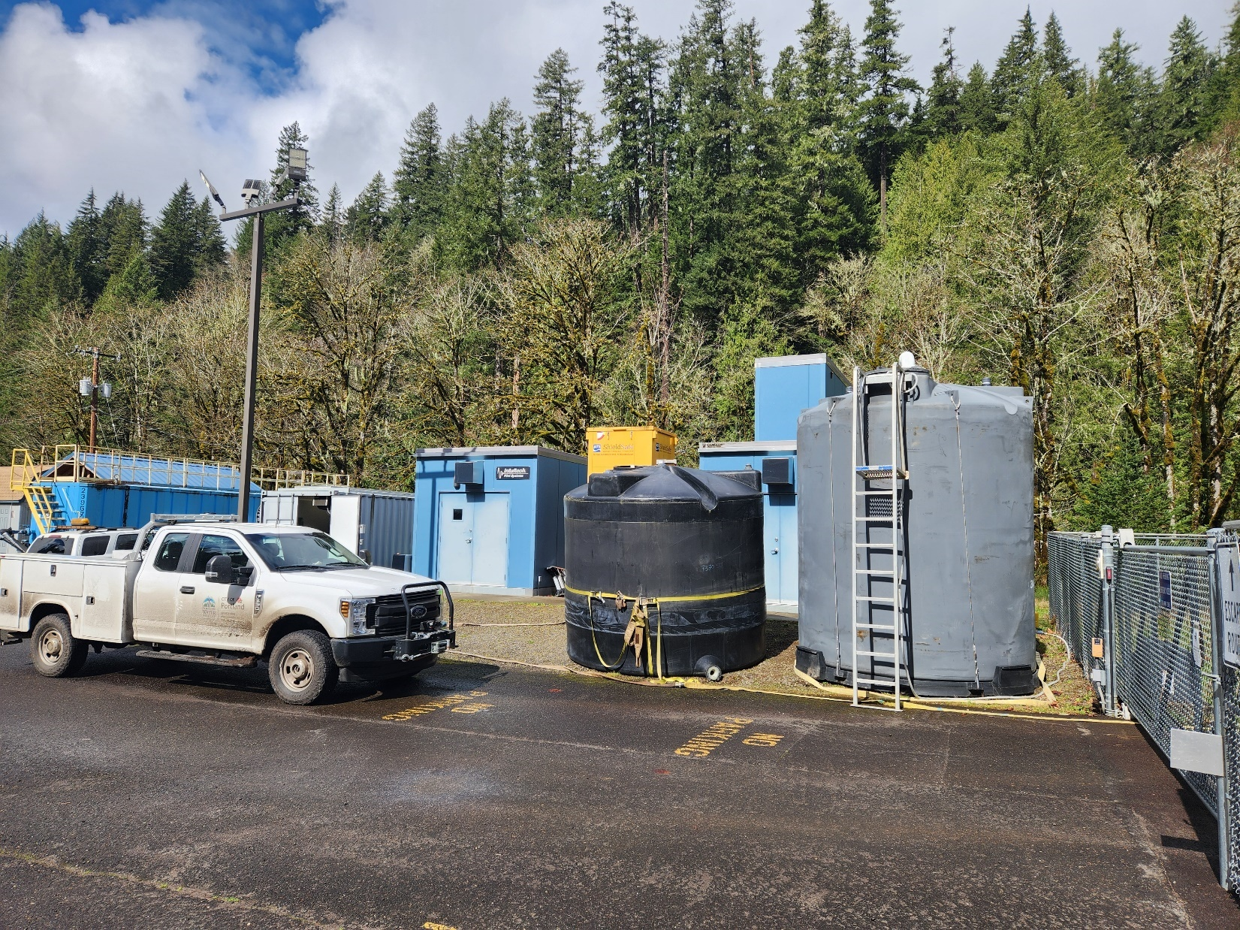
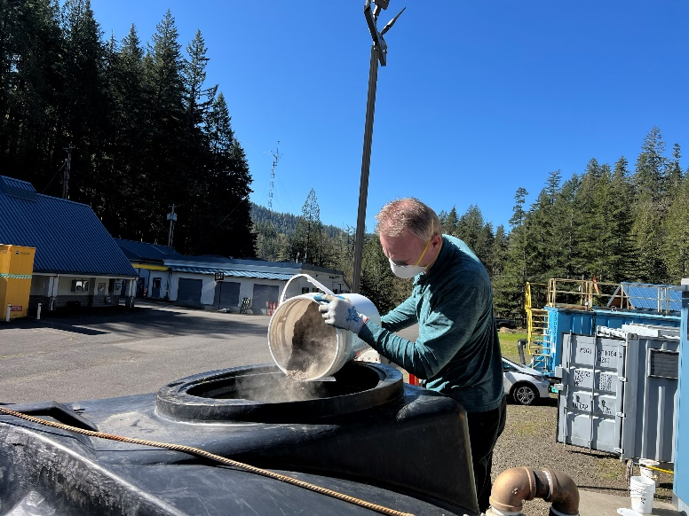
Pilot-scale Testing
Notes:
Scaling up the experiments to pilot-scale

Slide 15
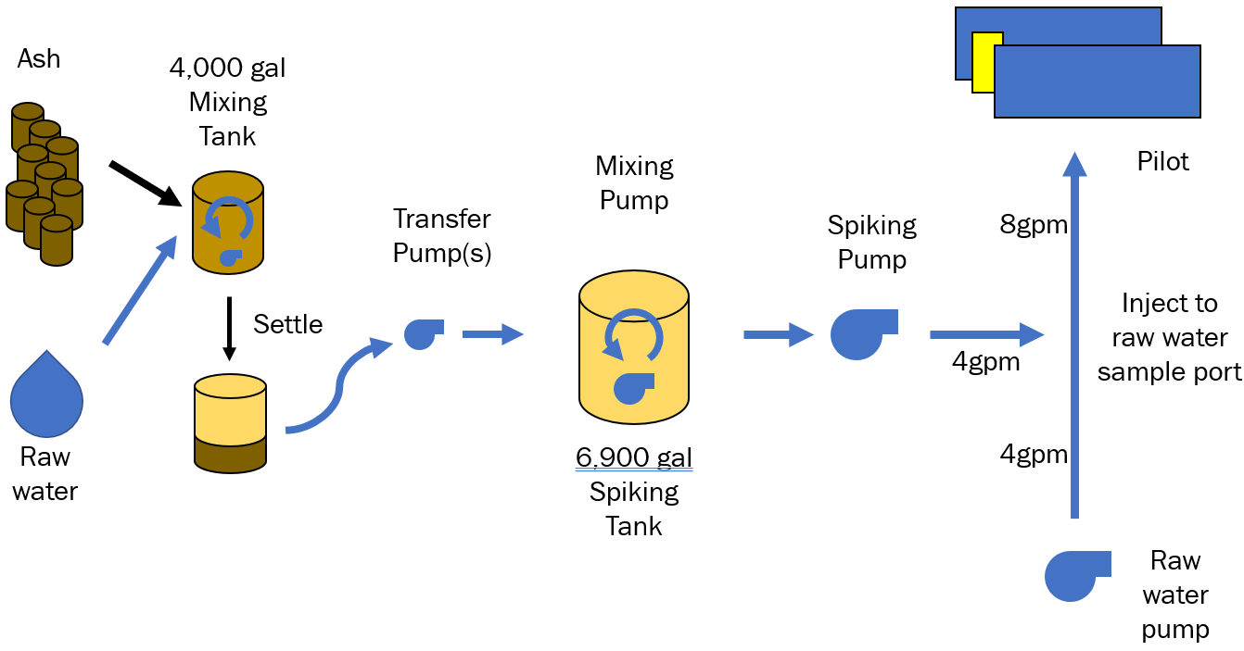
Overview of Pilot Testing
Pre-chlorination compared to pre-ozonation
Filtration rates:
  5 and 10 gpm/sf

Slide 16
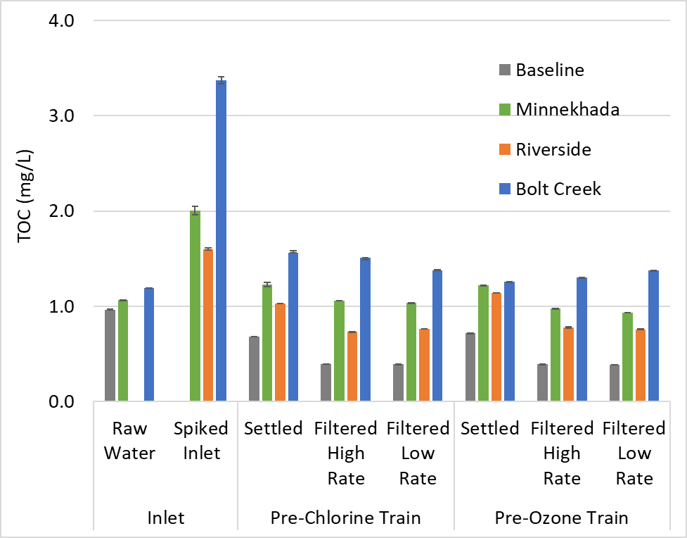
Organics Reduction through Treatment
Organics levels were higher through the entire treatment process
Organic impact was lower at pilot-scale than bench
Greater than 50% removal through filtration
Notes:
Decreased organic levels with pre-ozone. More indicative of long-term treatment challenges post fire when you cannot rely on an alternative source.

Slide 17

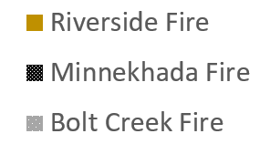
24-Hour DBP Concentrations
HAA5 MCL = 60 µg/L
TTHM MCL = 80 µg/L

Slide 18
Advanced Organic Characterization for
Bench- and Pilot-scale

Slide 19
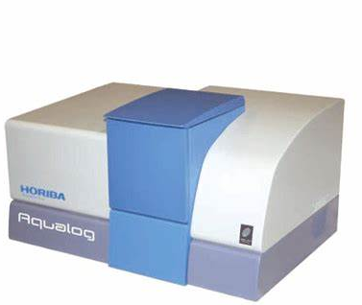
Research Approach
Fluorescence
  Assessed via ultraviolet (UV)–visible and three-dimensional fluorescence excitation-emission matrix (EEM) analysis
  Bench-scale testing assessed fluorescence in BC Laboratory using Horiba Aqualog (23 samples)
  Horiba Duetta sent to PWB for pilot testing and fluorescence analyzed in the field for each wildfire testing event (97 samples)
  Completed by Brown and Caldwell
Size exclusion chromatography (SEC)
  Assessed via liquid chromatography – organic carbon detection (LC-OCD)
  Completed by University of Waterloo

Slide 20
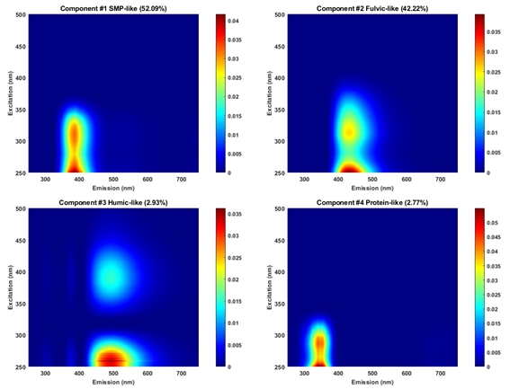
PARAFAC model was used to separate fluorescence peaks into components
Peak locations associated with different components but still ongoing research
Bench testing: 4 component model
  Soluble microbial products (SMP)-like
  Fulvic-like
  Humic acid-like
  Protein-like
Pilot testing: 3 component model
  SMP-like
  Humic/fulvic acid-like
  Protein-like (higher tyrosine-like contribution)
Sample score is a pseudo-concentration
Notes:
Parallel factor analysis (PARAFAC) - how many things can you add up to equal that one value.
At a given ExEm pair, known intensity, how much can you break that number up.
Sample score - % of each component that makes up the whole. "The whole" is the total fluorescence signal. But this only applies within one batch of PARAFAC, not between runs.

Slide 21
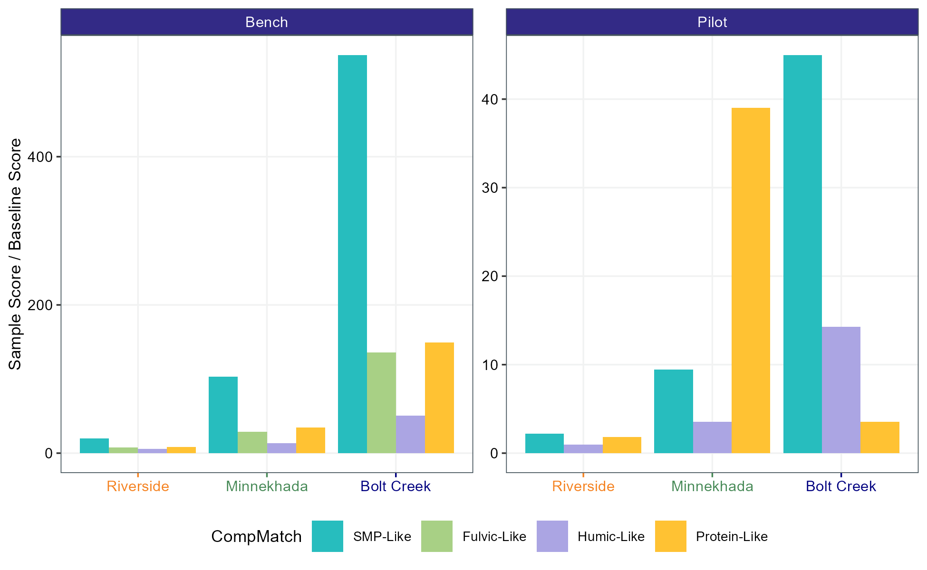
Organic composition was altered by ash spiking and was fire-dependent
Sample scores generally correlate with DOC
Largest increase typically in SMP-like component
At pilot-scale, the protein-like component was highest for the Minnekhada Fire
Notes:
Describe graph. This is sample score of each ash-spiked divided by the baseline score of the same component. This shows both the magnitude of increase and which components increased most.
SMP = anything derived from cells. Including trees and such.
Is it possible that SMP wasn't broken down by fire because it's the smaller MW, simpler compounds.

Slide 22
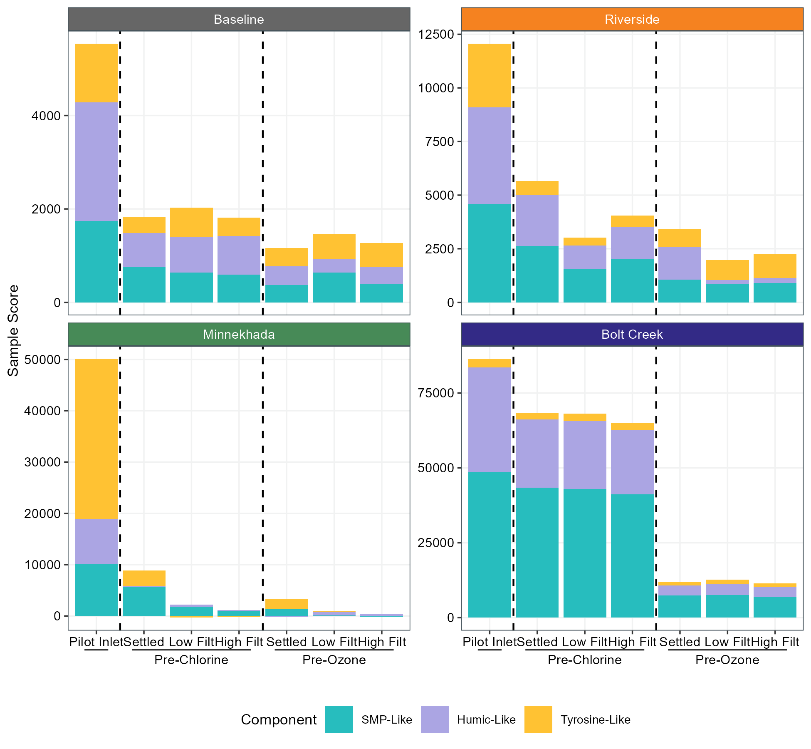

Impact of Treatment
(Pilot-scale)
Reduction was generally:
humic-like > SMP-like > protein-like
Pre-ozonation increased removal, especially for SMP-like and humic-like
Notes:
Note the scale of the y-axis is not the same for each fire.
Note that pre-ozone removed SMP-like well, which was the largest increase from baseline.

Slide 23
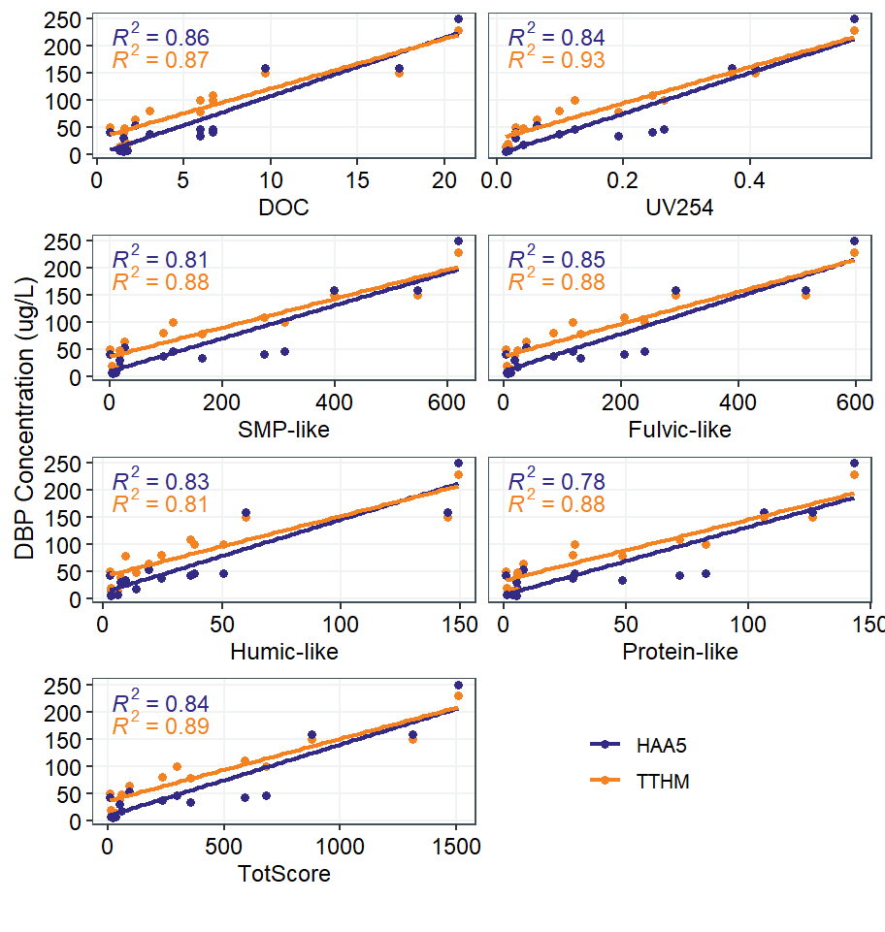
Bench-Scale EEM vs.
DBP formation
DBP values correlate with EEM components
UV₂₅₄ had highest correlation
Weaker correlations in
pilot-scale results

Slide 24
Summary
Drinking water is susceptible to risk of WQ challenges from wildfire
Site and fire characteristics impacted the water quality impacts
Wildfire drastically increased oxidant demand and coagulant demand
Pre-ozone further reduced organic components assessed through the advanced organic characterization and regulated DBPs

Slide 25
Summary
Advanced organic characterizations, specifically EEM, was deployed during bench- and pilot-scale testing
  Sample scores or fluorescence intensity aligned with organics and DBP values
  Each organic component was reduced through treatment
  Pre-ozonation removed more organic components
  DBP values and EEM components correlated at bench-scale, but so did other bulk parameters, such as UV₂₅₄
  Assessing components comparison to specific DBPs is ongoing and additional research could be beneficial

Slide 26

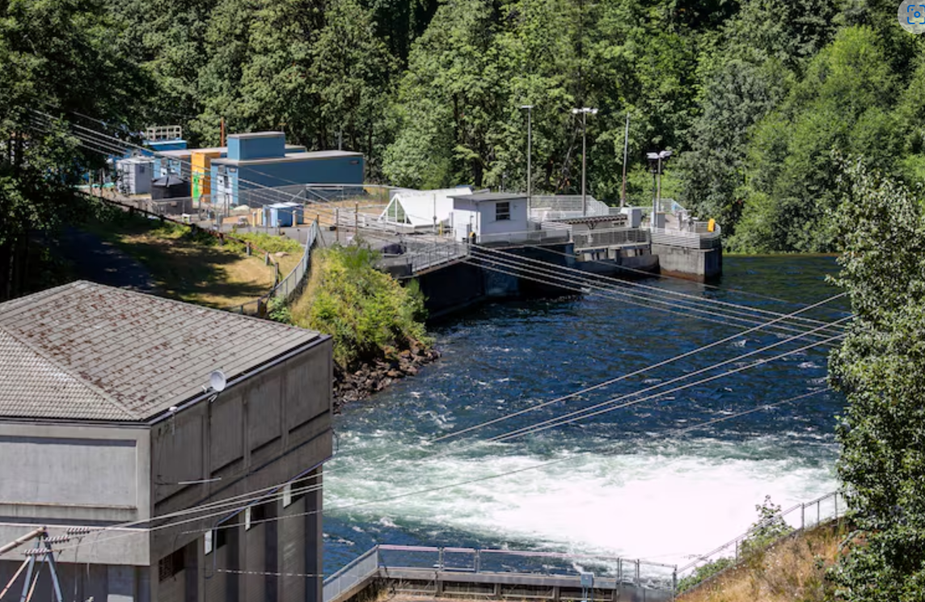
Learn more about WRF 5168
Final Water Research Foundation Report
anticipated in September 2025
Water Exchange: How can we prepare our
water treatment systems to withstand impacts
from climate change and increase resiliency?
Oregon Public Broadcasting:
Extreme wildfires threaten the Portland area’s drinking water. It’s not alone – OPB

Slide 27

Thank you.
Questions?
Lynn Stephens, PE Sierra Johnson, PE
206-749-2893 (303) 239-5472
LStephens@brwncald.com SJohnson2@brwncald.com

