Slide 1
Groundwater Management in California: State of Sustainable Groundwater Management Act Implementation Gus Tolley, PhD, PG (CA) AWWA PNWS Conference May 8, 2025

Slide 2
Typical understanding of water supply in California.
I have no information about this part

Slide 3
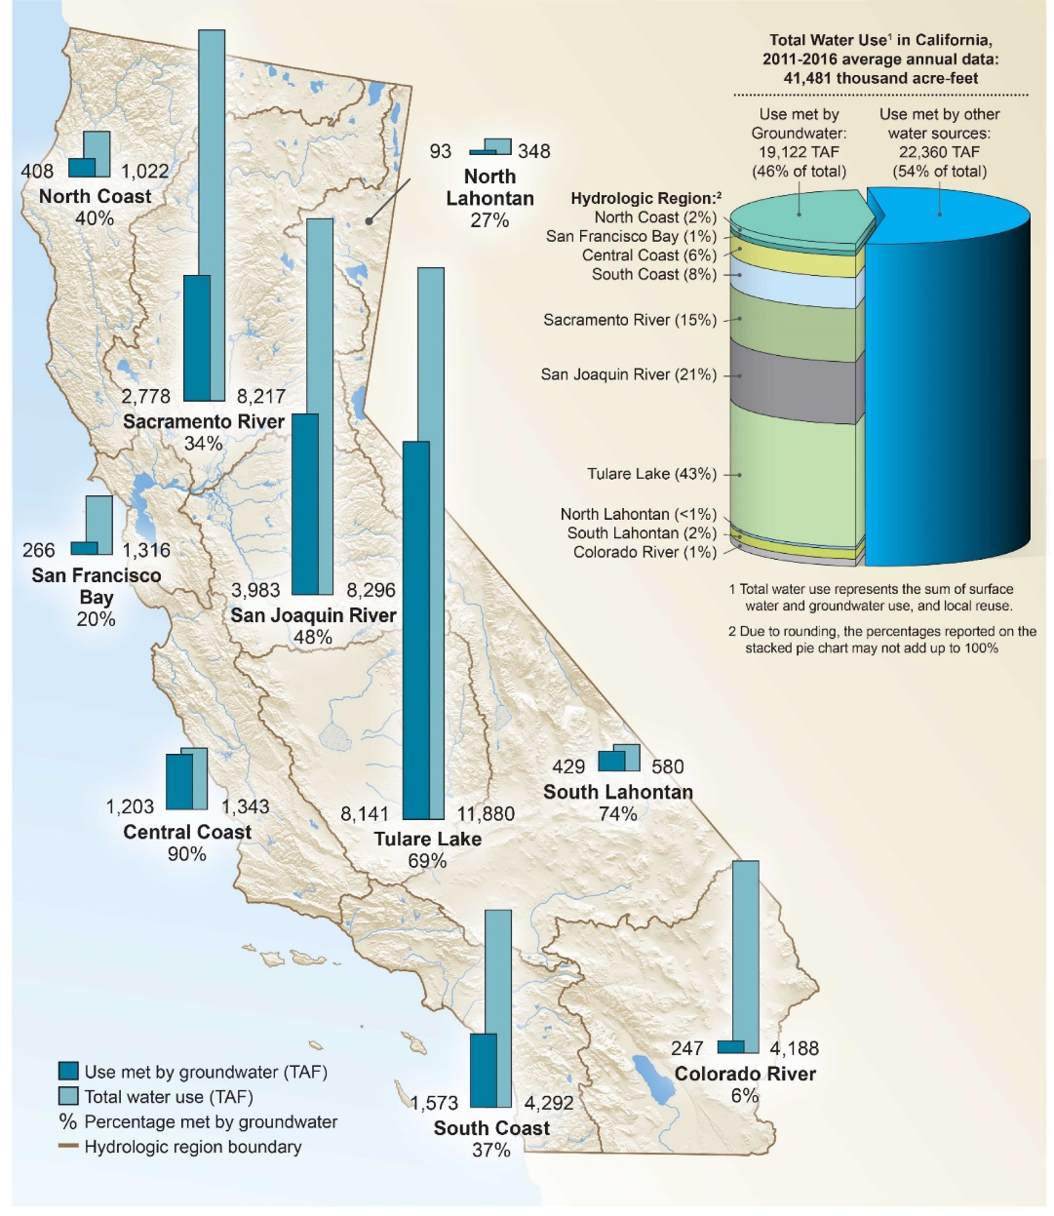
Groundwater is a large portion of California’s water supply.
On average, about 46% of water demand is met by groundwater
Some communities rely nearly entirely on groundwater
Critical resource for many farmers across California
CADWR (2020)
Notes:
About 85% of Californians depend on groundwater for some portion of their water supply.

Slide 4
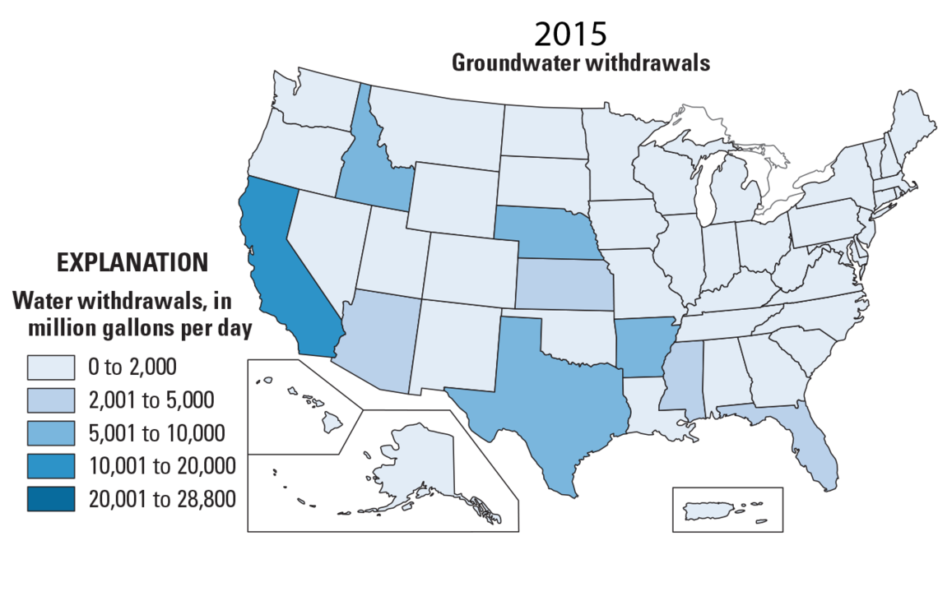
California uses more groundwater than any other state.
https://www.usgs.gov/special-topics/water-science-school/science/groundwater-use-united-states
Notes:
California, Arkansas, Texas, Nebraska, and Idaho are the top 5 states for groundwater use. They are 17% of the area of the US and account for about 54% of national groundwater use.

Slide 5
How Does Groundwater Management Compare Across Western States?
Groundwater rights are appropriative (Groundwater Water Act 1951/1953) excluding domestic wells
“ ‘Ground water’ is all water under the surface of the ground whatever may be the geological structure in which it is standing or moving”
Department of Water Resources has authority to protect ground water from depletion and to prohibit ground water withdrawal from existing wells when necessary to protect senior ground water appropriations.
-Ground Water Management Areas (GWMAs)
-Critical Ground Water Areas (CGWAs)
Idaho
95% of drinking water is sourced from groundwater
Idaho Dept of Health and Welfare

Slide 6
How Does Groundwater Management Compare Across Western States?
Combination of State and Federal Regulations
-Most aquifers are governed by state law (prior appropriation)
-North Florence Dunal Aquifer is protected at the federal level via a Sole Source Aquifer Petition (SDWA)
The Oregon Water Resources Department (OWRD) can apply designations to basins:
-Groundwater limited/classified areas
-Critical Groundwater Areas (CGAs): First was Cow Valley in 1959
-Groundwater mitigation areas
-Withdrawn from appropriation
Oregon

Slide 7
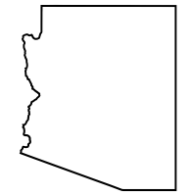
How Does Groundwater Management Compare Across Western States?
Groundwater Management Code (1980)
3 levels of water management
-Low: Statewide general provisions
-Medium: Irrigation Non-Expansion Areas (INAs)
-High: Active Management Areas (AMAs)
New AMAs or INAs can be created by the Arizona Department of Water Resources (ADWR) or by a vote of local residents.
Developers must demonstrate a 100-yr assured water supply (AWS)
Arizona

Slide 8
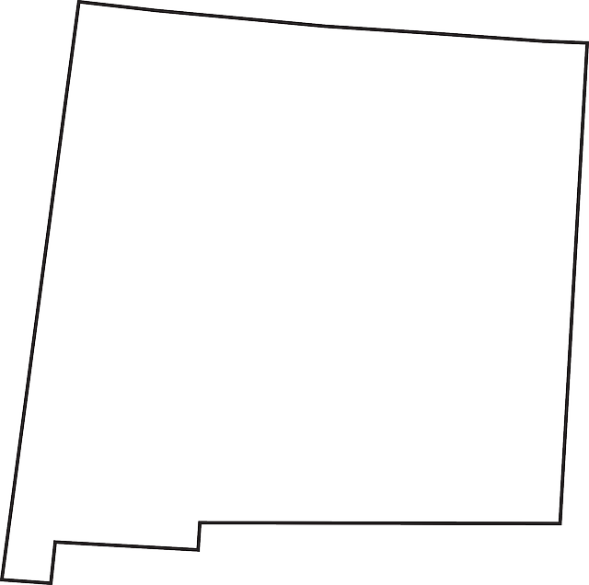
How Does Groundwater Management Compare Across Western States?
Article 16 of the New Mexico Constitution (1912)
-Water belongs to the public and is subject to appropriation by beneficial use
-Usufructuary right
Managed by the Interstate Stream Commission (ISC) under the Office of the State Engineer (OSE) by establishing Declared Underground Groundwater Basins
-Began in 1931, last basin declared in 2005
-108 declared basins (entire state)
One of the earliest states to legally recognize GW-SW interactions
New Mexico
Notes:
New Mexico law does not recognize a hierarchy of uses

Slide 9
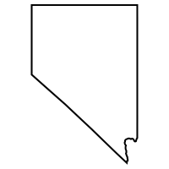
How Does Groundwater Management Compare Across Western States?
General Water Law Act (1913)
-Water in artesian wells and definable aquifers appropriable
- Also included an early reference to groundwater conservation
Nevada Underground Water Act (1939)
- All groundwater subject to appropriation and regulation by the State Engineer
State Engineer may designate critical management areas in any designated basin where withdrawals regularly exceed safe yield.
- If designated for 10+ years, withdrawals must be restricted based on priority (unless a GW management plan is approved)
Nevada
Notes:
New Mexico law does not recognize a hierarchy of uses

Slide 10
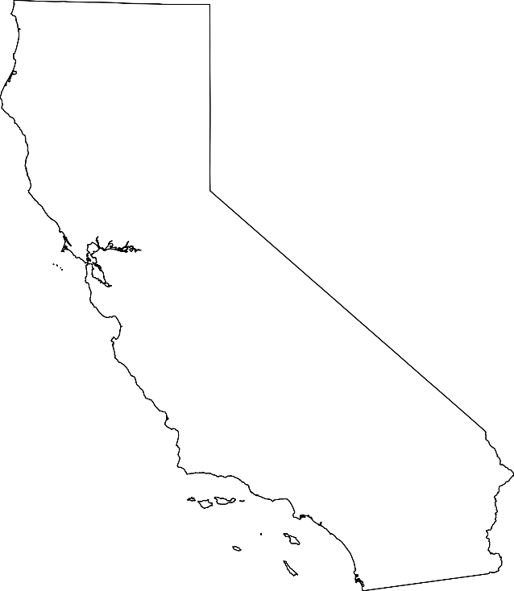
How Does Groundwater Management Compare Across Western States?
Overlying groundwater rights are correlative (similar to riparian rights)
Non-overlying uses and public uses (e.g., municipalities) are appropriative
Prescriptive rights can be obtained against private entities if certain conditions are met
Extractions exceeding 2 AF/yr in most high-use basins are subject to SGMA since 2014 (2020/2022 in reality) or prior adjudication
California

Slide 11
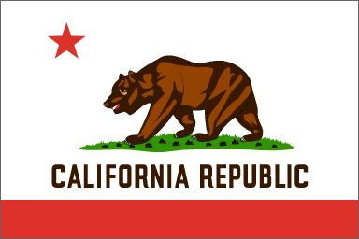
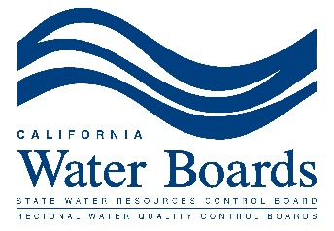
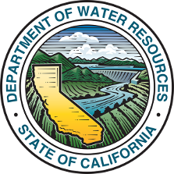
A Brief History of California Groundwater Regulation:
1850: California granted statehood
1969: Porter Cologne Water Quality Control Act
2014: Sustainable Groundwater Management Act

Slide 12
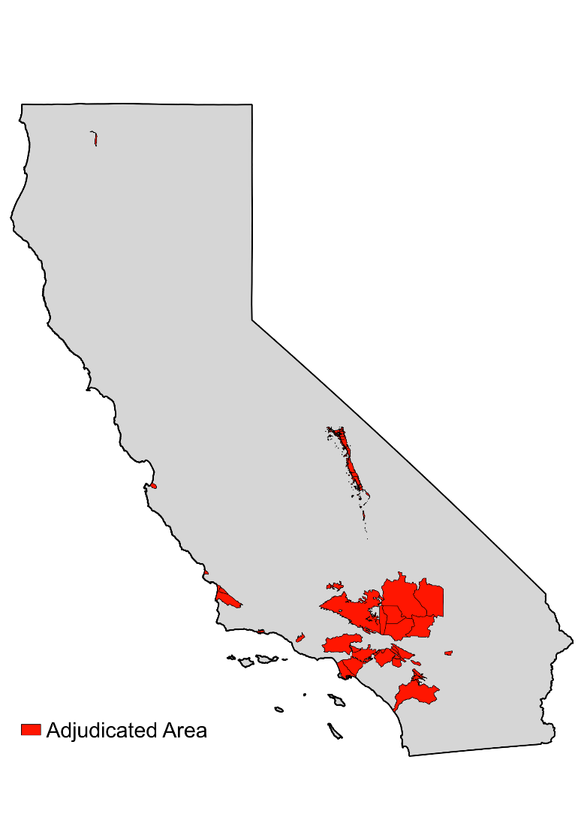
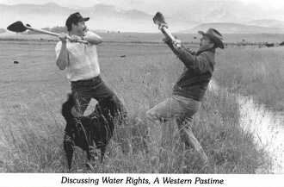
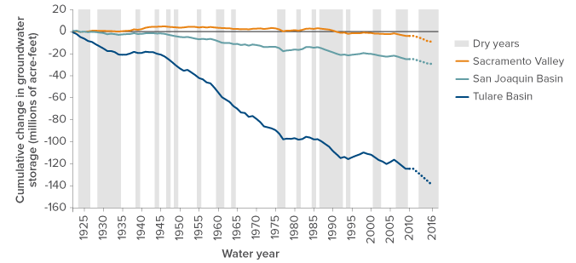
Until (relatively) recently, California groundwater pumping was only regulated by the courts.
Adjudication

Slide 13
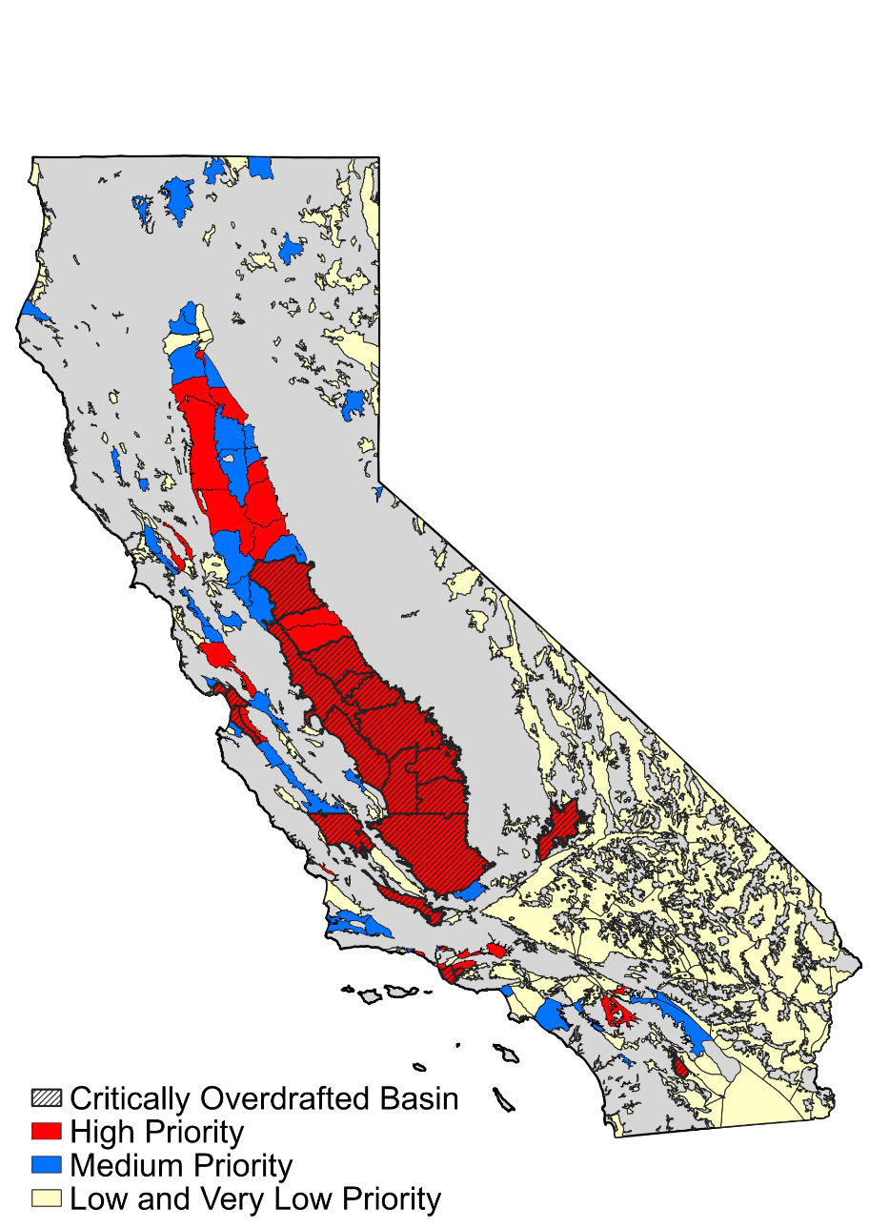
Sustainable Groundwater Management Act (SGMA)
260 Groundwater Sustainability Agencies (GSAs) were formed in 94 groundwater basins.
Notes:
SGMA covers:
-98 percent of groundwater pumping (20 million acre-feet)
-83 percent of the population (25 million Californians
-88 percent of all irrigated acres (6.7 million acres)
Additional layer on top of existing legislation and water rights

Slide 14
Local(ish) Control with a State backstop.
Groundwater Sustainability Agency
(GSA)
Department of Water Resources
State Water Board
Develop and implement Groundwater Sustainability Plan
(GSP)
Review and approve GSPs
Provide technical guidance
Administer financial assistance
Holds probationary meetings for basins without approved GSPs
Develops interim GSPs for basins that cannot get out of probation
Notes:
SGMA Round 1 funding: $152 Million
SGMA Round 2 funding: $187 million (originally planned to be $230 million)
Total: $339 million

Slide 15
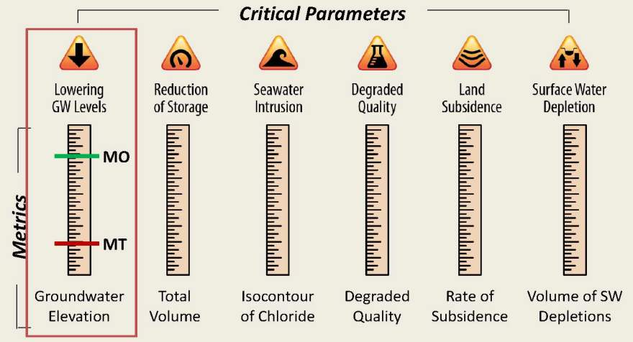
SGMA requires an attempt to quantify sustainability.
“Undesirable Results”
MO = Measurable Objective
MT = Minimum Threshold
Sustainable Management Criteria (SMCs)*
*Well or location specific
Prevent significant and unreasonable impacts

Slide 17
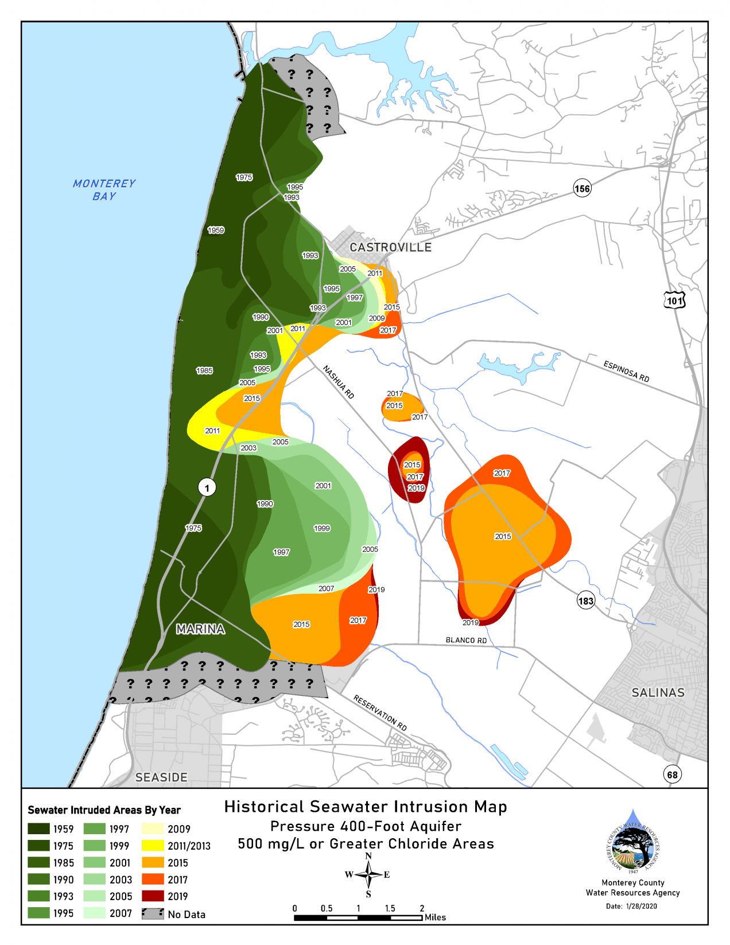
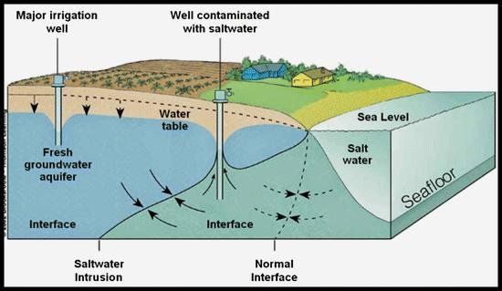
$$z=\frac{ρ_{f}}{\left(ρ_{s}−ρ_{f}\right)}h$$
h
z
$$z=40h$$

Slide 18
Don’t make existing problems any worse...

Slide 19
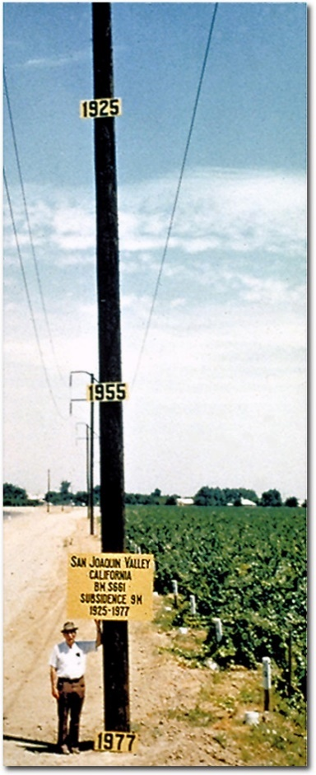
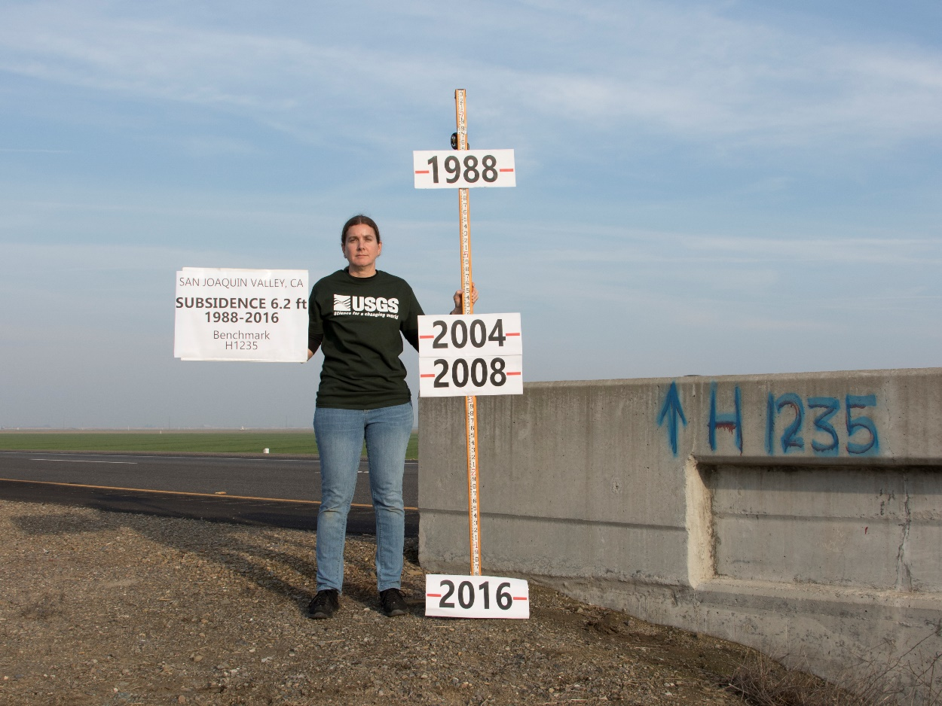
https://www.usgs.gov/media/images/aquifer-compaction

Slide 20
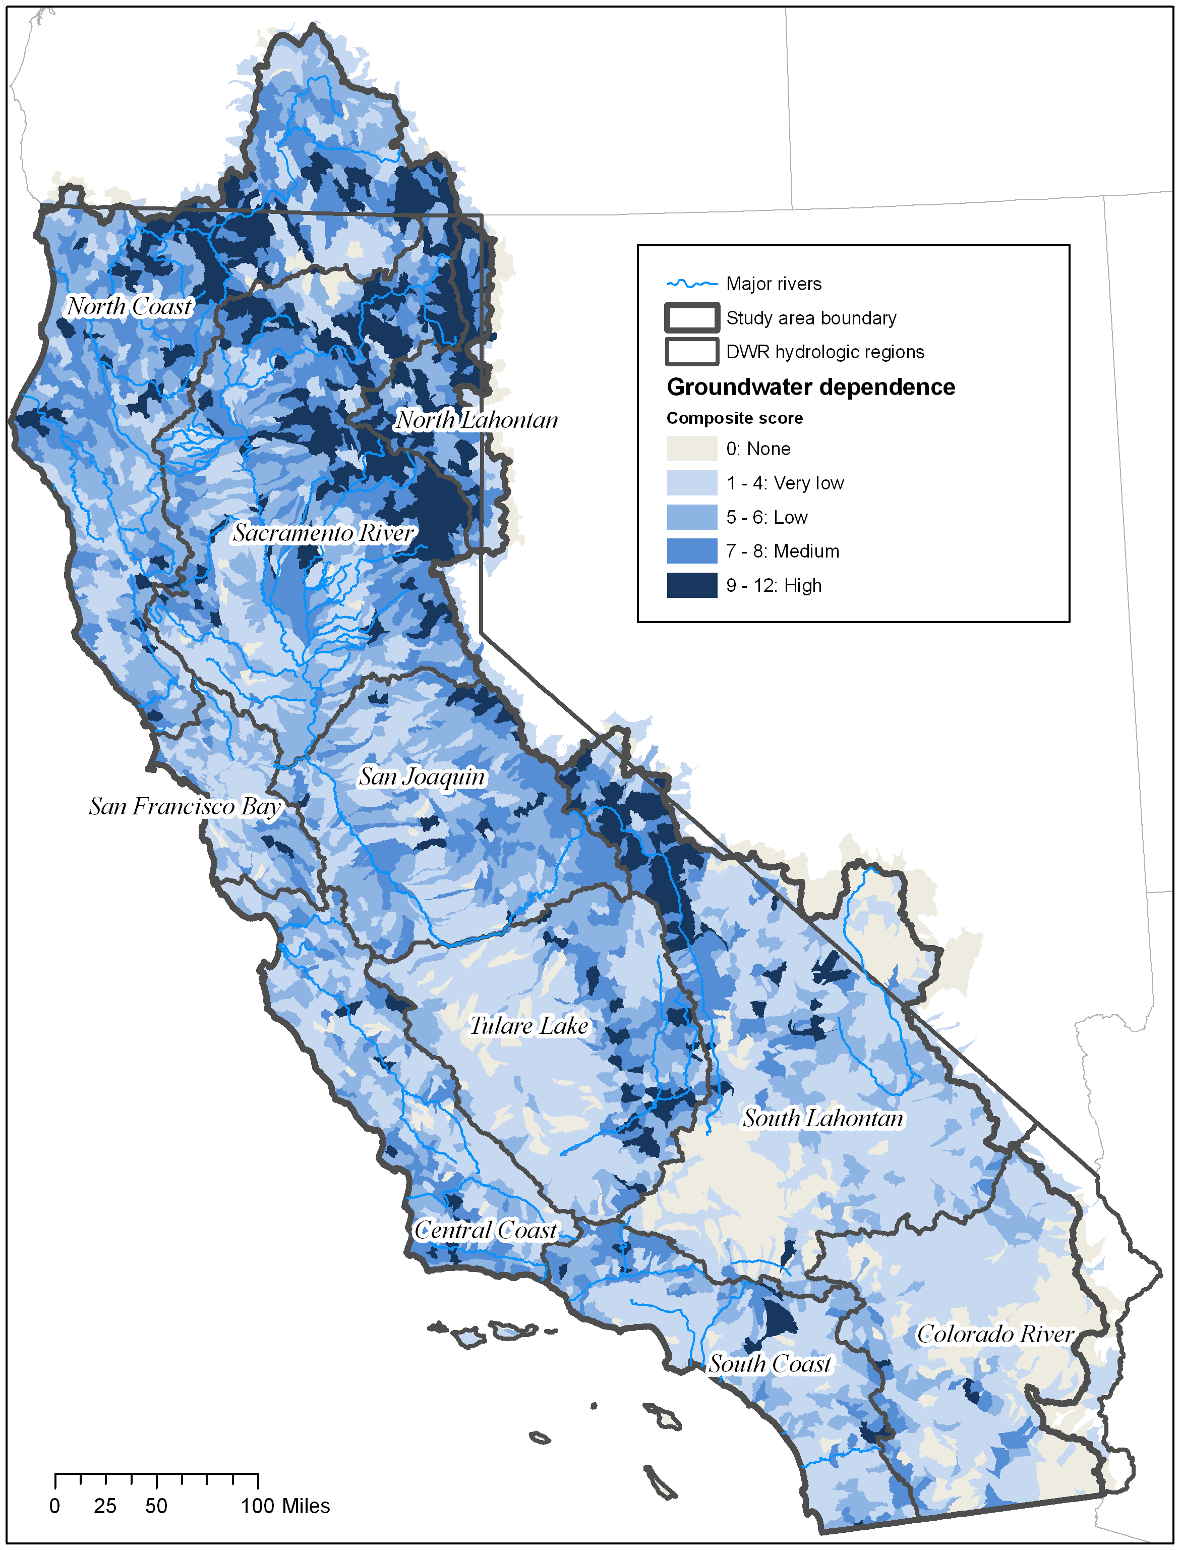
Barlow & Leake (2012)
Howard & Merrifield (2010)

Slide 21
SGMA Timeline
*We are here
Recurring Requirements:
Water Level Uploads (twice per year)
Annual Reports
5-yr Evaluations
https://www.countyofmerced.com/2798/Sustainable-Groundwater---SGMA

Slide 22
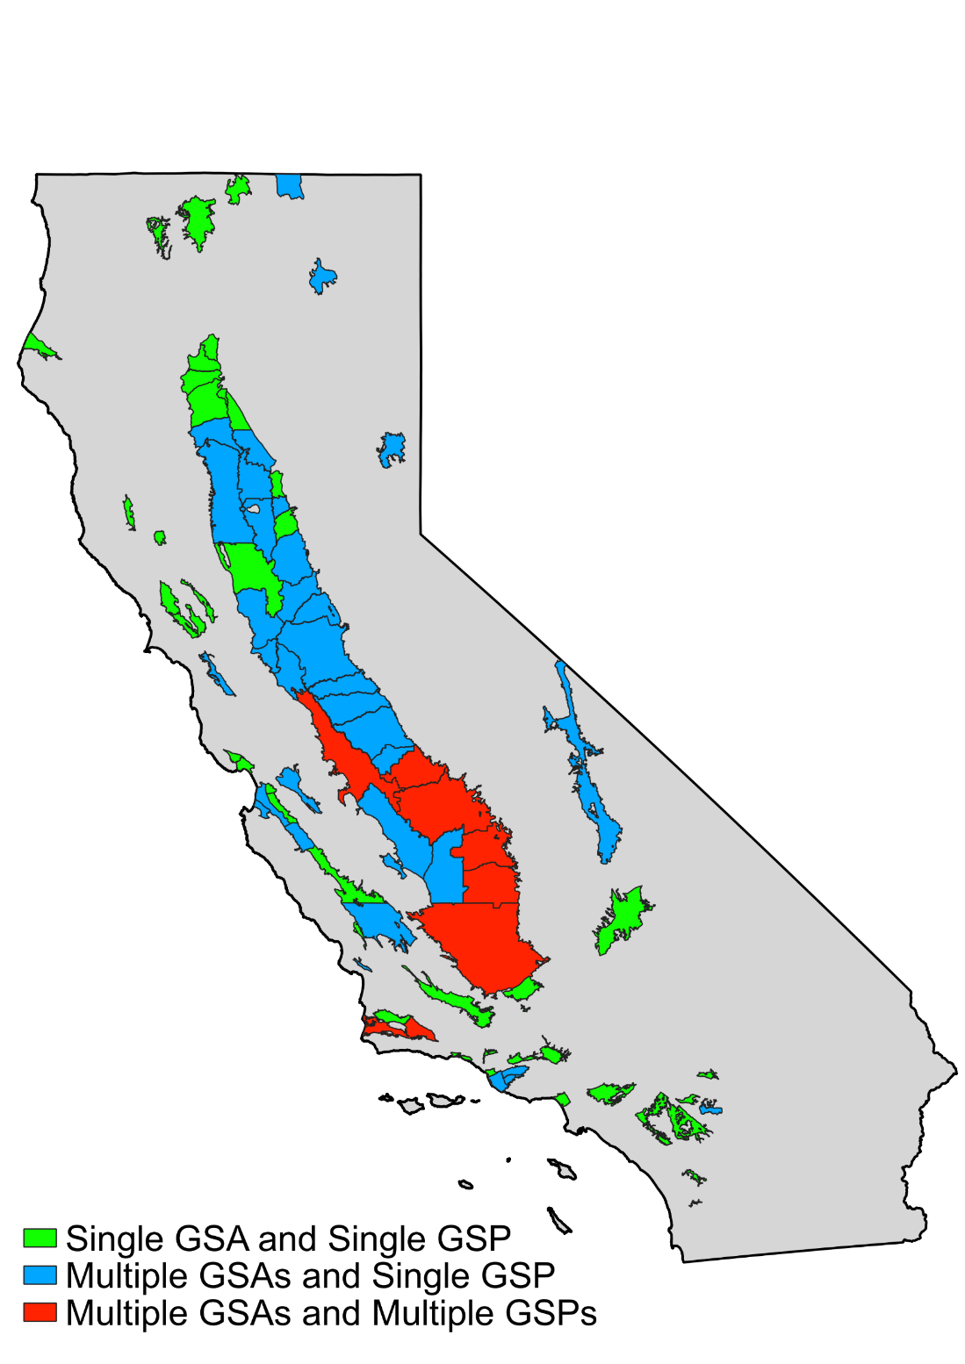
GSA and GSP Combinations
 | Single GSA | Multiple GSAs
Single GSP
Multiple GSPs
1 GSA, 1 Plan
23 GSAs, 6 Plans
49
36
0
7

Slide 23
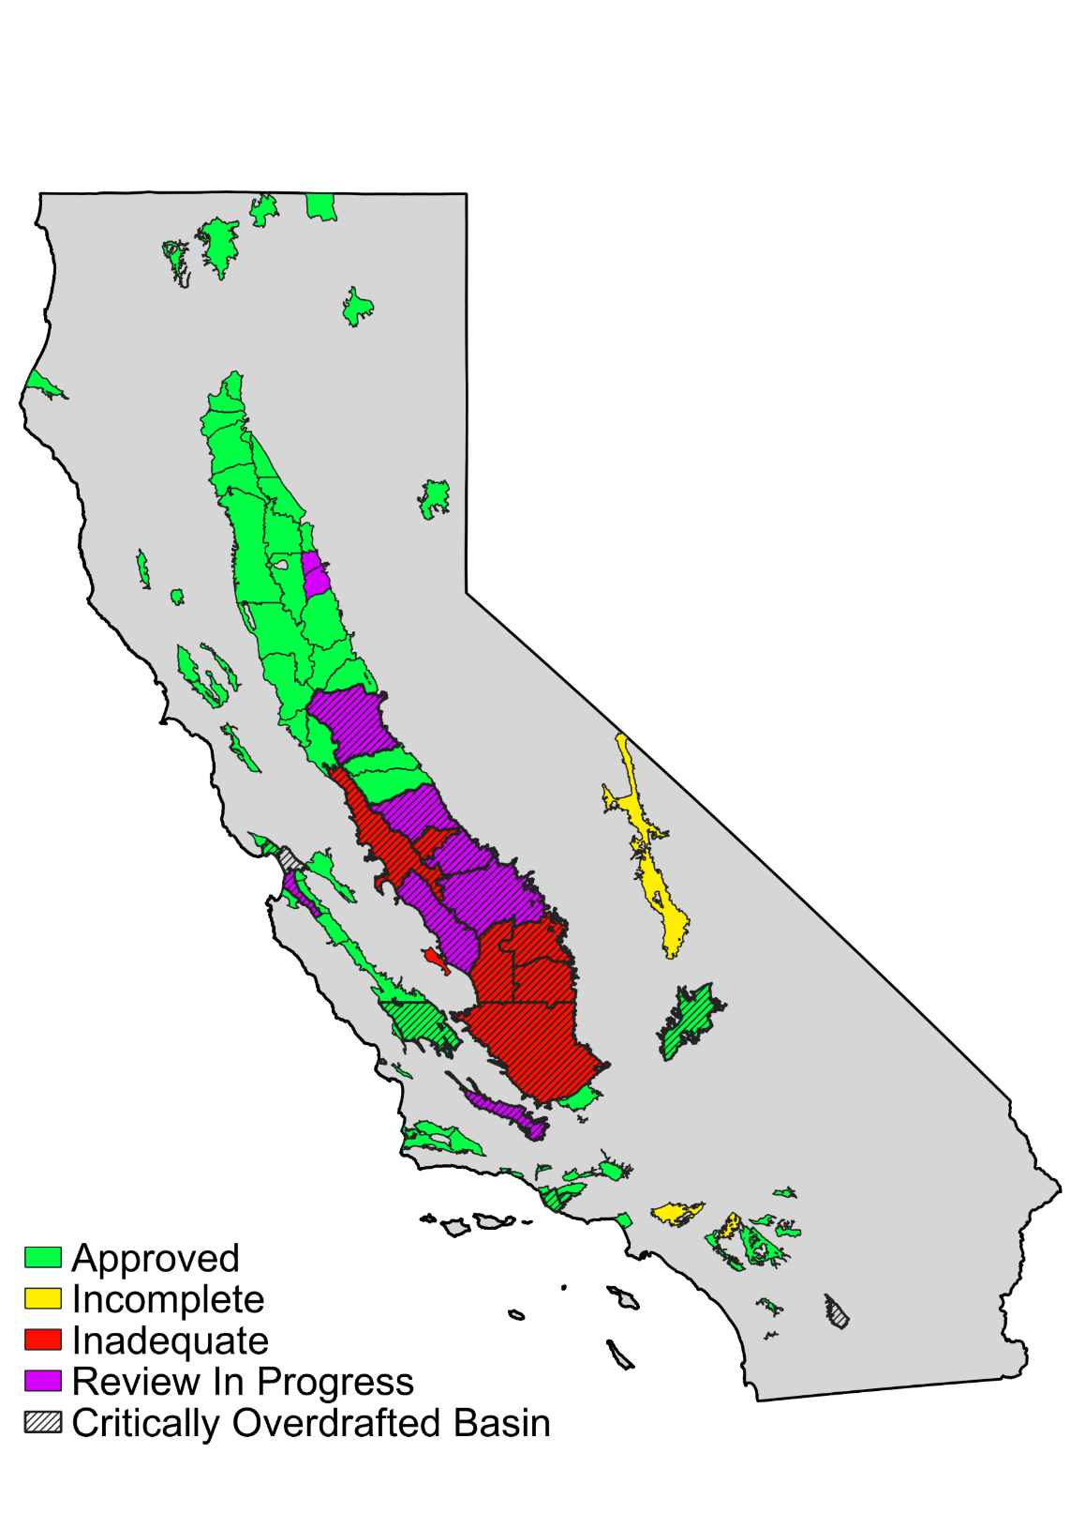
State of SGMA: Where are we now?
GSP Status Summary
Approved: 74 (62%)
Incomplete: 4 (3%)
Inadequate: 24 (20%)
Review in Progress: 18 (15%)
Recently resubmitted single GSP
Notes:
120 GSPs submitted for 92 groundwater basins

Slide 24
Upcoming SGMA Challenges
Technical challenges
Interconnected surface waters (ISWs)
Subsidence
Financial challenges for many basins
Feeling of “moving goalposts” and lack of consideration for basin-specific conditions by DWR.
Lawsuits?
???

Slide 25
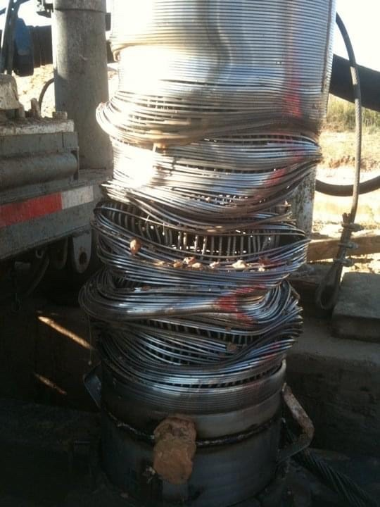
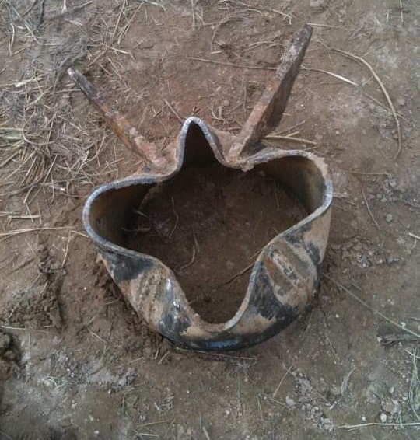
Questions?
Contact
Gus Tolley, PhD, PG
Hydrogeologist
Daniel B. Stephens & Associates, Inc.
gtolley@geo-logic.com
(530) 272-2448 x 865

