Slide 1
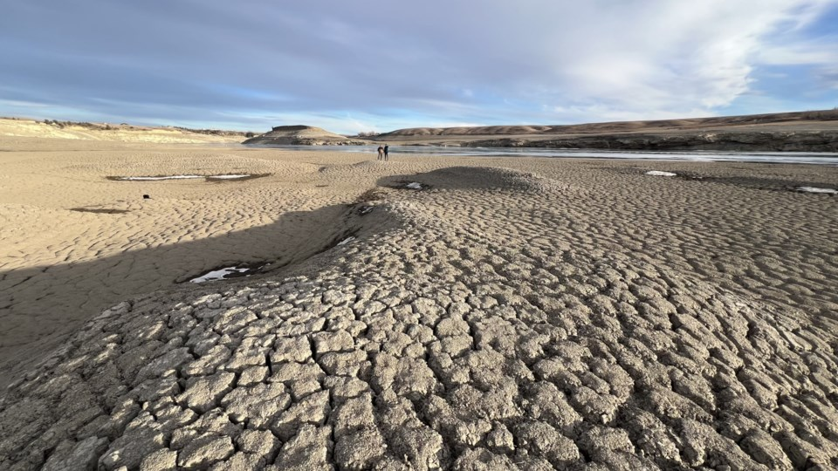
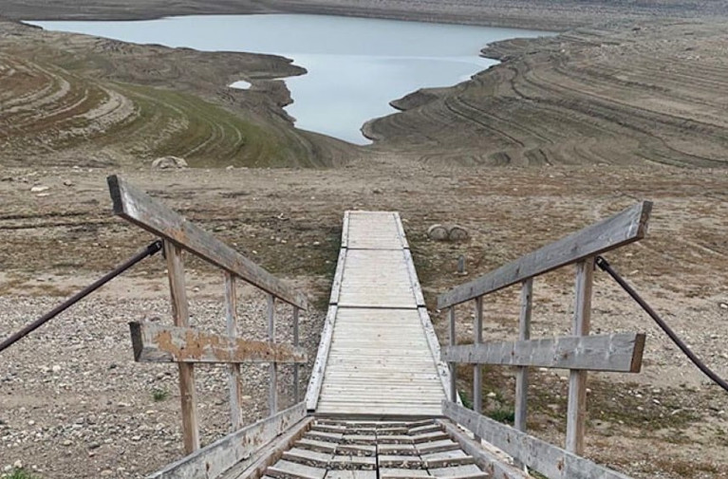
Prepare, Prevent, and Post-solve: Navigating the 2024 Alberta drought emergency with modeling exercises
PNW AWWA Section Conference, Boise ID
May 8, 2025
Michael Sheer
MSheer@hazenandsawyer.com

Slide 2
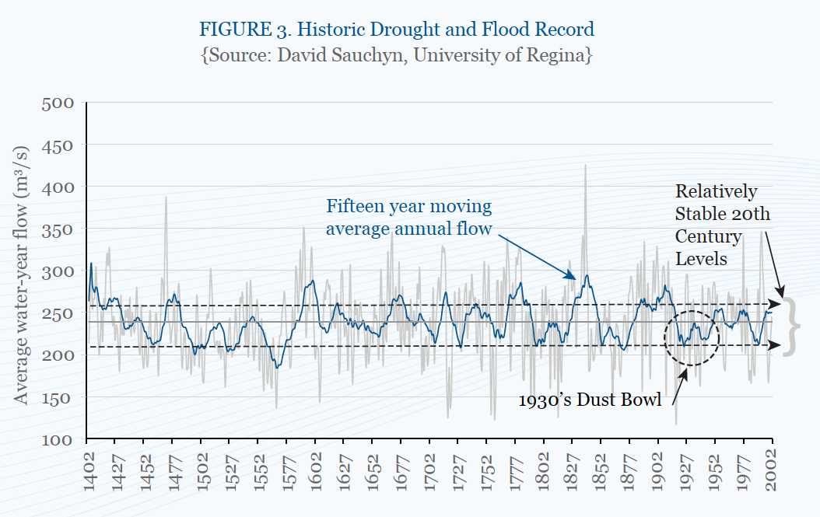
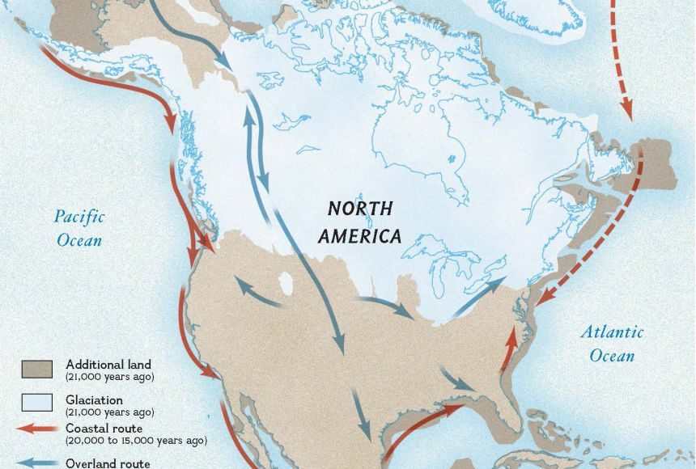
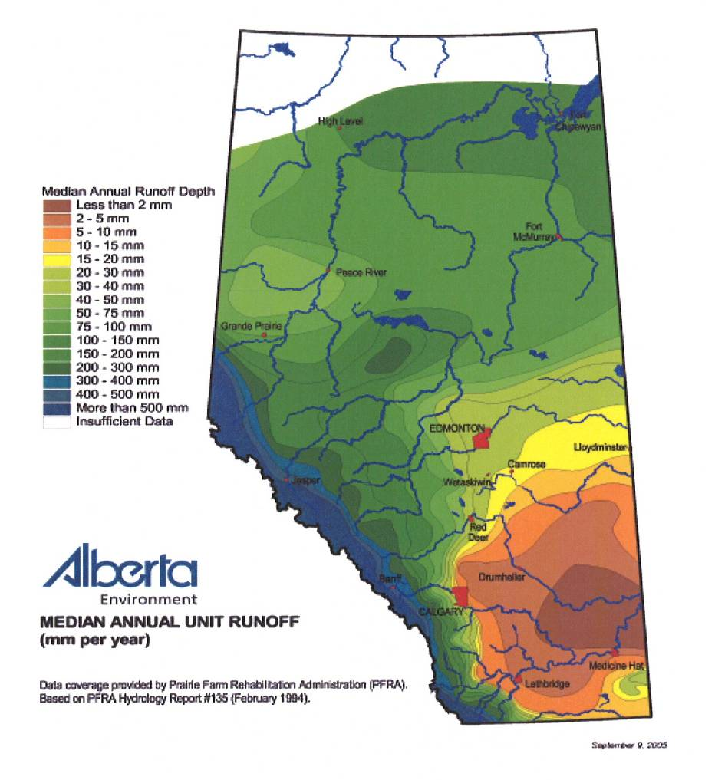
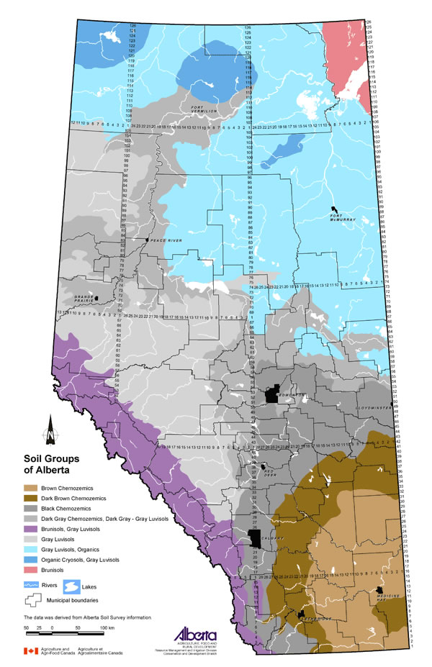
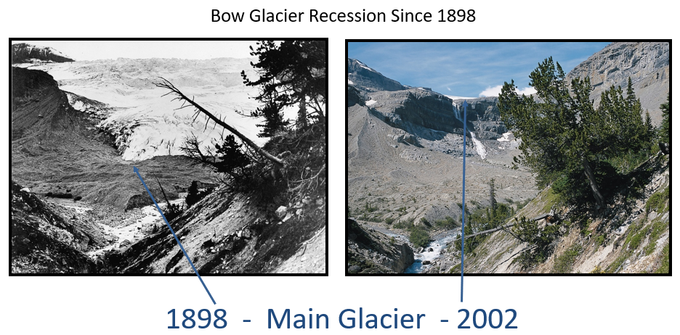
A Brief History of Alberta’s Water
Alberta
>10,000 years ago
Hunting/trapping/fishing in forested areas,
semi-nomadic plains bison hunting in the south
Southern Alberta: chernozemic soils
(rich from long-term grass decomposition)
Southern Alberta: good at growing grass,
irrigation limited for modern croppage

Slide 3
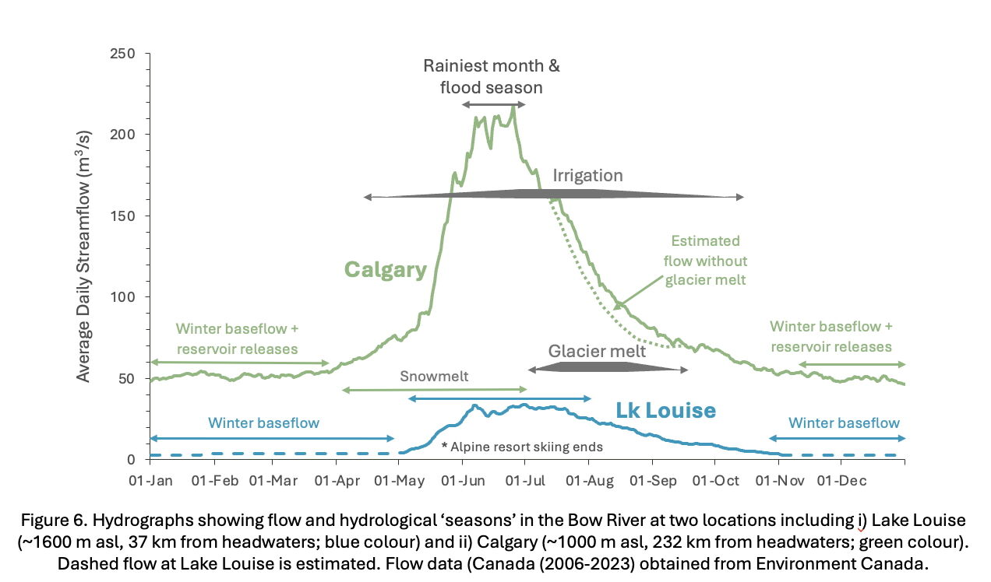
The South Saskatchewan River Today
Closed basins
Except the Northerly Red Deer
Heavily agricultural in terms of water use
30 – 60% of use depending on sub-basin
World-class fisheries and outdoor recreation opportunities
Diverse stakeholder groups
Hydropower
Petrochemical
Environmental NGOs
Agricultural districts
Industrial (esp. chemical & food processing)
Municipal
1 major, several smaller municipalities
Calgary, Lethbridge, Red Deer, Medicine Hat
Cathy Ryan, University of Calgary

Slide 4
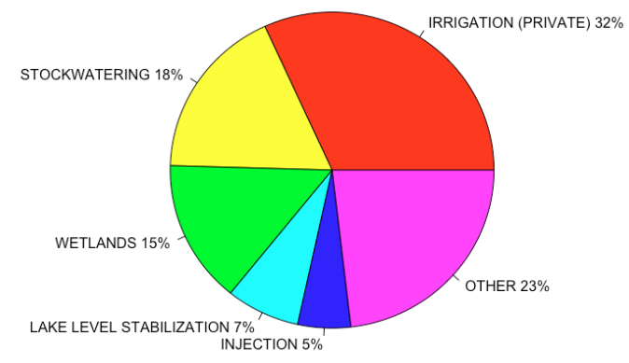
Red Deer Basin – Smaller Licences – 127,158,687 m³
The largest categories are:
Private Irrigation: 40,402,214 m³/yr
Stockwatering: 22,504,908 m³/yr
Wetlands 18,601,733 m³/yr
The largest ‘smaller’ licences are:
Ducks (3,308,190 m³/yr)
Private Irrigation (962,120 m³/yr)
Injection (938,270 m³/yr)
% Vol | Other Categories
<5% | Confined Feeding, Oil and Gas Plant Processing, Parks & Rec, Food Processing, and more
<1% | Gravel, Golf Courses, Fish Farms, Waste Disposal, Sawmills, Car washing, and more
CONFIDENTIAL – NOT FOR DISTRIBUTION
Notes:
Note (to Alex – ‘population under 2,500 is municipal)

Slide 5
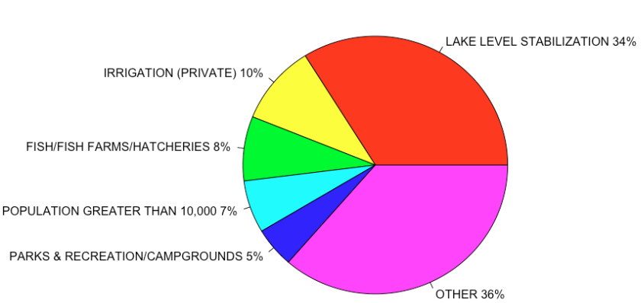
Bow Basin – Smaller Licences – 288,477,313 m³
The largest categories are:
Lake Level Stabilization: 97,639,124 m³/yr
Private Irrigation: 28,809,714 m³/yr
Fish Farms: 23,289,617 m³/yr
The largest ‘smaller’ licences are:
Alberta Infrastructure (68,600,000 m³/yr)
Allen’s Trout Farm (16,760,536 m³/yr)
Ducks (7,971,993 m³/yr)
% Vol | Other Categories
<5% | Storage Reservoir, Stockwatering, Food Processing, Golf Courses, Feedlots, and more
<1% | Minerals & Metals, Snow/Ice Making, Hydraulic Fracturing, Oil and Gas Plant Processing, and more
CONFIDENTIAL – NOT FOR DISTRIBUTION
Notes:
Unknown is when it is not recorded in the Government dataset.

Slide 6
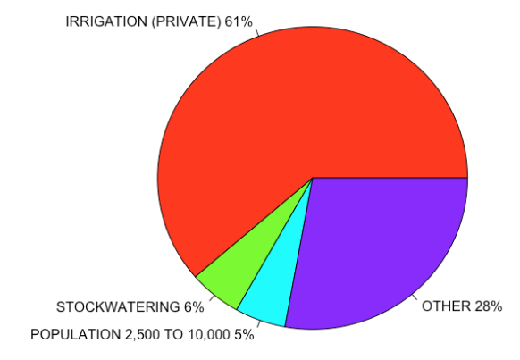
Oldman Basin – Smaller Licences – 300,167,688m³
The largest categories are:
Private Irrigation: 184,098,583 m³/yr
Stockwatering: 16,529,746 m³/yr
Population 2,500 to 10,000: 15,927,933 m³/yr
The largest ‘smaller’ licences are:
Lethbridge Water Operations Branch (7,820,280 m³/yr)
Ducks (3,742,700 m³/yr)
Deseret Ranches of Alberta: (3,376,040 m³/yr)
% Vol | Other Categories
<5% | Food Processing, Confined Feed, Flood Control, and more
<1% | Fish Farms, Golf Courses, Wetlands, Gravel, Cement and Concrete, and more
CONFIDENTIAL – NOT FOR DISTRIBUTION
Notes:
Unknown is when it is not recorded in the Government dataset.

Slide 7
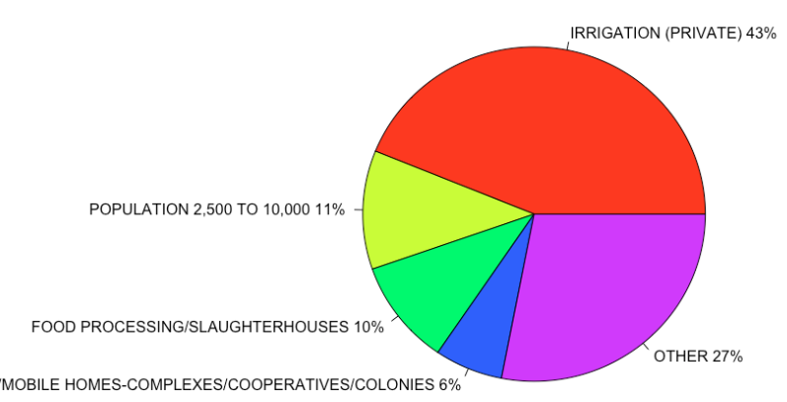
Southern Tributaries – Smaller Licences – 91,217,010 m³
The largest categories are:
Private Irrigation: 39,129,005 m³/yr
Population 2,500 to 10,000: 10,247,860 m³/yr
Food Processing/Slaughterhouse: 9,070,766 m³/yr
The largest ‘smaller’ licences are:
Southeast Alberta Water Co-op (1,604,938 m³/yr)
County of Warner (727,750 m³/yr)
Country of Lethbridge Rural Water Association (470,120 m³/yr)
% Vol | Other Categories
<5% | Stockwatering, Fish Farms, Urban, Oil & Gas Plant, and more
<1% | Regional Water Lines, Wetlands, Gravel, Parks & Rec, Confined Feeding, and more
CONFIDENTIAL – NOT FOR DISTRIBUTION
Notes:
Unknown is when it is not recorded in the Government dataset.

Slide 8
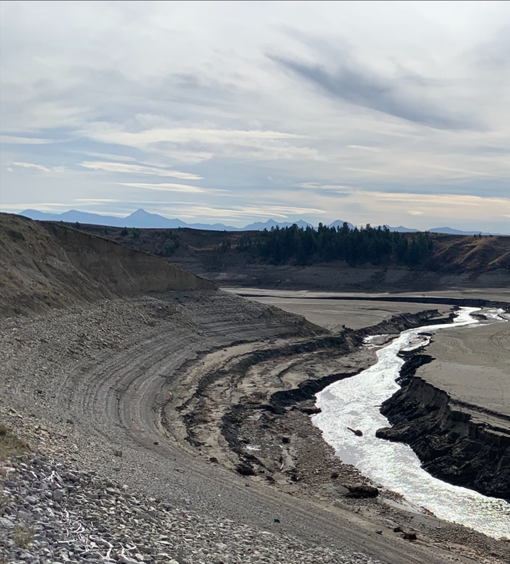
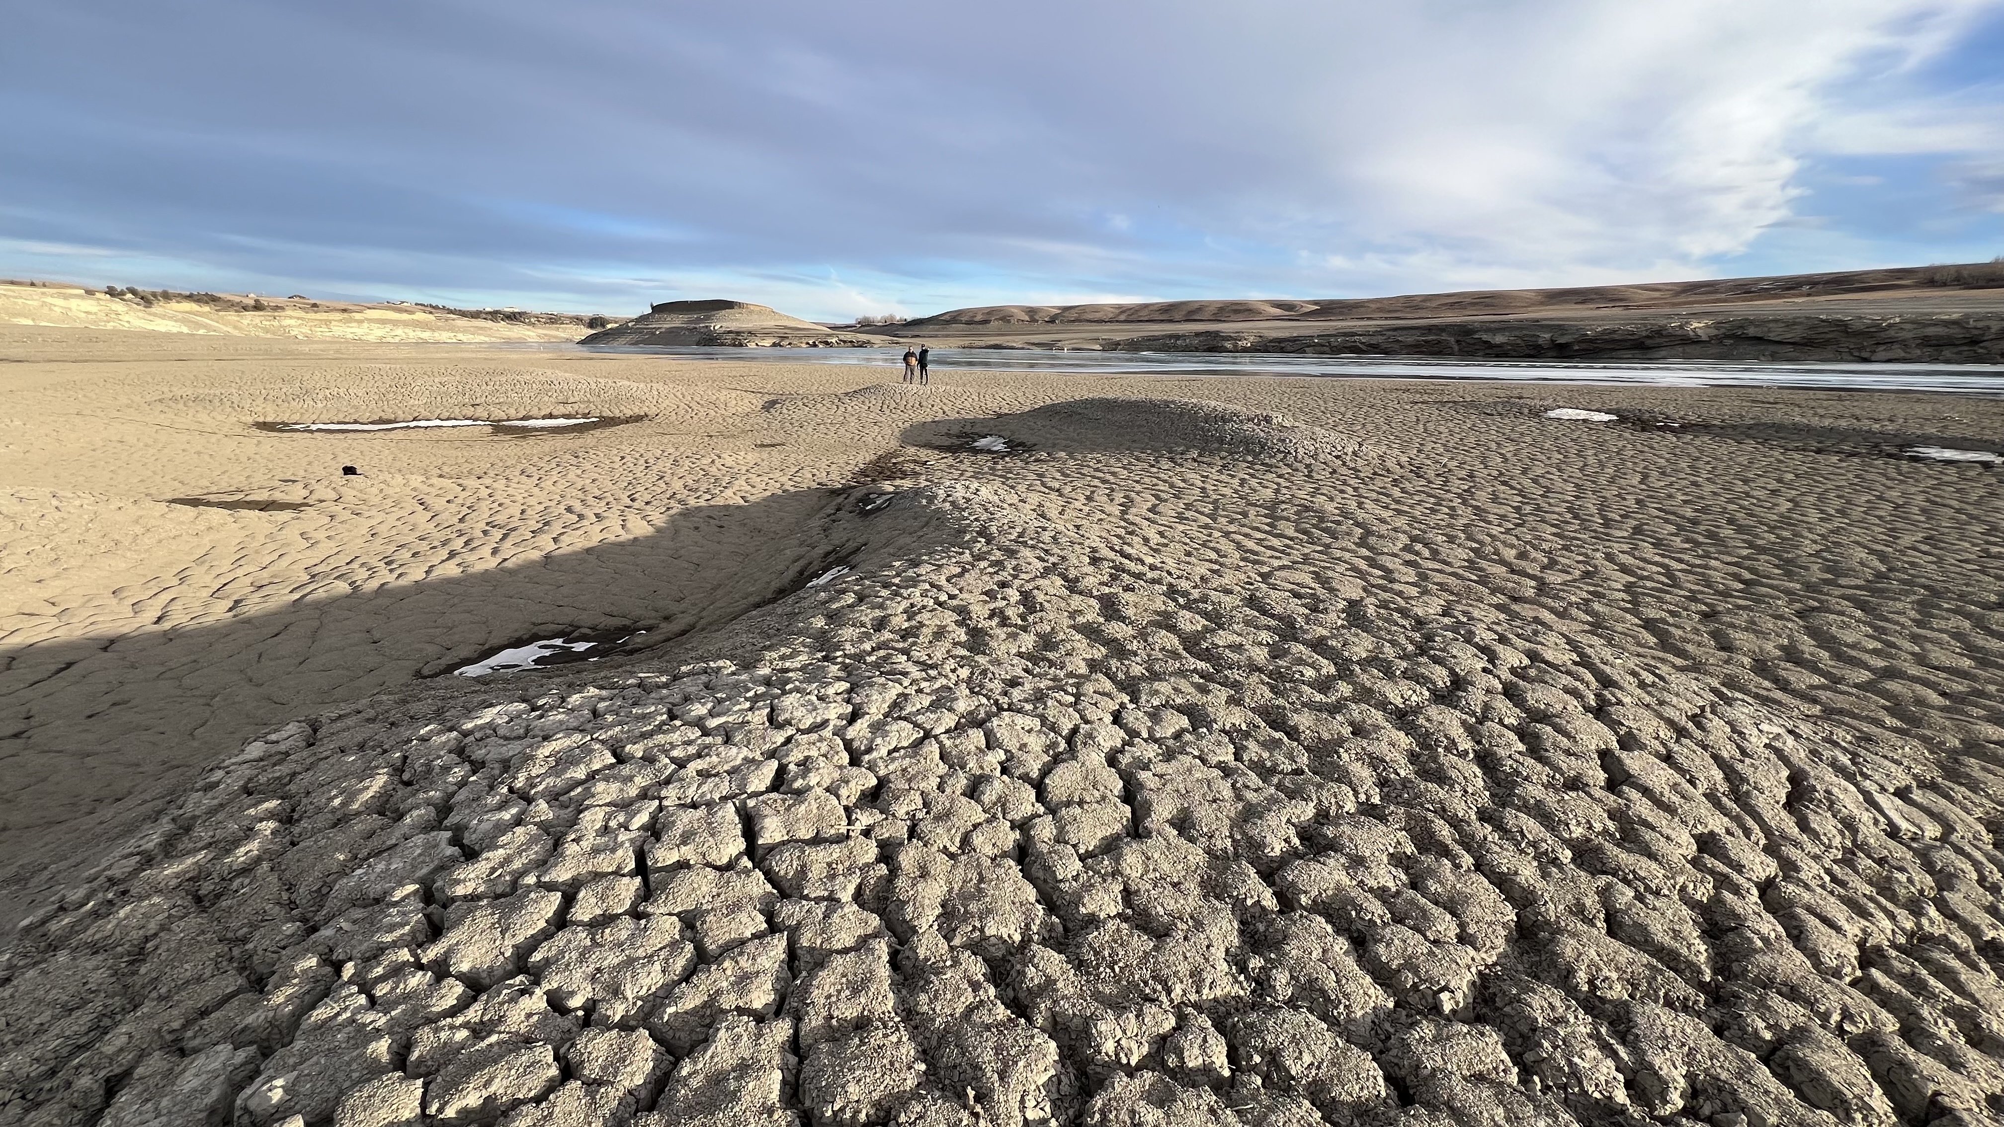
The S. Sask River, Early 2024
Oldman Reservoir – Silt Plain with the river running through
Oldman Reservoir Bed

Slide 9
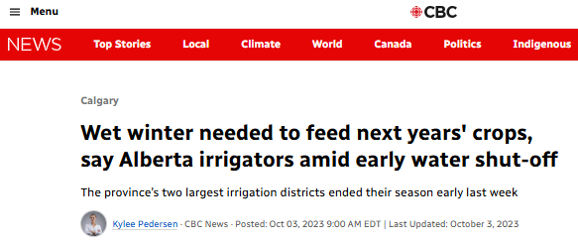
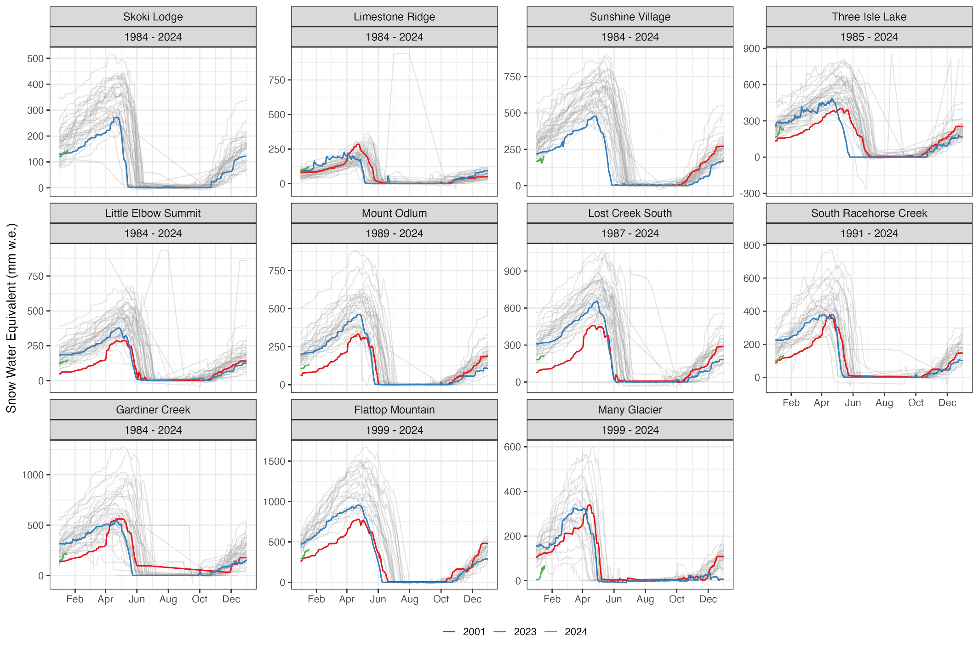
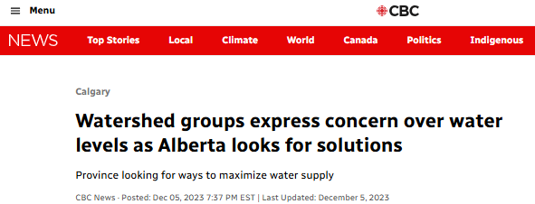
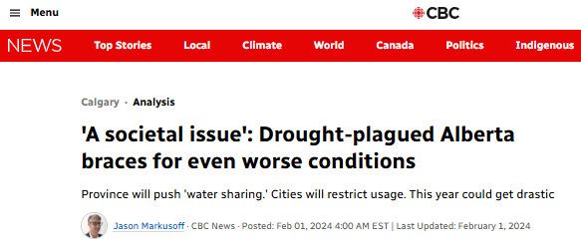
The Bow River, Early 2024
Oct
Dec
Feb
Mar
Notes:
Trouble brewing -> No really, trouble -> BIG trouble -> It’s here

Slide 10
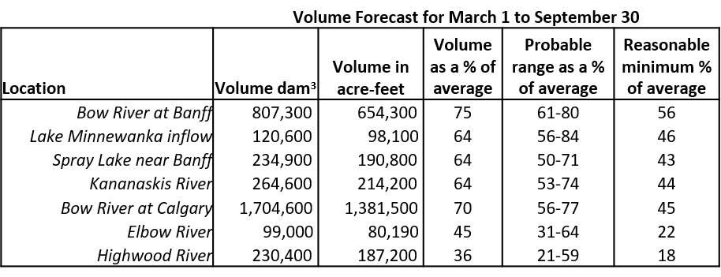
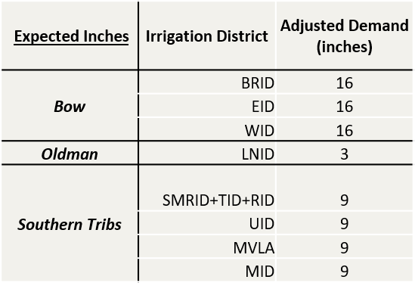
Principles of A Draft Plan
Voluntary
Government is not enforcing the agreement
Shared Pain
Everyone contributes as they can, even if the volumes aren’t consequential
Regular Communication & Coordination

Slide 11
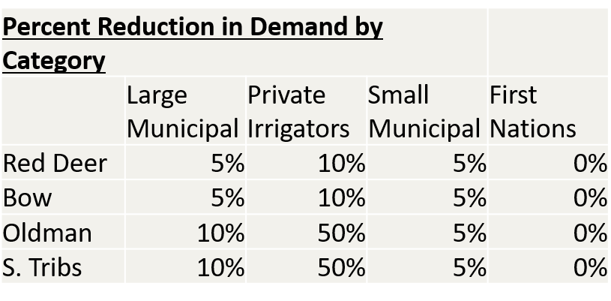
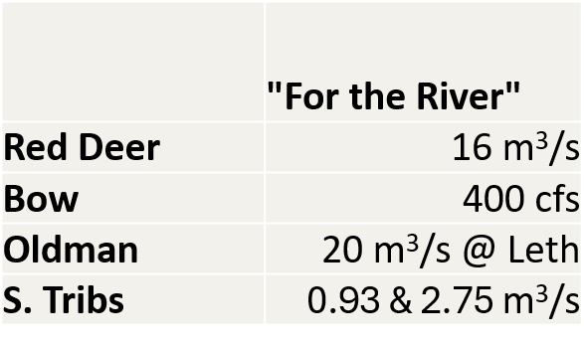
Draft Water Sharing Agreement
An agreement for one year, a framework for the future
1. Start with the water supply forecast
2. Apply Municipal and Private Reductions
3. Provide Flows for the River
4. Remainder is available for large irrigators, allocated by relative acres

Slide 12
Parties to the Shortage Sharing Agreements
Irrigation Districts
Environmental flows
Large industrial licences
Large municipalities
Participating in WSAs
TransAlta
Impacts to be seen through PMs
TDLs
First Nations
Smaller licences (industrial, Private irrigation, etc.)
Smaller municipalities
Largely suspended

Slide 13
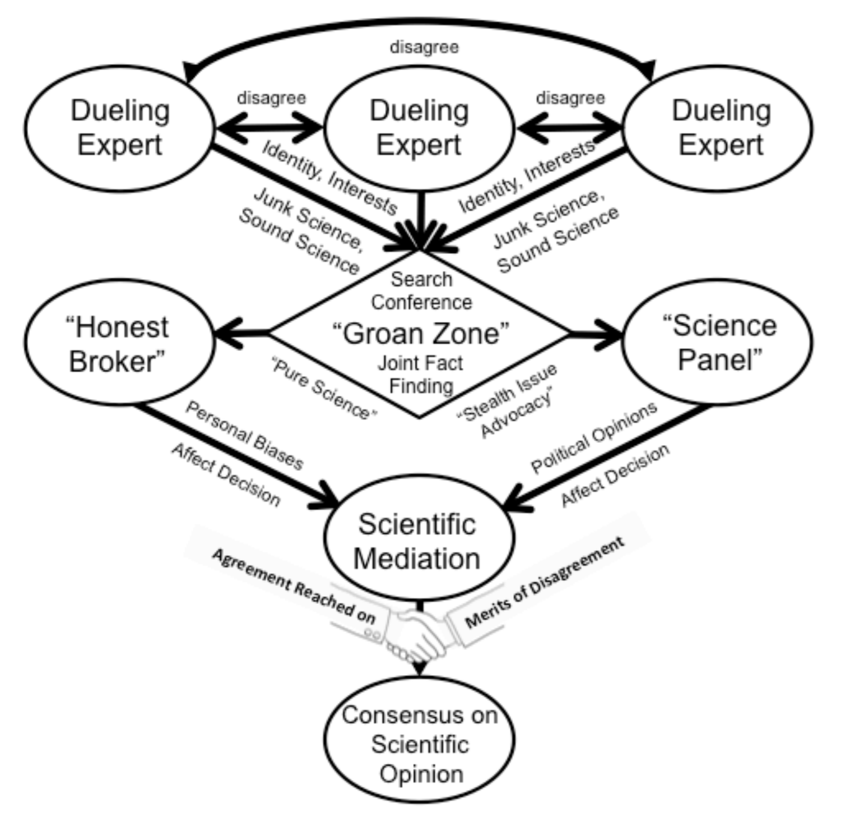
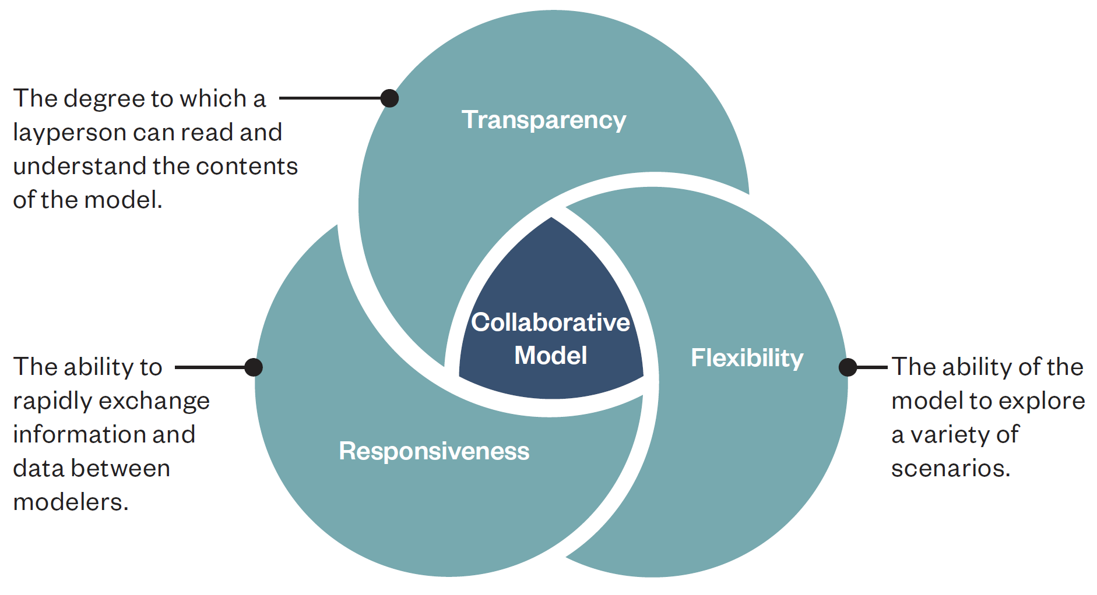
The Role of Models in Decision-Making

Slide 14
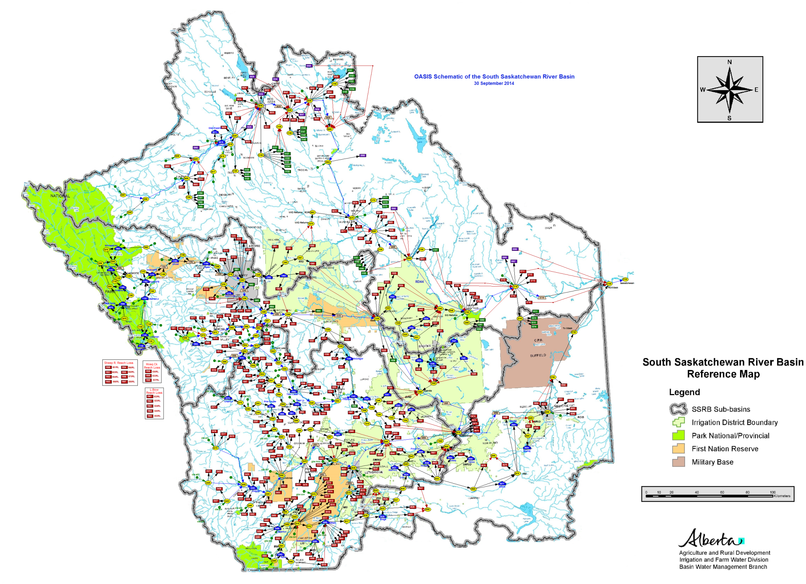
South Saskatchewan River Operations Model (SSROM)
Mass-balance model (what goes in = what comes out)
Runs on a daily time-step
Operating rules in a “plain English” like language intelligible to operators
Easily modifiable “on-the-fly”
Evolved from smaller individual basin-planning models
In use for nearly 20 years
Modified into “gaming mode” for this exercise

Slide 15
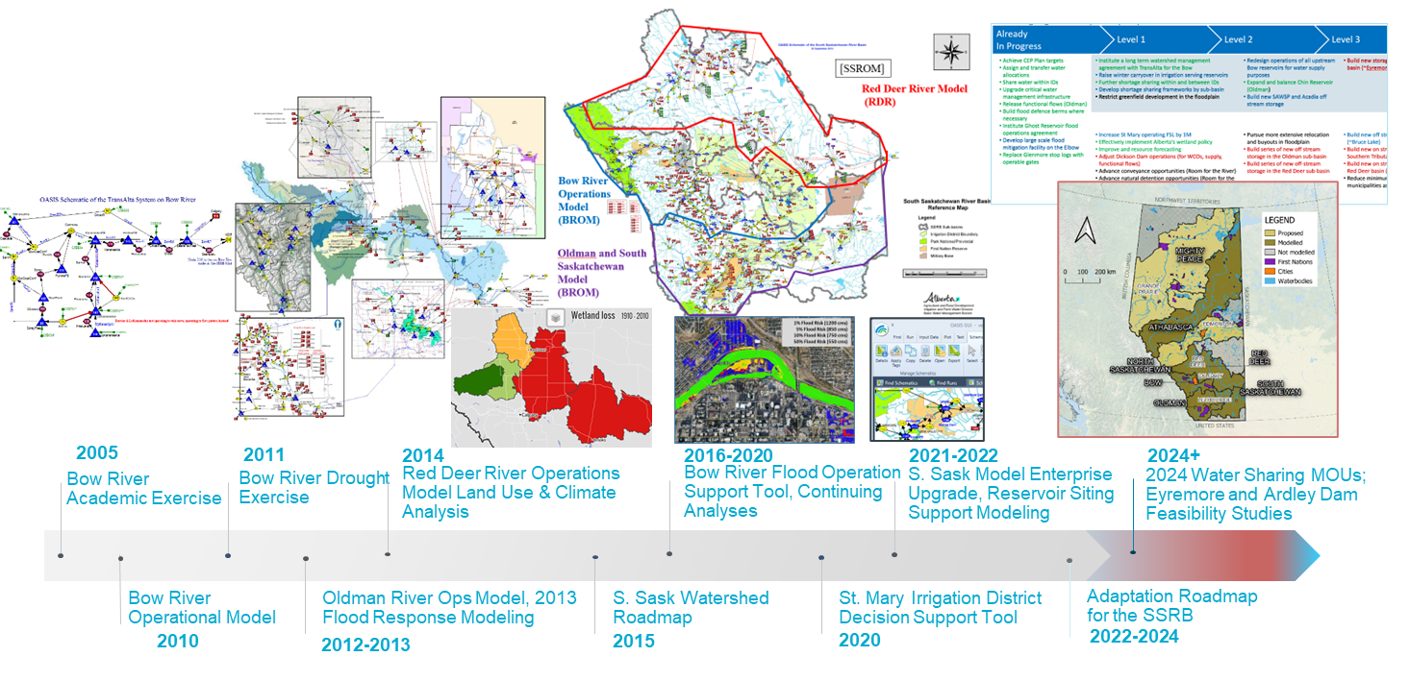

Slide 16
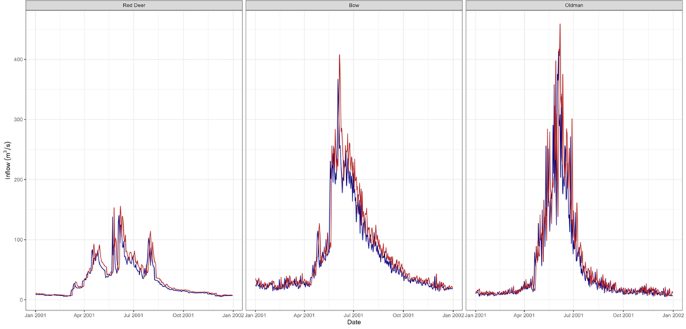
Derived Hydrographs for the Drought Simulation
Shifted the 2001 time series by 21 days to account for recent observations of earlier freshet.
Scaled the 2001 time series by 10% down in the Bow River Basin based on guidance to make it more challenging than 2001.
The inflows in the model are not forecast flows for 2024 – these flows are being used to represent a stressful drought across the whole SSRB to support discussions about WSAs.

Slide 17
Drought Exercise Event Layout
Basin Wide Provincial Objectives
Oldman
Bow River
Red Deer
Basin Lead
Basin Lead
Basin Lead
Participants
Basin Facilitator
Basin Facilitator
Basin Facilitator
Regulators
Stakeholders
Hazen Staff
Modeller
Modeller
Modeller
Screen
Screen
Screen

Slide 18
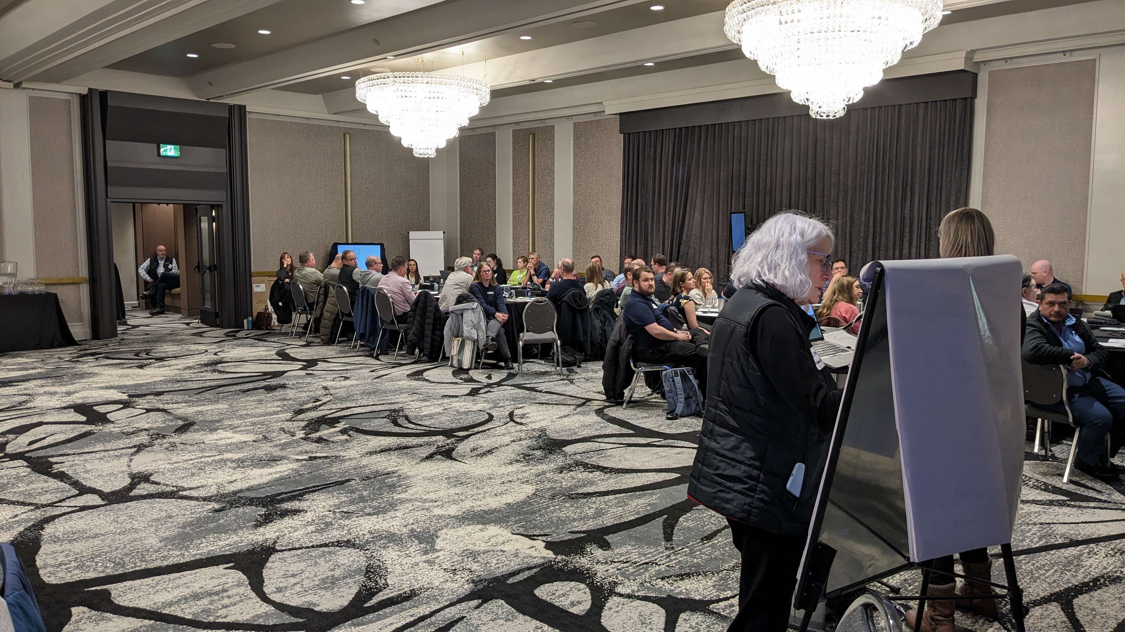
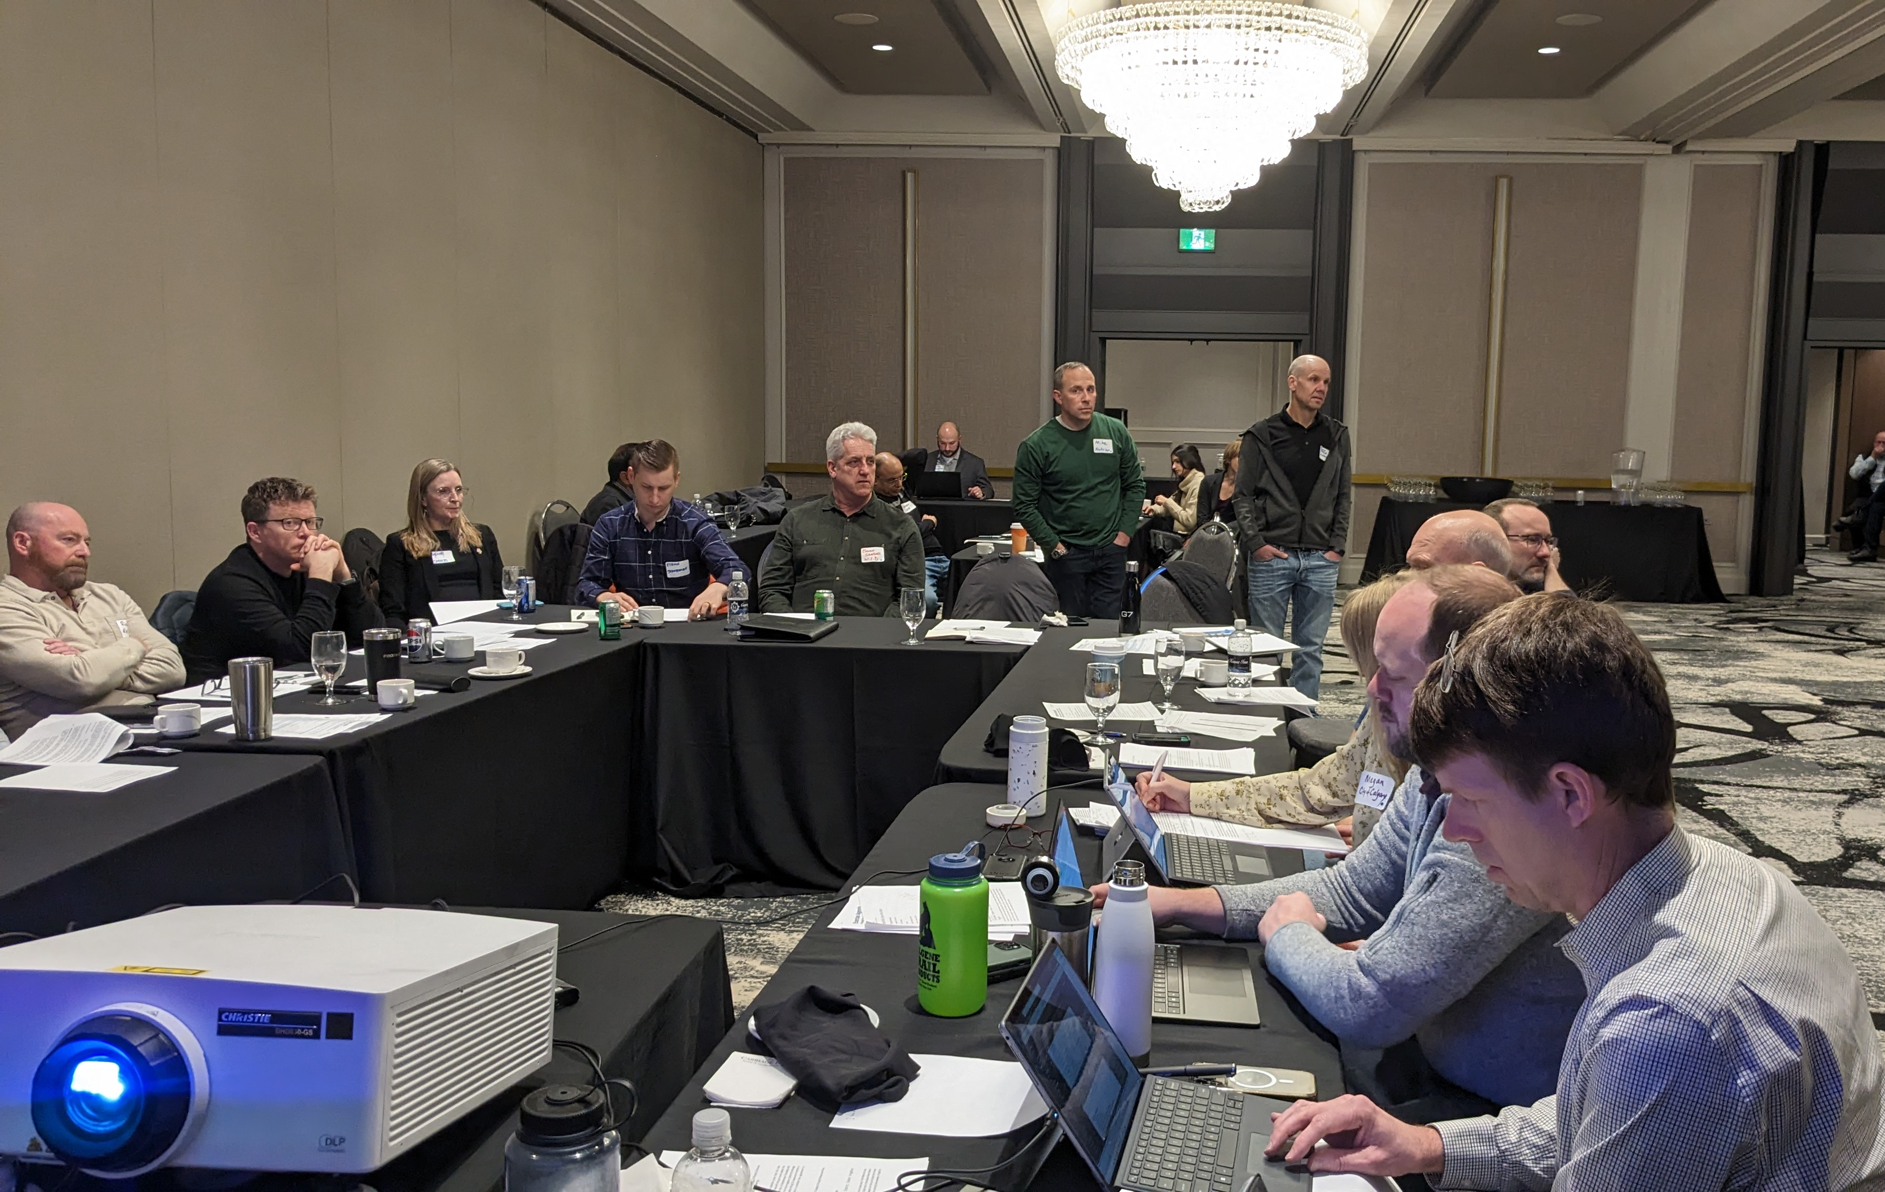
Drought Exercise Event Layout
Basin Wide Provincial Objectives
Oldman
Bow River
Red Deer
Basin Lead
Basin Lead
Basin Lead
Participants
Basin Facilitator
Basin Facilitator
Basin Facilitator
Regulators
Stakeholders
Hazen Staff
Modeller
Modeller
Modeller
Screen
Screen
Screen

Slide 19
Drought Exercise Decision-Making Process
Waster Sharing MOUs to be discussed/updated based on simulation
Participants are presented with new information at each decision point and tasked with discussing actions
Participants review SSROM PMs and determine if additional action is needed
Actions are modelled live and recorded in the meeting notes
Actions noted as successful by participants are carried forward
At the end of the exercise participants will discuss if WSAs were successful and align on changes needed
March
April
May
June
July
August
September
Example considerations
Snow pack status
Status of reservoirs
Example considerations
Snow pack status
Status of reservoirs
Demand projections
Example considerations
Status of reservoirs
Demand status
Precipitation forecast
Example considerations
Status of reservoirs
Demand status
Precipitation forecast
Example considerations
Status of reservoirs
Environmental flow
Demand status
Example considerations
Status of reservoirs
Environmental flow
Example considerations
Suitability of response
Lessons learned
Considerations for following year

Slide 20
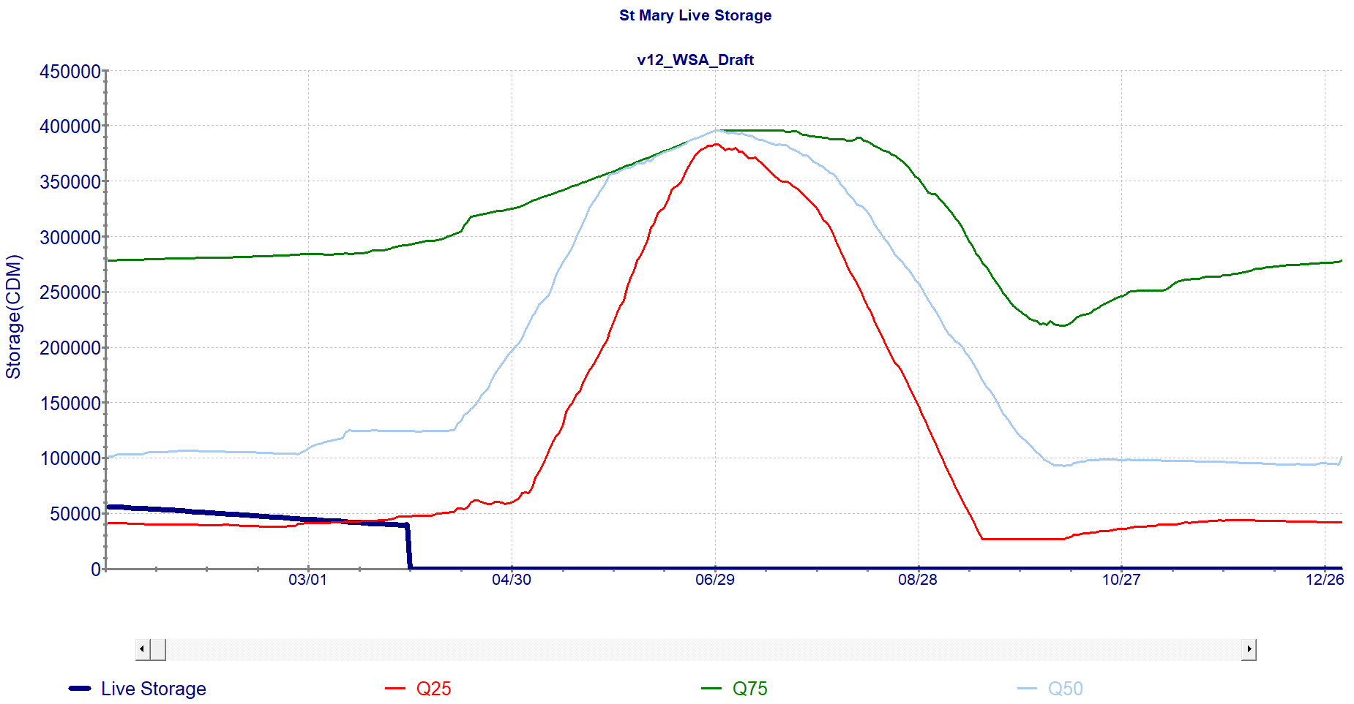
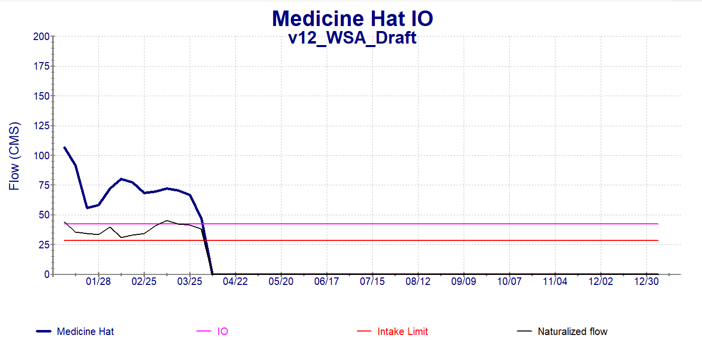
Performance Metrics Explores “As We Go”
Reservoir Storage

Slide 21
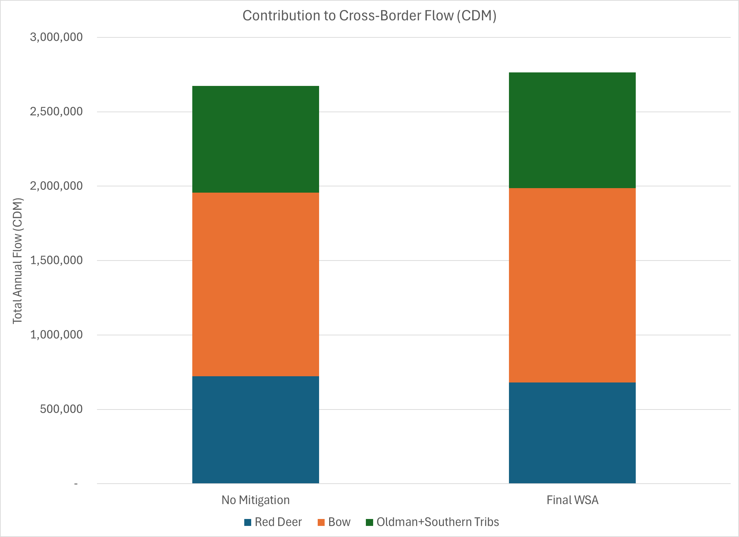
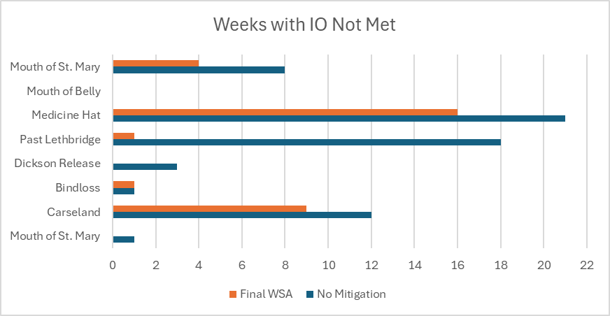
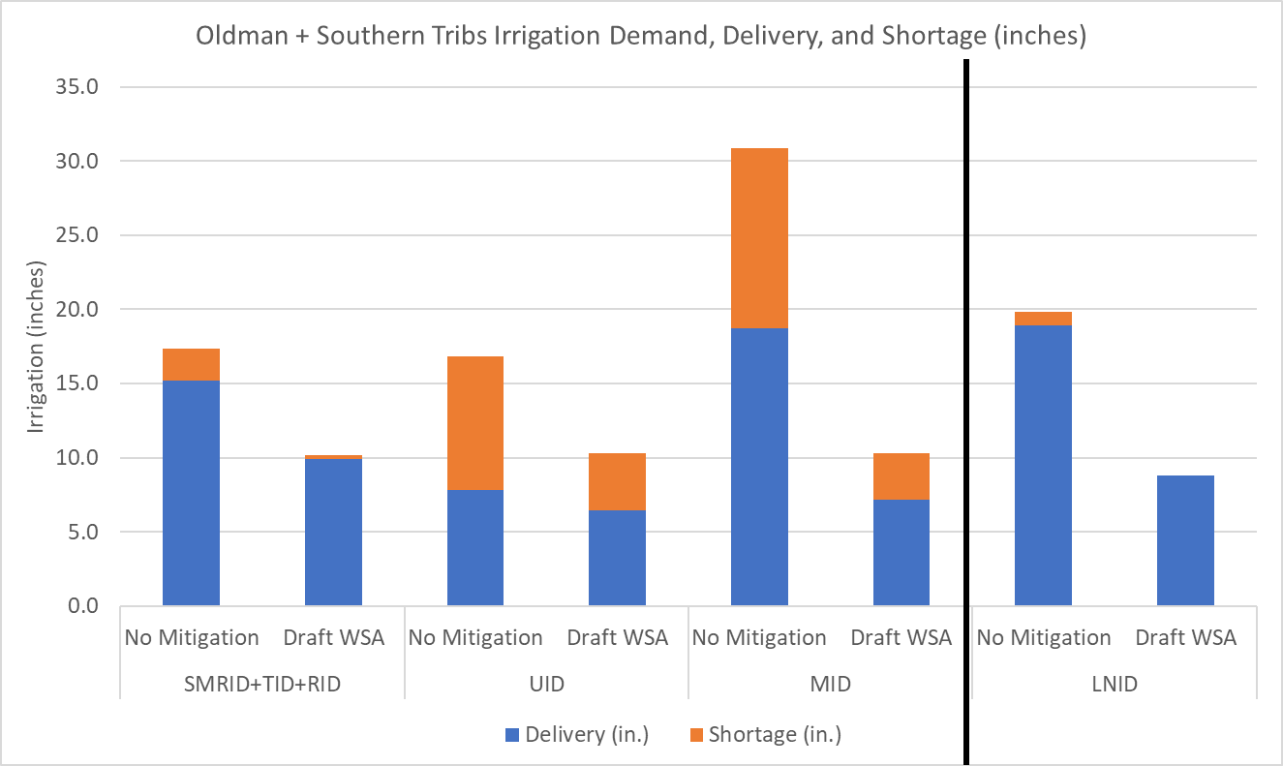
End of Simulation Metrics
Additional PMs were explored after the exercise (full year) was complete, such as percent of days above IO, apportionment, and inches irrigated.
Irrigated Inches
Apportionment Reqt (50% of Natural)
Apportionment Reqt (50% of Natural)

Slide 22
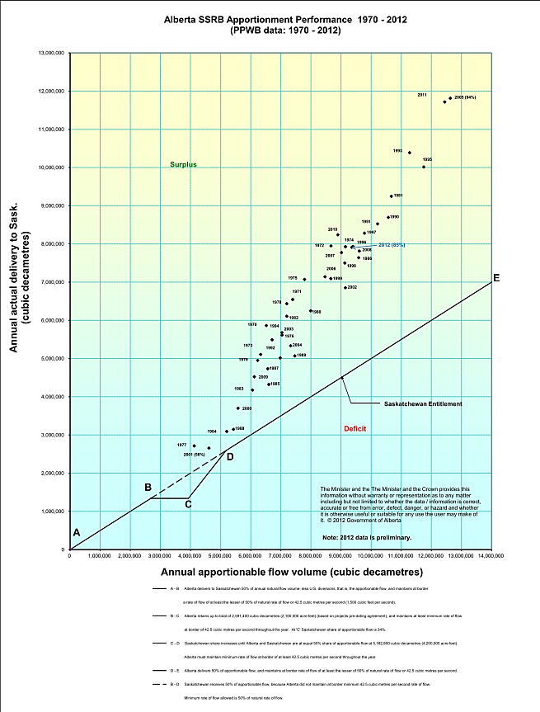
Natural flow varies from 4 million to 13 million dam3.
Minimum flow to Sask: 58% in 2001
Maximum flow to Sask: 94% in 2005
Typical flow to Sask: 75% to 85%, avg 81%
Cumulative surplus delivery to Sask since 1970 is about 132 million dam3 (107 M ac.ft.)

Slide 23
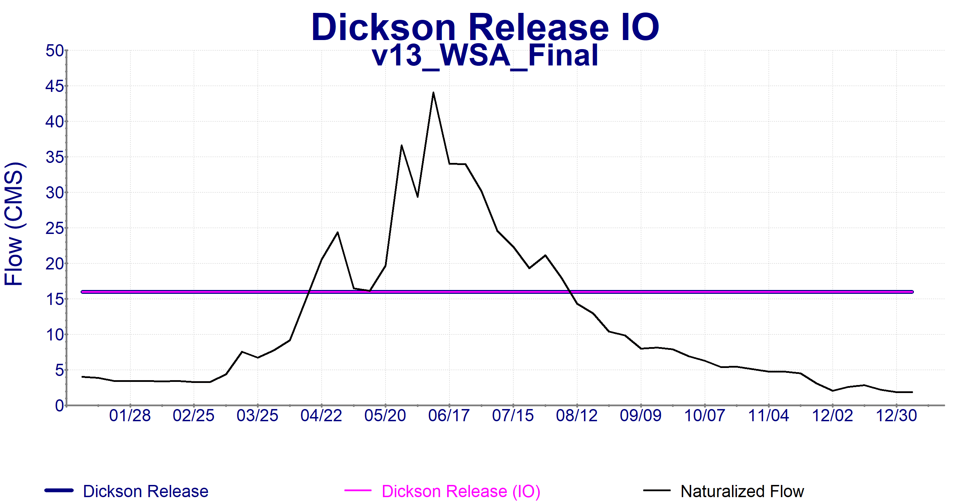
Performance of "Final MOU"
Final Water Sharing MOU is the result of the discussion at the live modeling exercise
Components of Final (Live) MOU:
Red Deer: Dickson releases only 16 m^3/s
Red Deer: Municipal (-5%) & Industrial (~2023 use) cutbacks starting in March
Red Deer: Industry use variable by month
Red Deer: Small Irrigator cutback starting in Sept
Cutback
Jan-Mar
Jun
Jul
Apr
May
Aug
Sep
Oct-Dec

Slide 24
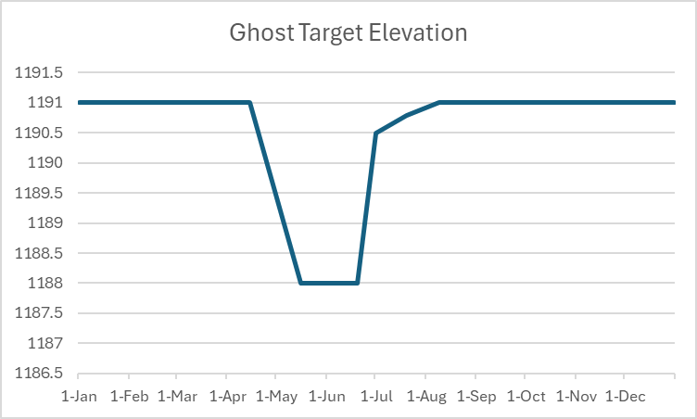
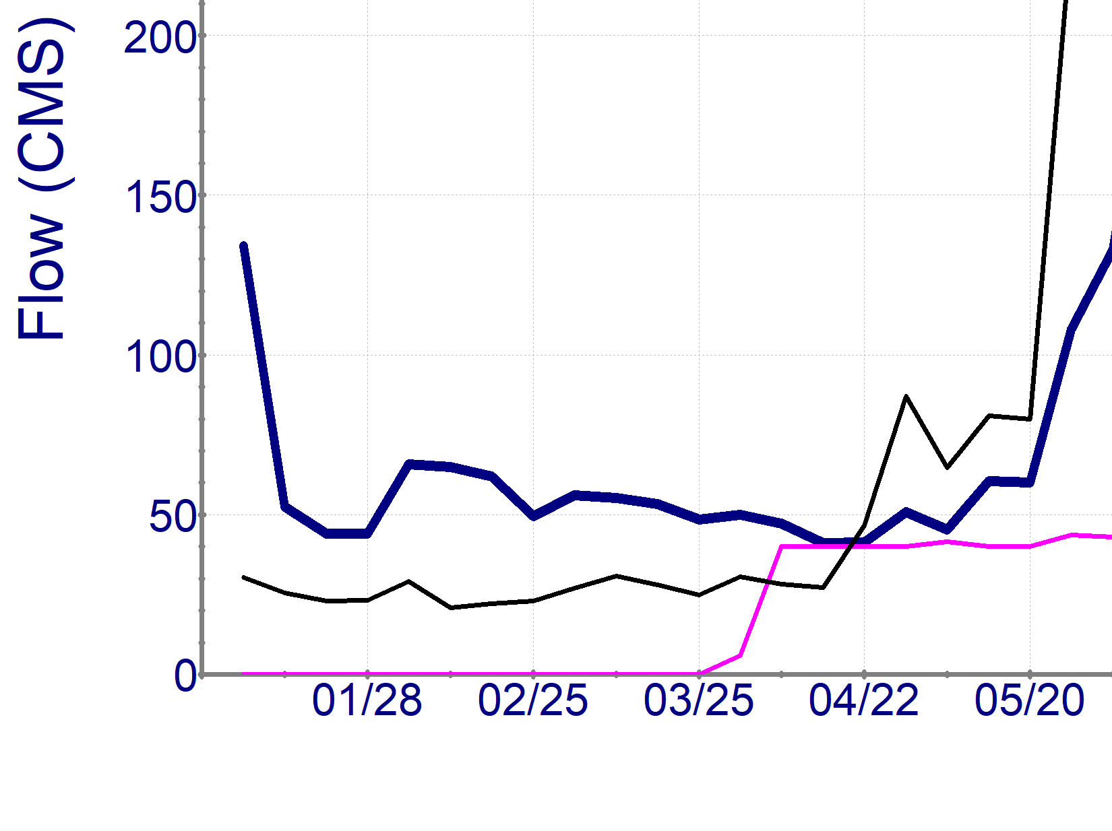
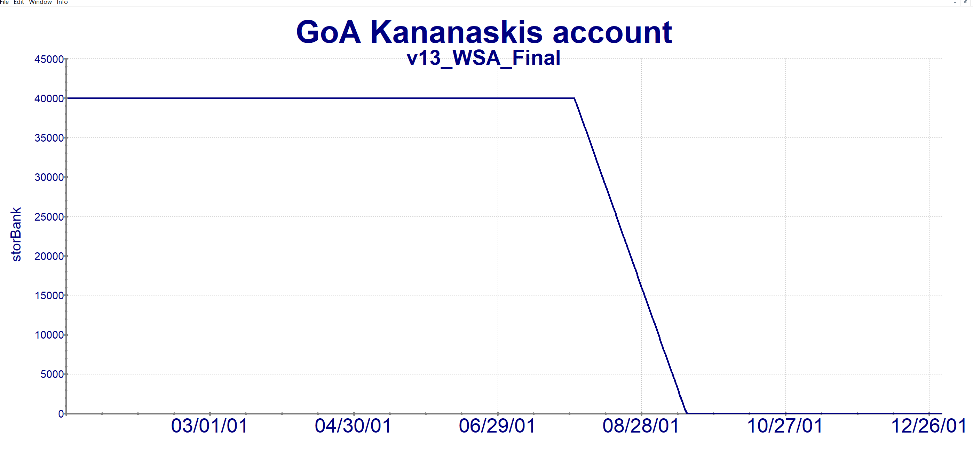
Performance of "Final MOU”
Final Water Sharing MOU is the result of the discussion at the live modeling exercise
Components of Final (Live) MOU:
Bow: Ghost rule curve redesigned to preserve storage and allow irrigation capture
Bow: Calgary begins messaging in March, 5% cutbacks begin June
Bow: Irrigation storage refill limited by Carseland IO until July
Bow: Irrigation cutbacks start in May at May forecasted availability, driven by available storage targets
Bow: Provincial storage in Kananaskis releases to mitigate late season flow concerns
Calgary dilution issues, late season flows below IO, or others
Cutback
Carseland IO
400 cfs, till empty
Jan-Mar
Jun
Jul
Apr
May
Aug
Sep
Oct-Dec

Slide 25
Performance of "Final MOU"
Final Water Sharing MOU is the result of the discussion at the live modeling exercise
Components of Final (Live) MOU:
Oldman: LNID cuts back to March forecasted availability, only releases extra irrigation in July
S. Tribs: Irrigation cuts back below March forecasted availability (forecast less 2”) to preserve storage
Oldman: Oldman Reservoir reduces outflows to preserve storage
Still releases for flow targets and LNID
Oldman: Municipal mandatory cutbacks (10%) in March, reduced to voluntary [Leth] in July (5%)
S. Tribs: Early season diversions through canal limited (~40m^3/s) to preserve storage in St. Mary reservoir system.
Canal restored to full capacity diversions after Sept to refill ID storage
Oldman
Reduction
St. Mary Canal
Limit
St. Mary Canal
Full Diversion
Mandatory
Cutbacks
Cutback
LNID addt’l
irrigation
Voluntary
Cutbacks
Jan-Mar
Jun
Jul
Apr
May
Aug
Sep
Oct-Dec

Slide 26
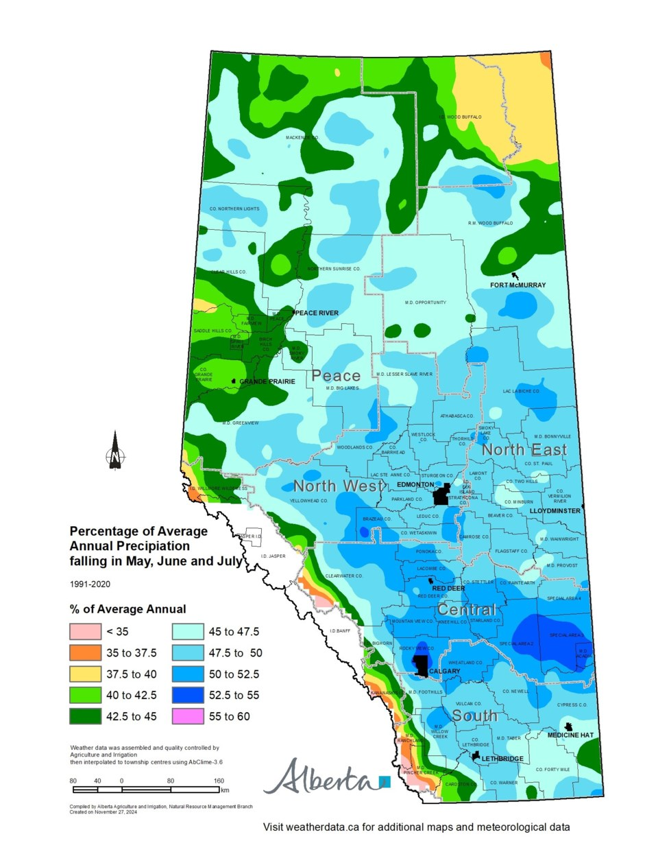
2024 Outcomes
Deus Ex Machina
Identified limited ability of Red Deer & Oldman/S. Tribs to respond to prolonged drought
Reviewing long-term infrastructure now
Prepared with a framework to address the next drought
Each agreement is intended to be a “one-off” but there exists a template now

Slide 27
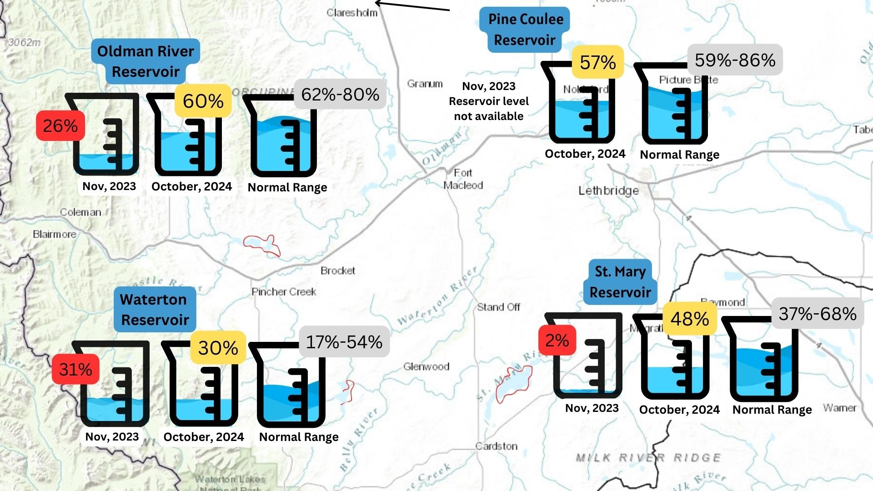
https://oldmanwatershed.ca/blog-posts/2024/10/29/drought-update-how-did-we-fare

