Slide 1
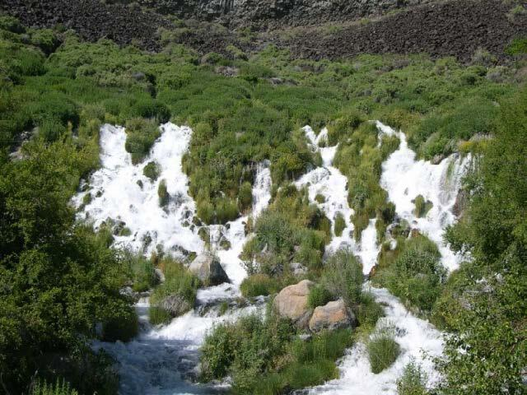
Idahoans Have Changed the Trajectory of the ESPA!!
David Hoekema, Ph.D.
Idaho Department of Water Resources
5/8/2025
Photo from USGS: Fork Collins Science Center, November 8, 2016

Slide 2
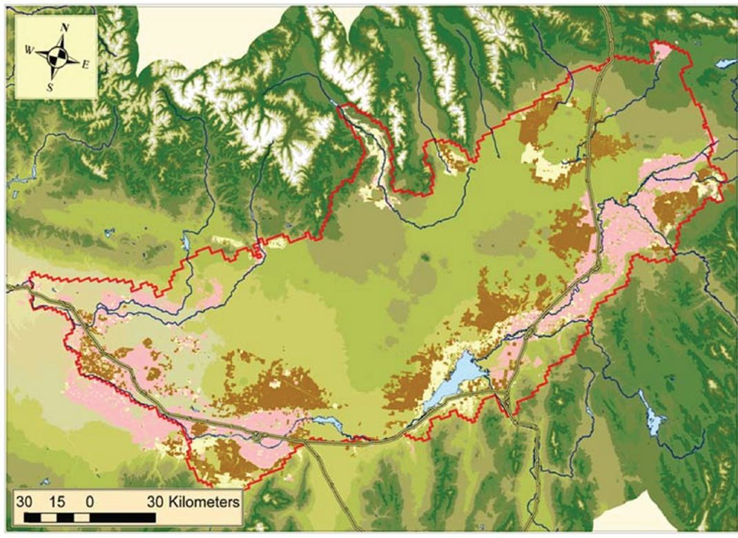
Groundwater and Surface Water Irrig.

Slide 3
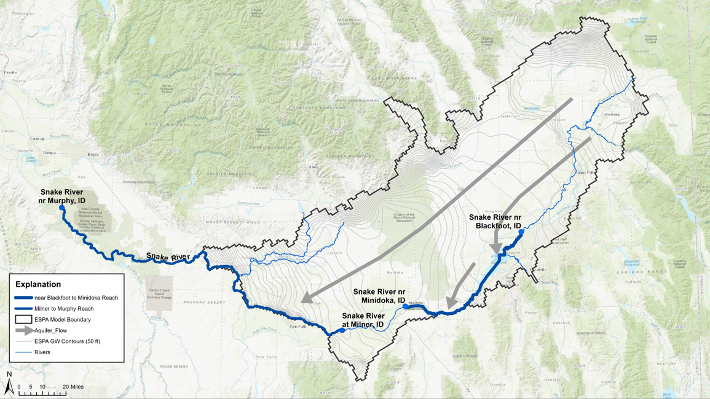
Two Main Aquifer Discharge Locations

Slide 4
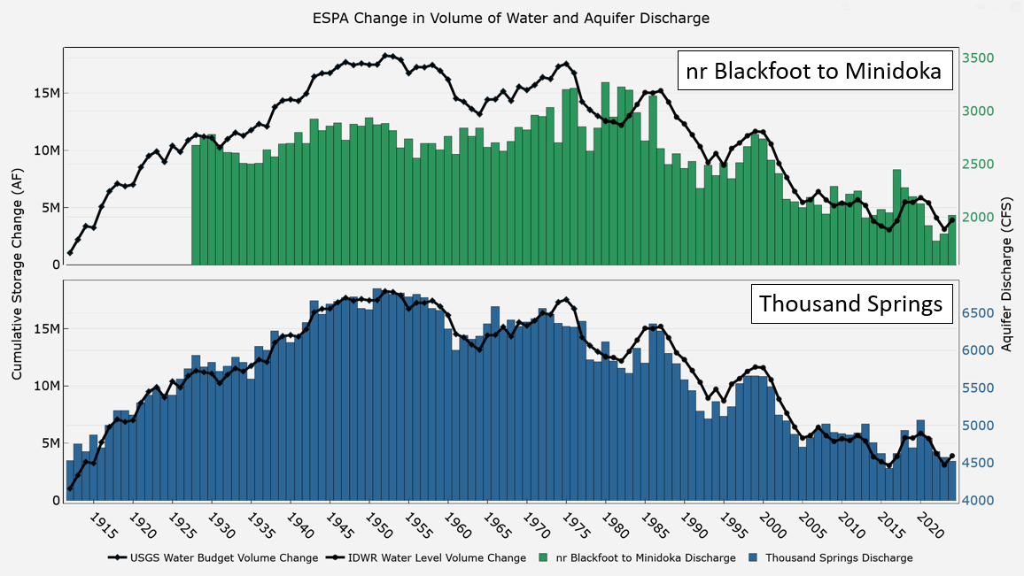
History of the ESPA
Groundwater Development Period
Surface Water Development Period
Surface Water Efficiency Increases

Slide 5
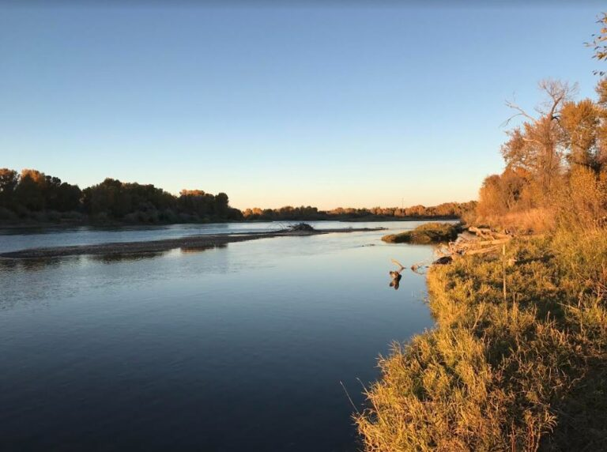
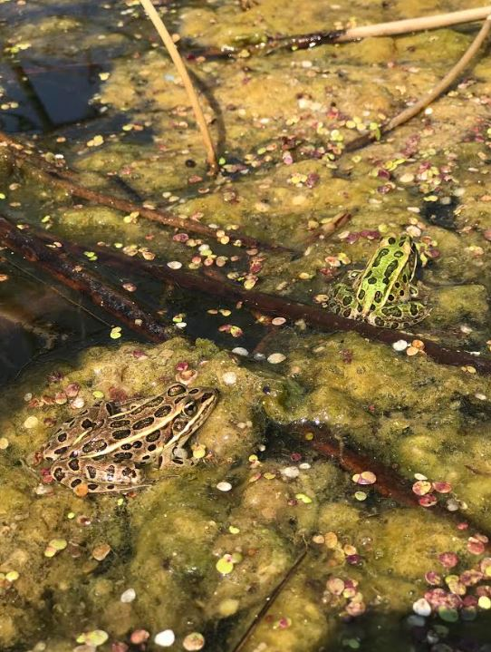
American Falls/Fort Hall Bottoms
https://idahoconservation.org/blog/stories-of-the-snake-a-precious-resource-since-time-immemorial/

Slide 6
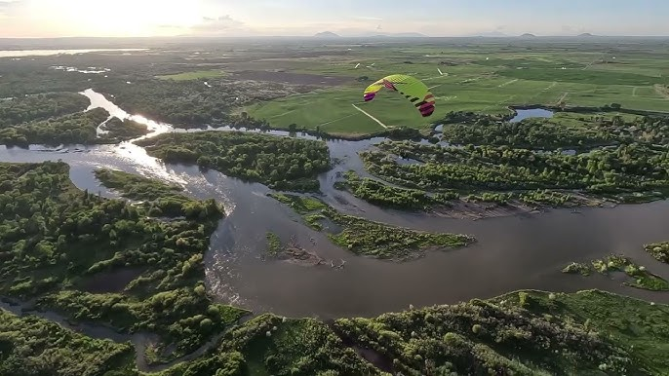
American Falls/Fort Hall Bottoms
https://idahoconservation.org/blog/stories-of-the-snake-a-precious-resource-since-time-immemorial/

Slide 7
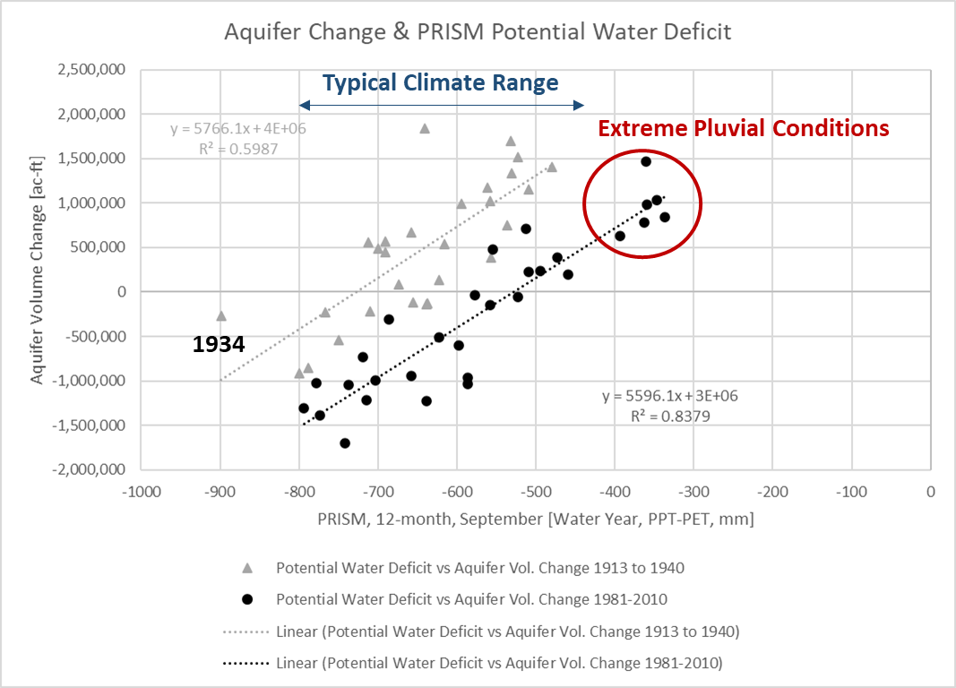
Climate and Aquifer Volume Change

Slide 8
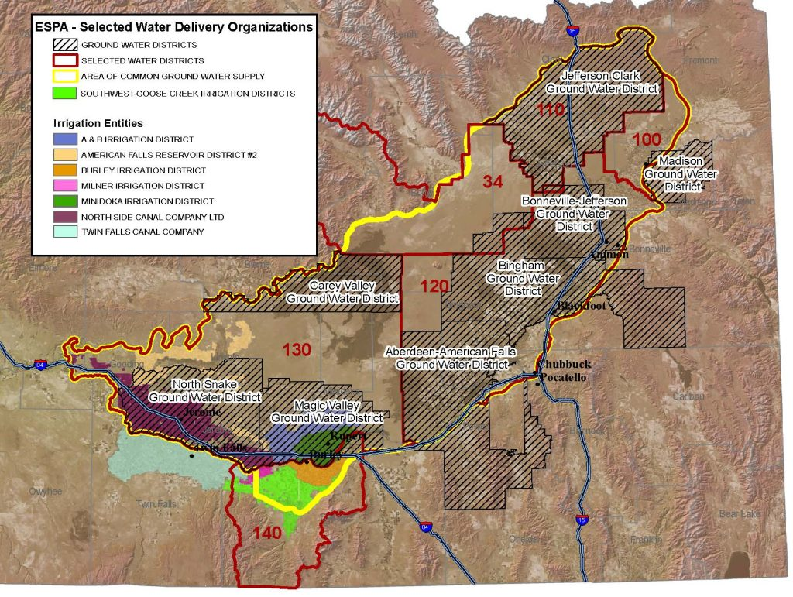
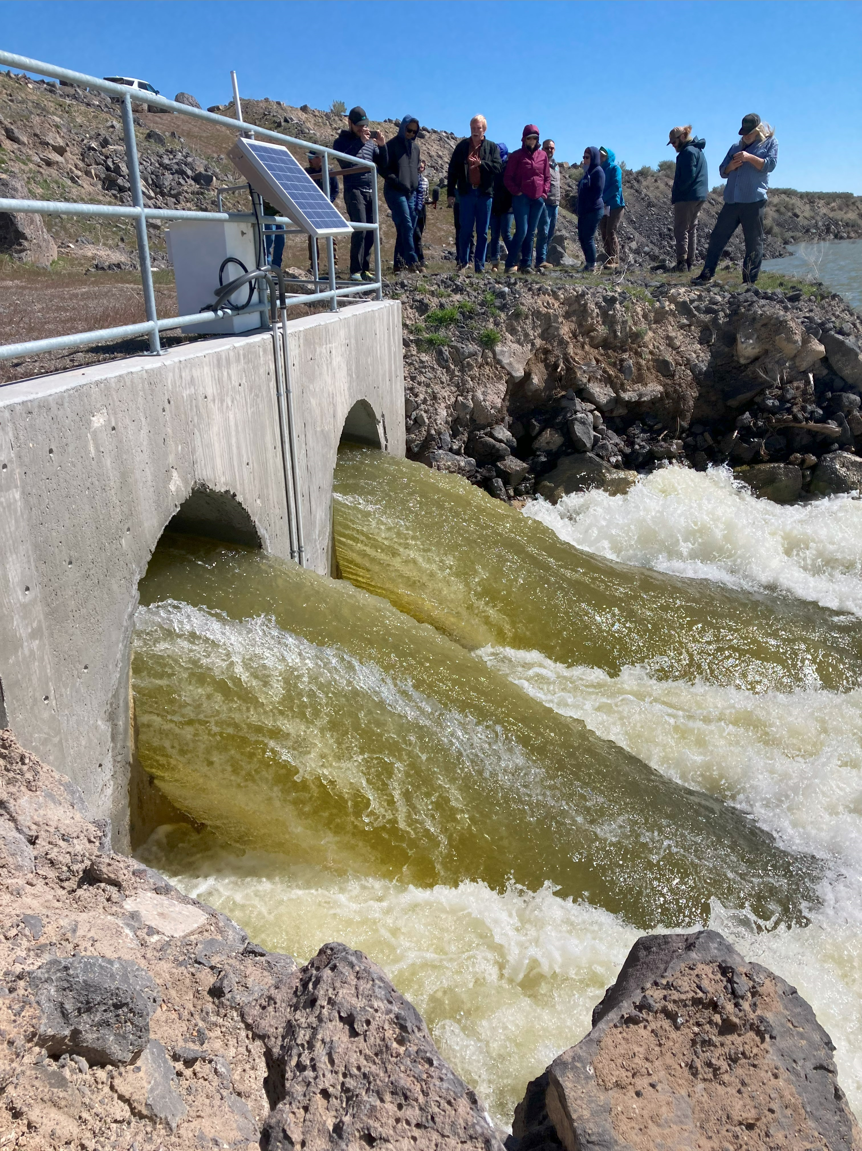
SWC-IGWA 2015 Settlement Agreement
240,000 ac-ft of groundwater pumping cutbacks
250,000 ac-ft of surface water recharge under natural flow rights
Rented Storage delivered to SWC.

Slide 9
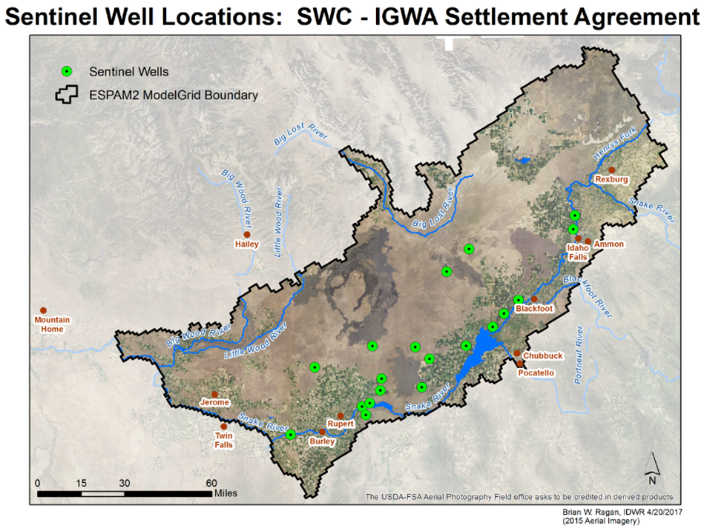
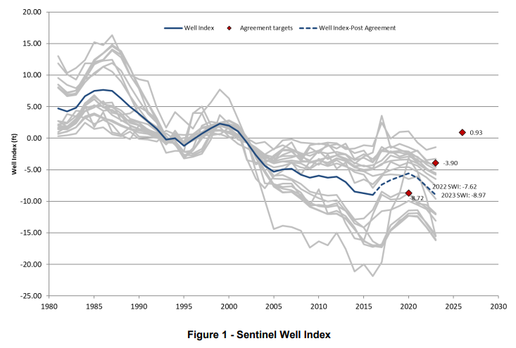
Sentinel Well Index
SWC/IGWA Settlement Agreement Mitigation Plain—2022 Breach
Expert Report: Docket No. CM-MP-2016-001 (Colvin et al., 2024)

Slide 10
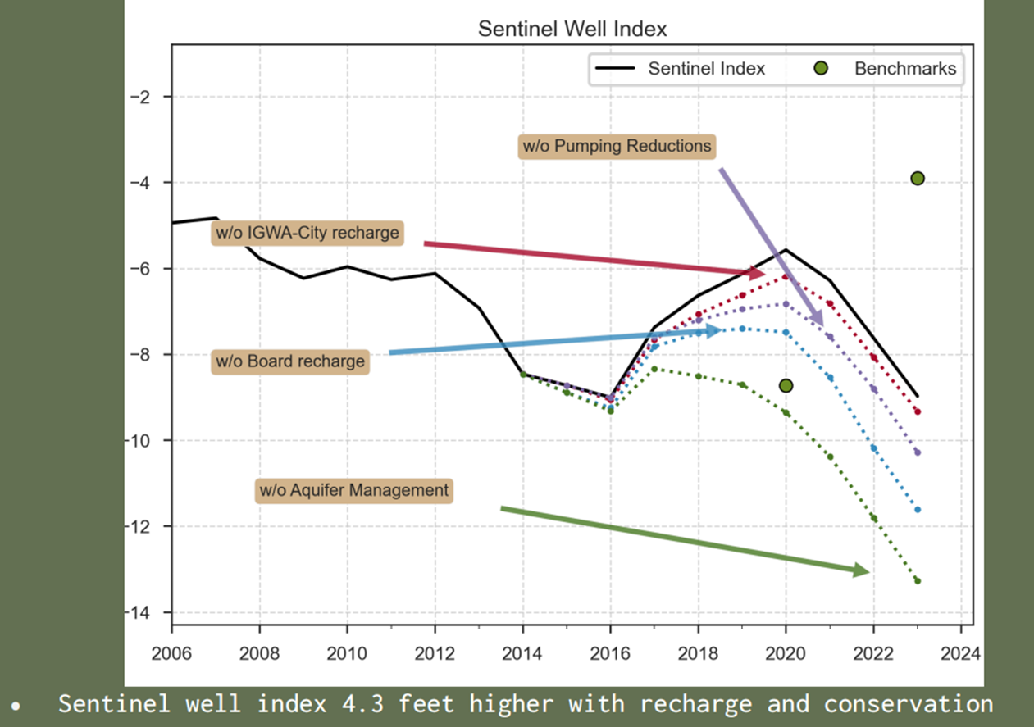
Sentinel Well Index
Provided by
Alex Moody at IDWR

Slide 11
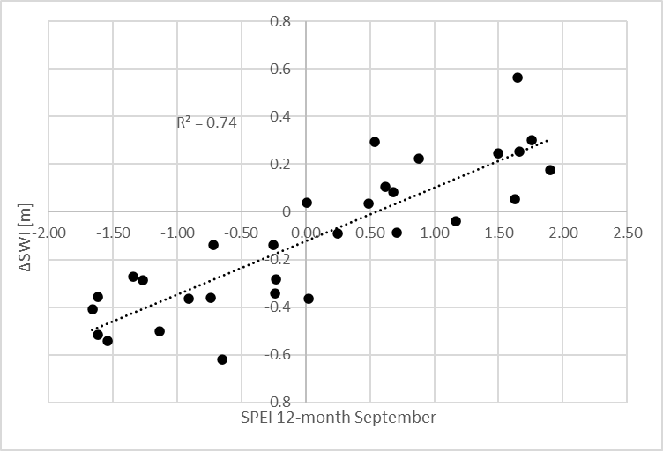
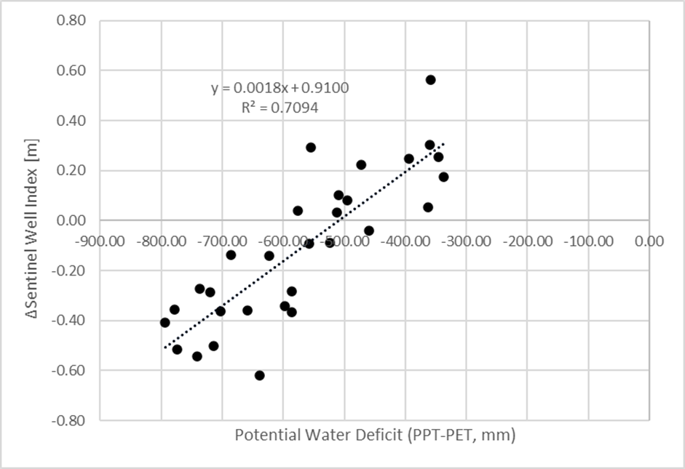
Standardized Precipitation & Evapotranspiration Index (SPEI) Potential Water Deficit: Precipitaton - Evapotranspiration PPT-PET or (ETo or ETr)

Slide 12
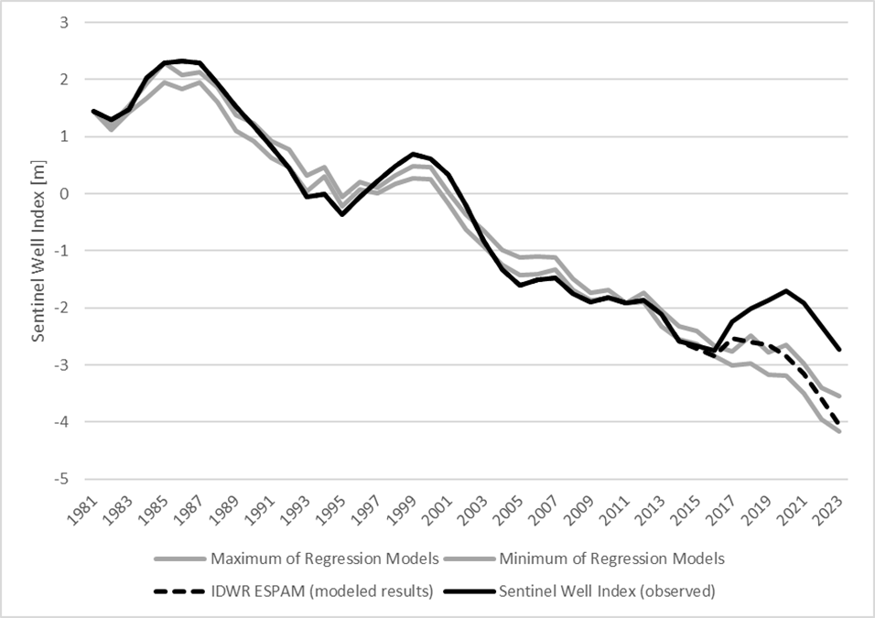
Climate Model vs ESPAM (Modflow)

Slide 13
History of the ESPA
Groundwater Development Period
Surface Water Development Period
Surface Water Efficiency Increases

Slide 16
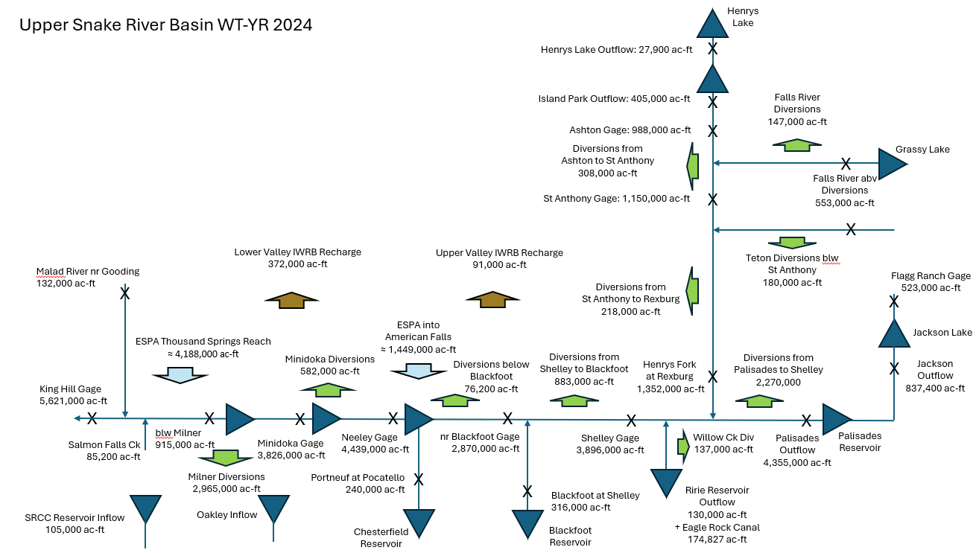

Slide 17
Milner to Murphy
ESPA Estimate (ac-ft)
+5,621,000 ac-ft, Snake River at King Hill
-911,000 ac-ft, Milner Dam
-211,000 ac-ft, TFCC Returns
-36,100 ac-ft, NSCC Returns
-85,200 ac-ft, Rock Creek
-58,200 ac-ft, Salmon Falls Creek
-132,000 ac-ft, Malad River nr Gooding
(does not appear to contain flood control)
4,188,000 ac-ft, discharge from ESPA (5,770 cfs)
1,434,000 ac-ft, surface water returns
X
Malad River nr Gooding
132,000 ac-ft
Upper Malad
8.3 MW
Lower Malad
13.5 MW
Thousand Springs Hydro
6.8 MW
Lower Salmon Falls Dam
60.0 MW
4,585,000 ac-ft
Water District 2
501,173 ac-ft
Upper Salmon Falls Dam
34.5 MW
Shoshone Falls Hydro
14.7 MW
King Hill
5,621,000 ac-ft
Twin Falls Hydro
52.9 MW
Malad Combined
902,000 ac-ft
X
X
X
Snake River nr Murphy
Blw Swan Falls Dam
5,692,000 ac-ft
Swan Falls Dam
27.2 MW
Bliss Dam
75.0 MW
5,501,000 ac-ft
Rock Creek
85,200 ac-ft
Snake River nr Buhl
2,124,000 ac-ft
Snake River blw
Milner Dam
59.4 MW
915,000 ac-ft
(30,300 Winter Bypass)
(669,000 flood control)
(216,000 IPCO storage &
USBR flow augmentation)
CJ Strike Dam
82.8 MW
5,614,000 ac-ft
Bruneau River
281,000 ac-ft
Salmon Falls Creek
85,200 ac-ft
TFCC & NSCC Returns
247,000 ac-ft

Slide 18
Additional Pictures

Slide 19
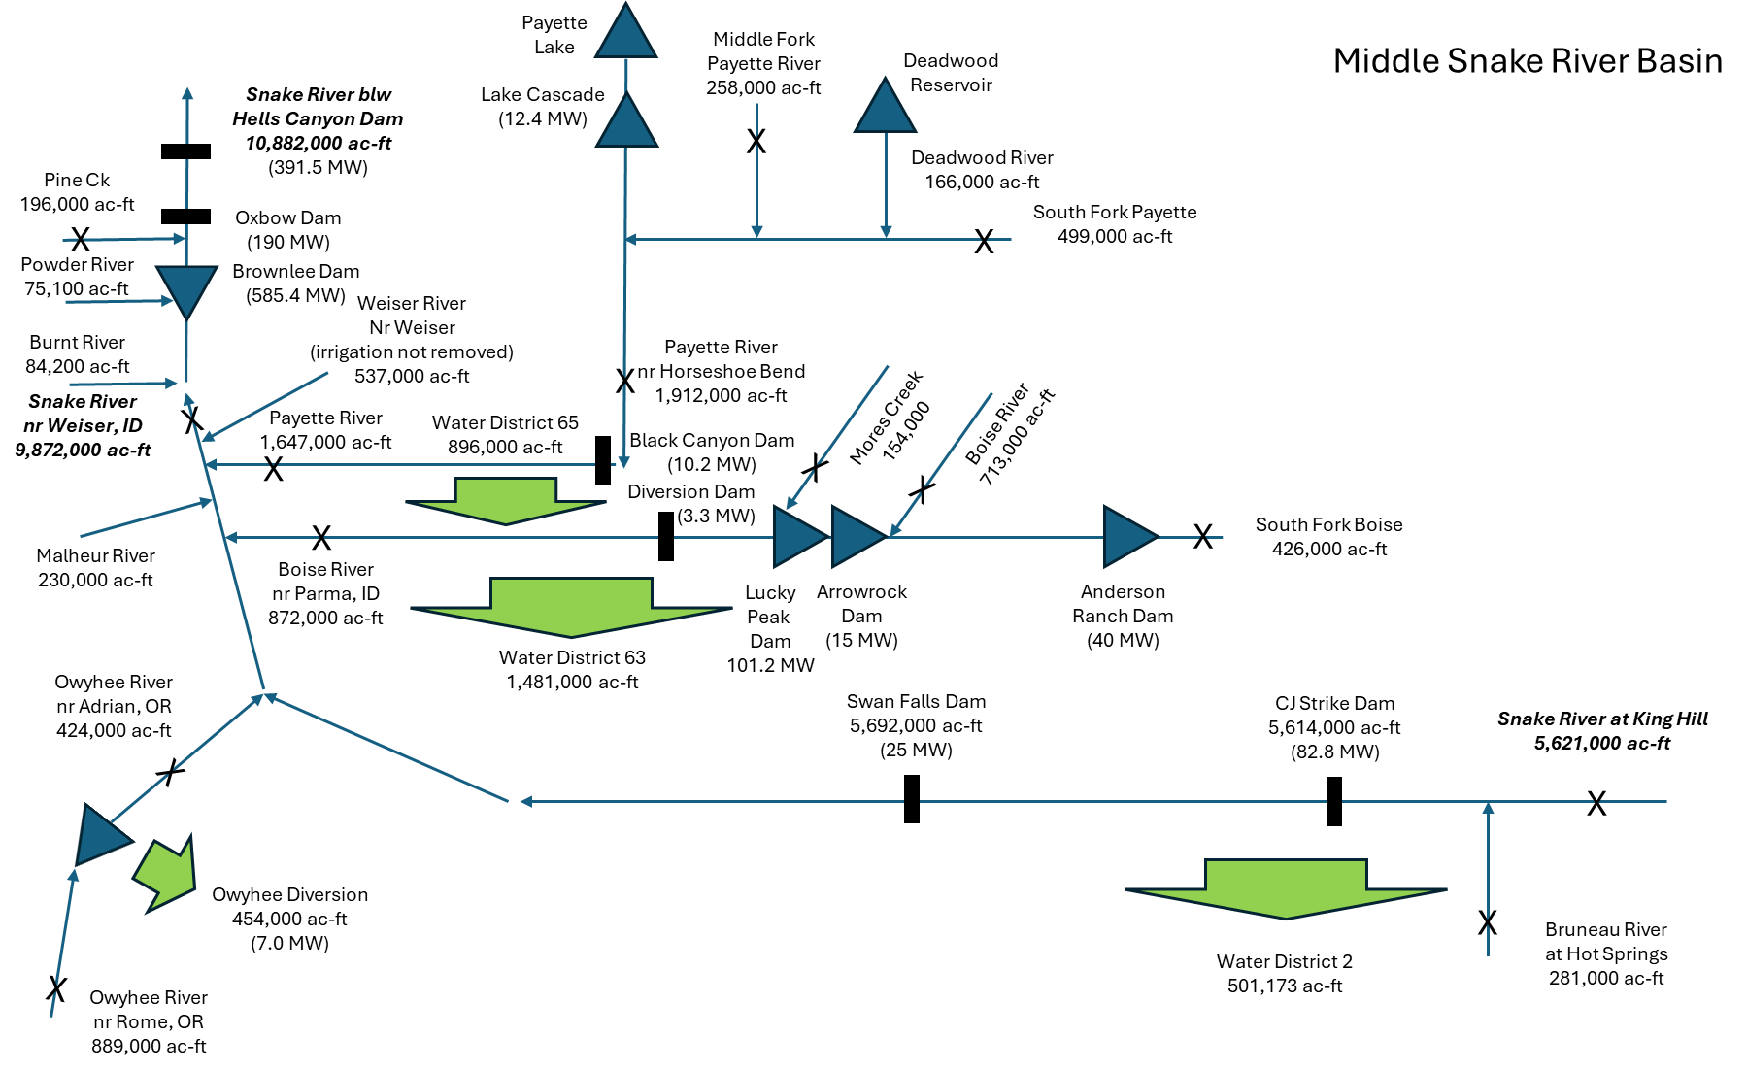

Slide 20
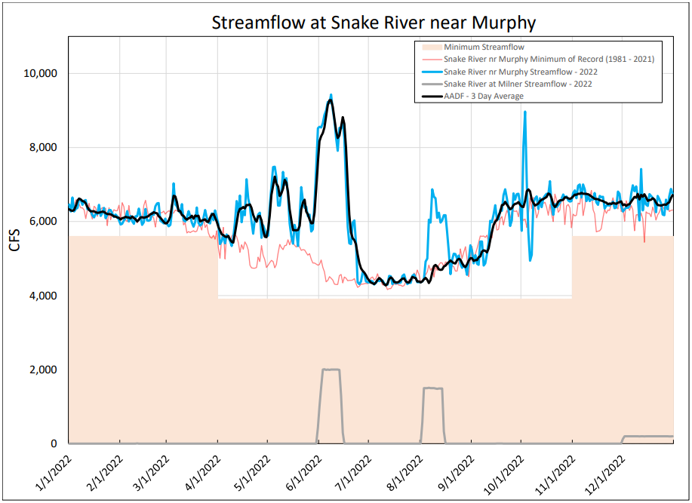
Provided by
Ethan Geisler at IDWR

Slide 21
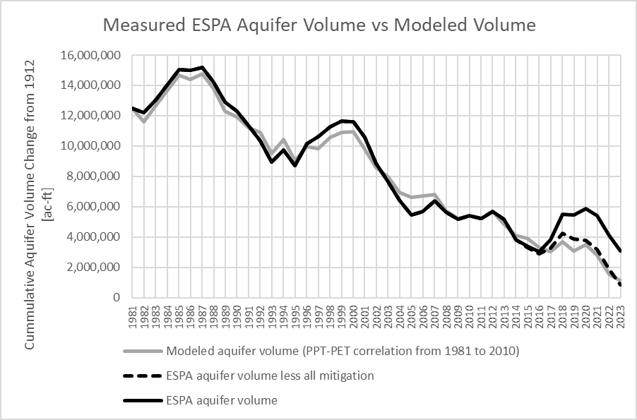
Additional Impacts of the 2015 Agreement
Swan Falls Minimum Streamflow

Slide 22
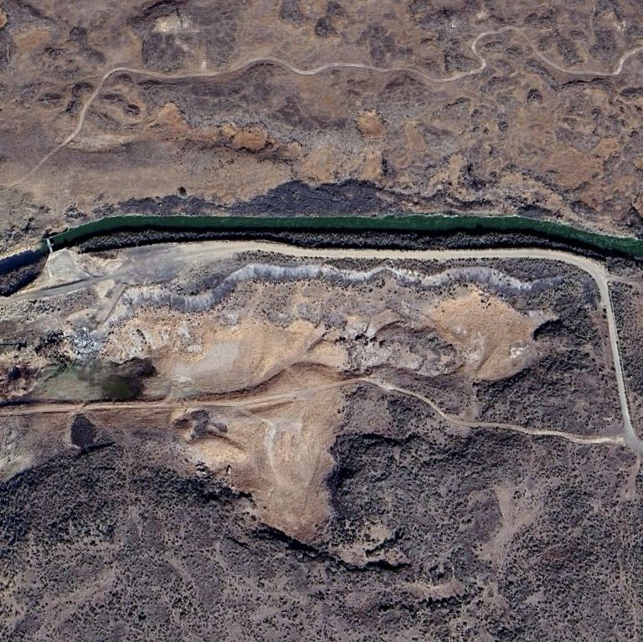
Questions?
Contact:
David Hoekema, Ph.D.
Hydrologist, IDWR
714 697-3203
David.Hoekema@idwr.Idaho.gov

