Slide 1
Surpassing Standards: Elevating Source Water Protection
Elizabeth Crafton, PhD

Slide 2
Agenda
System Overview
Source Water Protection Plan
Enhanced Best Management Practices
Algaecide Treatment
Remote Sensing

Slide 3
Core Components to Elevating Source Water Protection
Source Water Protection and Management
Source Water Protection
External
Internal
Source Water Management
Maintain quality of receiving waters
Restore or maintain quality of source water
HAB
Prevention
Offset anthropogenic impact
Buffer impact of external influences
Watershed
Lake
Watershed-based
In situ management

Slide 4
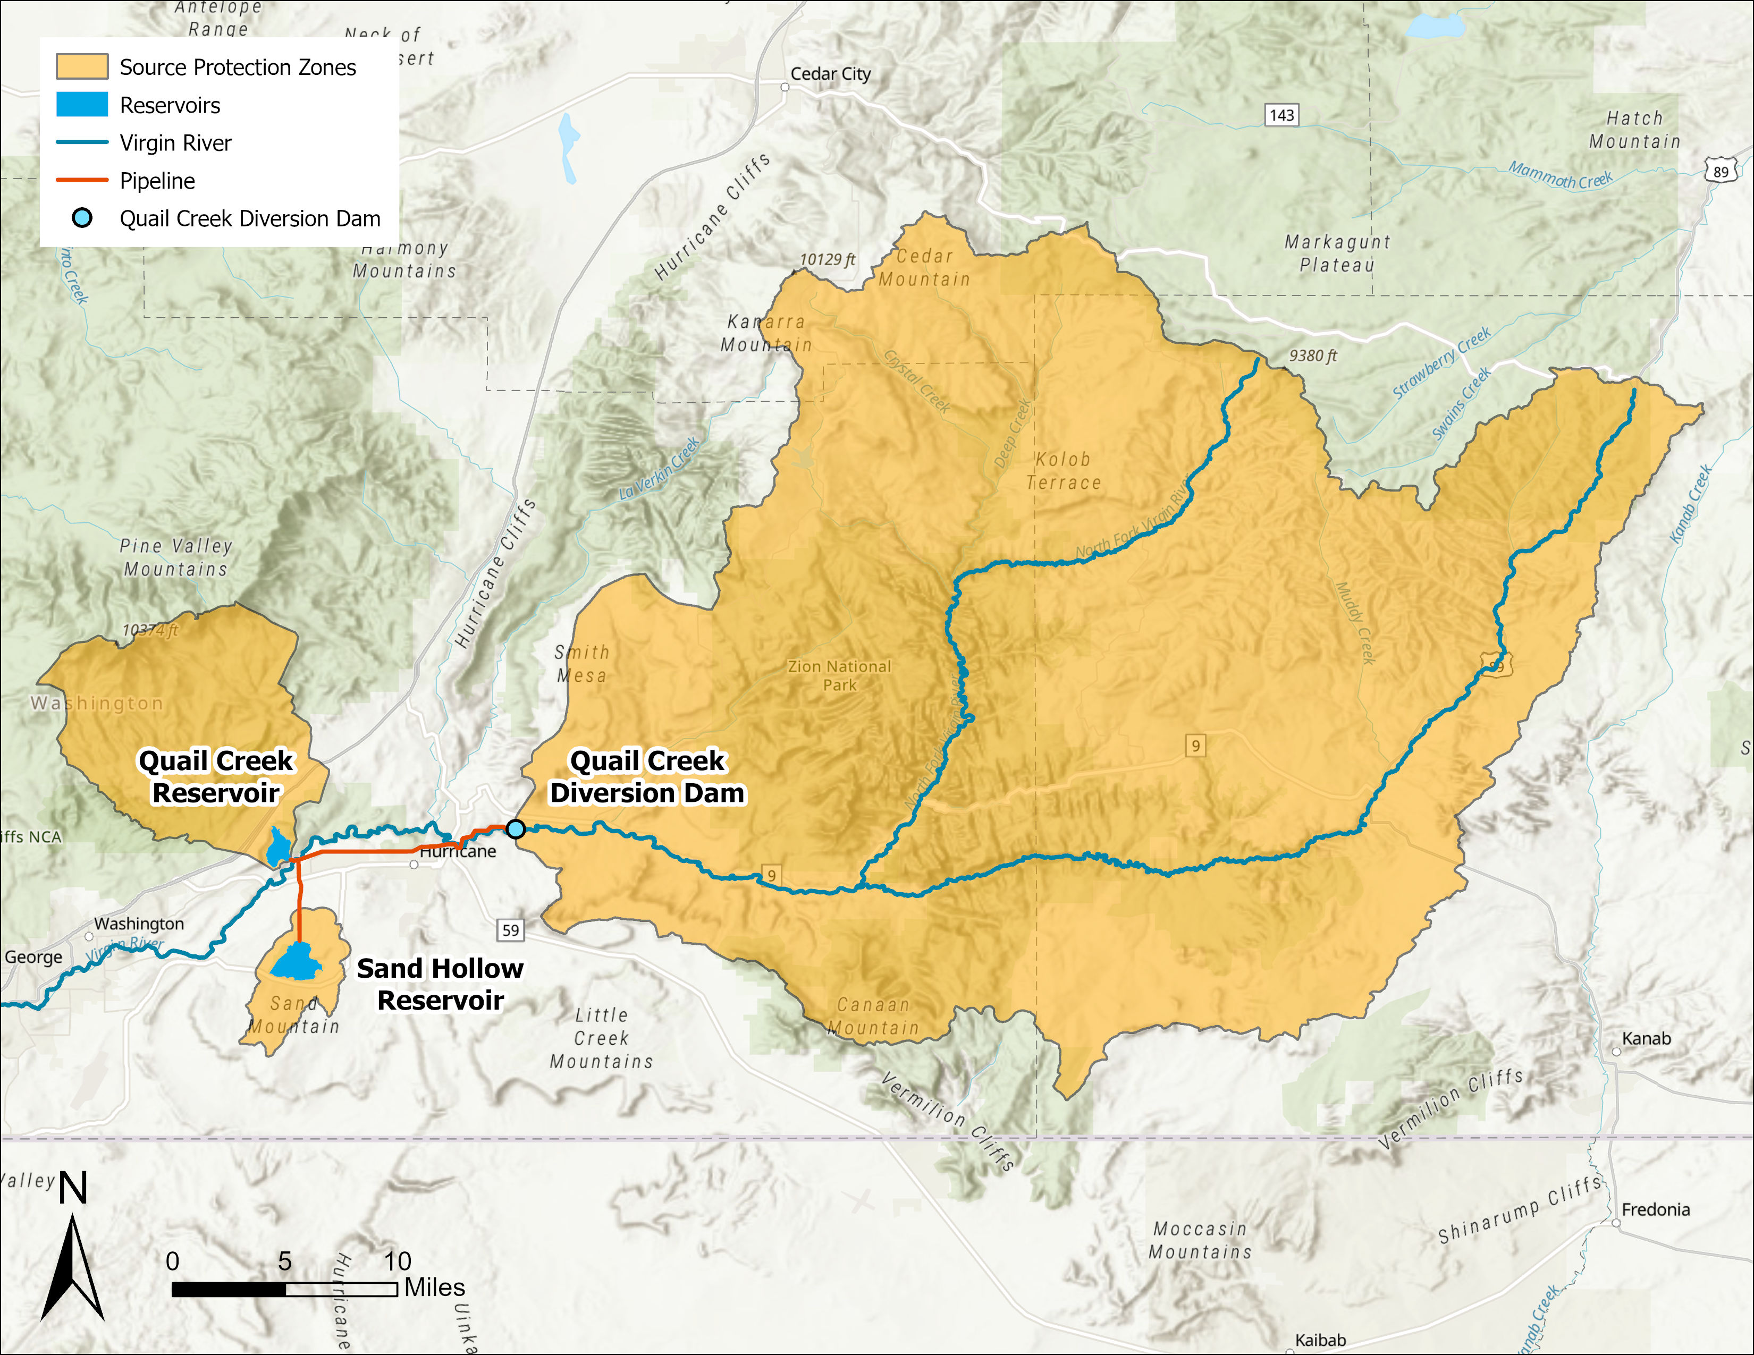
Background
The Quail Lake System has two primary drinking water reservoirs:
Quail Creek Reservoir
Sand Hollow Reservoir
Water for both reservoirs is diverted from the Virgin River at the Quail Creek Diversion Dam
Increases in development and agriculture have caused nonpoint source pollution concerns for the system
Specifically, benthic harmful algal blooms (HABs) have been developing in the Virgin River for decades
These blooms have more recently made their way into the reservoirs, leading to direct drinking water quality implications

Slide 5
Source Water Protection Plan (SWPP)
Precipitation
Two main components:
Prioritized inventory of potential contaminant sources (PCSs)
Action Plan to address top source water threats
Built off the previous Source Water Protection Plan, which was developed in 2008
Updated PCS information by conducting a windshield survey
Updated prioritization input datasets
Highest priority PCSs:
Abandoned mines
Campgrounds
RV Parks
Vacation rentals
Structural Integrity
Existing Controls
PSOC Priority
Slope
Proximity
Soil Type
Contaminant Type
Land Cover

Slide 6
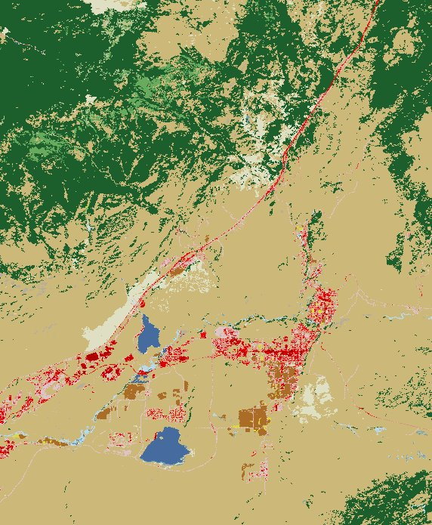
Potential for Improvement
The SWPP is a good basis for prioritizing acute contamination concerns
However, less tangible concerns can be missed in contaminant inventories
Climate change-driven threats (HABs, wildfire)
Long-term watershed changes (urban development, agriculture)
The following additions to the initial source water protection plan were proposed:
Water quality modeling to better understand priority areas for nutrient loading
Additional best management practices (BMPs) to address nutrient loading, urban development, septic systems, and data gaps
Algaecide treatment for HABs in Sand Hollow Reservoir
Remote-sensing of upstream reservoir conditions to predict water quality threats

Slide 7
Nutrient Load Modeling and Enhanced BMPs

Slide 8
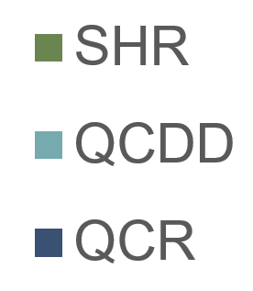
Nutrient Load Modeling
Pollutant Load Estimation Tool
Models such as EPA’s the PLET (Pollutant Load Estimation Tool) can be leveraged to better understand sources of nutrient loading and assess impacts of changing land use over time
Inputs: Land use/land cover, precipitation, soil characteristics, agricultural animal counts, irrigation, septic systems
Outputs: Annual loading estimates for total nitrogen, total phosphorus, BOD, and sediment (not considered in this model)
Three subbasins were modeled to assess areas with highest nutrient loading and recommend best management practices (BMPs) based on contributing land use
Total loading identifies largest loading contributors
Area-normalized loads help identify target areas for nutrient reduction BMPs
Total Annual Load
Area-Normalized Annual Load

Slide 9
Application to Enhanced BMPs
PLET results indicate that forest land contributes most to total nutrient loading
However, pastureland, cropland, and urban land are much larger contributors on a per-acre basis
A BMP applied to agricultural or urban land result in more nutrient load reduction per acre treated than forest land, lowering costs
Septic systems were also a notable source in model outputs
Couple PLET output with LULC analysis
Recommended BMPs:
Septic to sewer conversion for the upstream town of Virgin, UT
Edge-of-field buffers for agricultural land use
Stormwater management in urban areas
Total Annual Load
Area-Normalized Annual Load

Slide 10
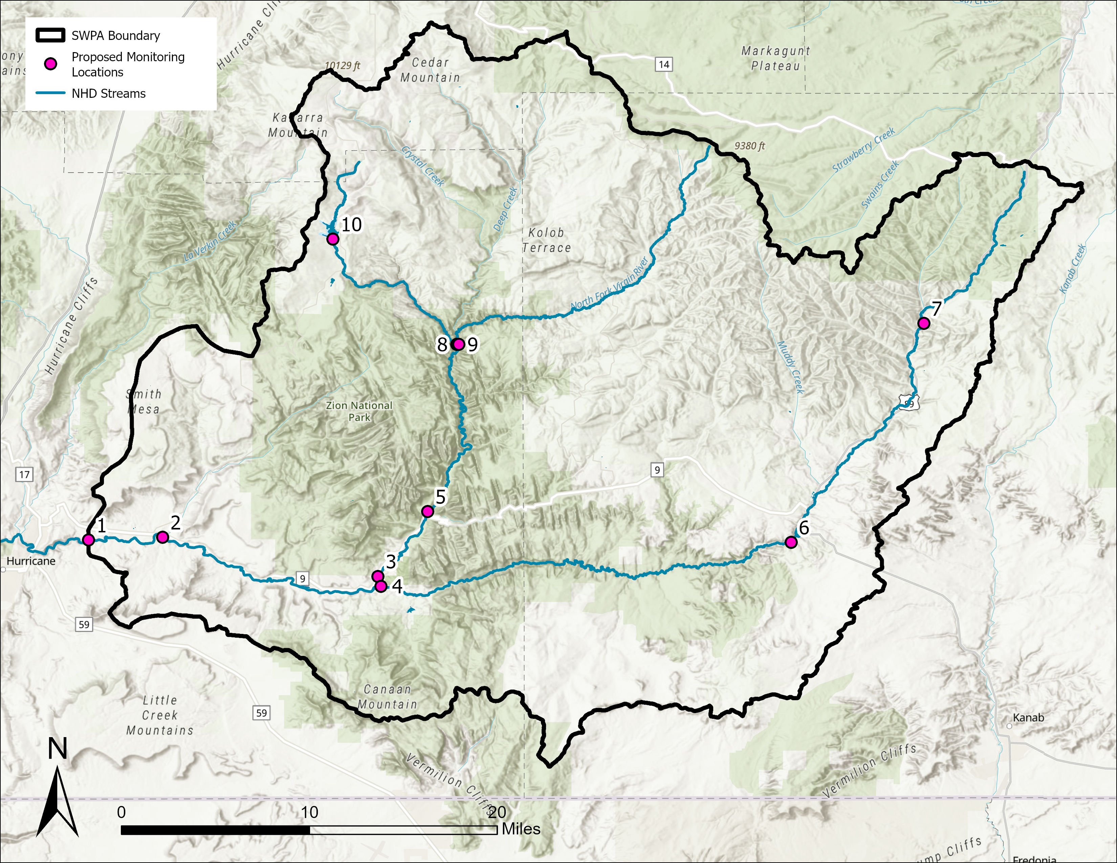
Watershed Monitoring
Watershed monitoring can help fill data gaps in nutrient load modeling
Nutrient or sediment lads caused by factors not considered in model inputs
Higher spatial resolution for nutrient loads
Can track seasonal dynamics and long-term watershed changes
Watershed monitoring can also be used to evaluate BMP effectiveness
Change in nutrient loads downstream of a contaminant source before and after implementation
Monitoring locations were designed to capture major river reaches, critical infrastructure, and key areas for nonpoint sources

Slide 11
Algaecide Treatment

Slide 12
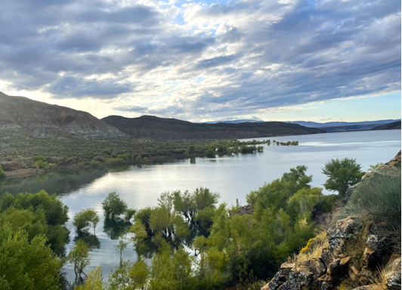
Sand Hollow Reservoir: Novel Peroxide Treatment
Benthic algal blooms have been observed in Sand Hollow Reservoir and the upstream Virgin River for decades
The most recent bloom in Sand Hollow Reservoir was observed in October of 2024
Historical algaecide treatments in Sand Hollow Reservoir had used copper
However, due to the ecological impacts of using copper algaecide, WCWCD was interested in exploring peroxide as an alternative solution

Slide 13
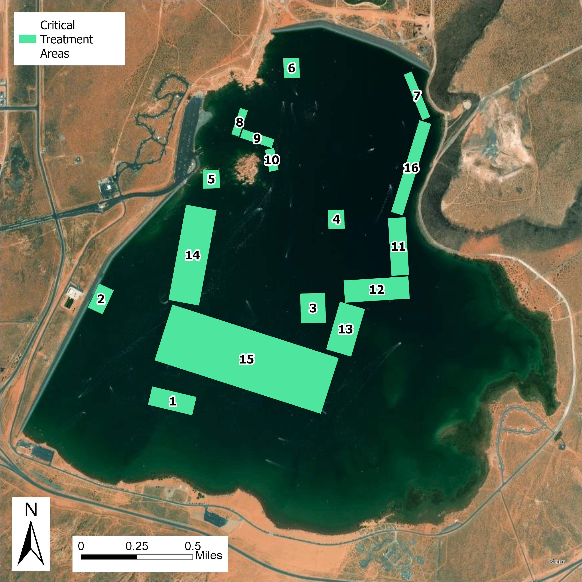
Treatment Planning
Divers surveyed the reservoir pre-treatment to determine areas of growth
Key Observations: 9 pockets of growth identified, generally occurring at a depth range of 35 – 45 ft
Bathymetry data was combined with survey observations to generate a set of treatment areas (right)
PAK27 dosage:
Target Concentration: 4 mg/L
Target Dose: 20 lbs/ac-ft
Application done by boat
Alternating bands to avoid harming fish populations
Approximately 20 ft surface broadcast width
Divers completed follow-up survey
Cyanotoxins (anatoxin-a) was detected prior to treatment, was ND at 24 hrs and 7 days post treatment

Slide 14
Future Preventative Treatments
Preventative treatment was recommended for subsequent seasons
Easier to address algal blooms before populations have established
Reduced risk of cyanotoxins or taste and odor (T&O) compounds developing
Temperature monitoring will be used to inform treatment timing
Target surface temperature of 15 to 18 C
Areas where there has been previous growth should be targeted for preliminary treatment in the following growing seasons
Begin Treatment

Slide 15
Source Water Monitoring

Slide 16
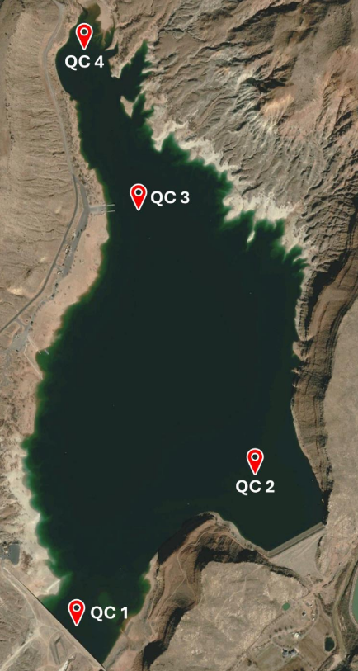
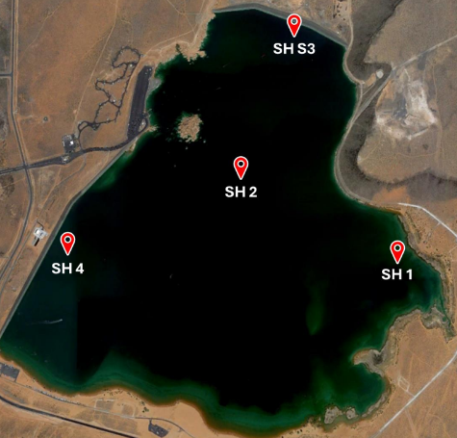
Monitoring Plan & Water Quality Modeling
A comprehensive routine monitoring plan is necessary for source water protection
Characterizes baseline conditions and seasonal trends
Enables proactive implementation of management strategies and monitoring of the success and impacts of those strategies
Recommended an expanded monitoring program in Quail Lake Reservoir and Sand Hollow Reservoir
Includes water quality profiles, algal enumerations, MIB/geosmin, cyanotoxins, nutrients, and metals
With sufficient monitoring data, a CE-QUAL-W2 model can be constructed to further enhance management decision-making
Models hydrodynamics and eutrophication processes
Increases understanding of the underlying causes of HABs and enables prediction of conditions leading to future HAB events

Slide 17
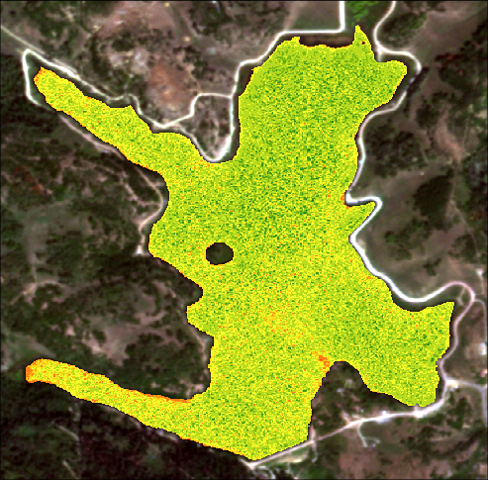
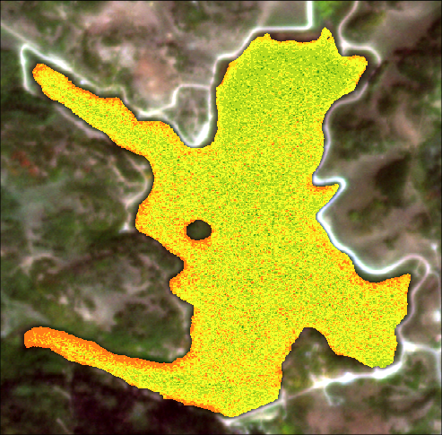
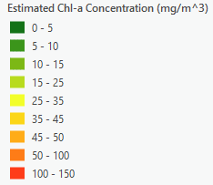
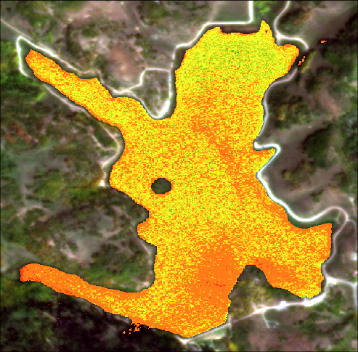
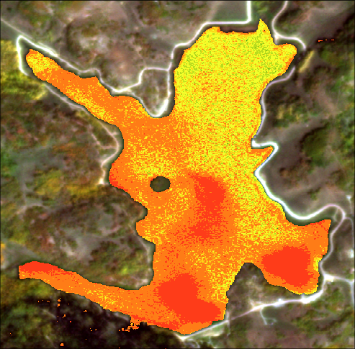
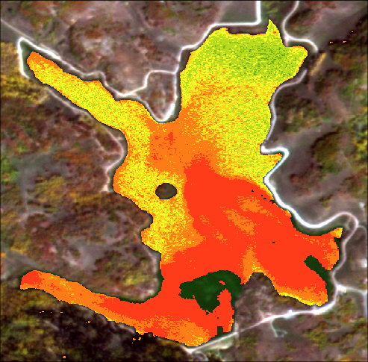
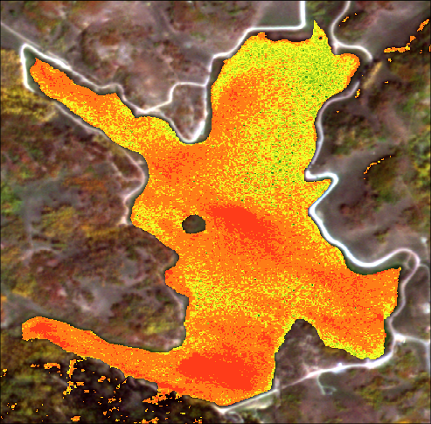
Enhanced Monitoring: Remote Sensing
Remote-sensing has advantages for HAB monitoring:
Early detection
Provides spatial data for targeted algaecide treatments
Cost-effective
Remote-sensing captured a bloom in an upstream reservoir within the Quail Lake System in October 2022
The reservoir normally releases into Quail Creek and Sand Hollow in October, but operations were halted due to the observed bloom
Chl-a estimates shown were computed using the Normalized Chlorophyll Difference Index (NDCI)
Computed using the differential reflectance of red and near-infrared wavelengths
Chlorophyll absorbs red light but reflects/fluoresces in the near-infrared range
9/25/2022
10/01/2022
10/07/2022
10/12/2022
10/14/2022
10/18/2022

Slide 18
Source Water Protection Has Tangible Impacts
Completion of a SWPP is often considered to be the end product of source water protection
However, there are substantial benefits to expanding source water protection programs:
Prediction of water quality changes and treatment impacts
Reduced treatment costs
Improved data and understanding of watershed conditions
Reduced contamination risk
Healthier ecosystems
Improved public confidence
Modern water treatment challenges make source water protection non-negotiable for utilities:
Wildfire
Drought
Harmful Algal Blooms
Urbanization

Slide 19
Summary

Slide 20
Key Takeaways
SWPPs are great for contextualizing acute risks and prioritizing action
SWPPs are less tangible for dispersed, persistent issues (i.e., wildfire, eutrophication, climate driven changes, flooding, etc)
Augmenting SWPP for dispersed risks is key
Leverage watershed monitoring and modeling
Leverage natural treatment systems to increase biodiversity and habitat conditions
Determine habitat conditions and ecosystem health in the watershed to delineate restoration efforts (i.e., raise ecosystem function)
Eutrophication cannot be reversed through watershed action, source water management must also be included
Actively manage the lakes and reservoirs through in-situ action
Minimize HAB and cyanobacteria dominance
Raise the ecosystem function

