Slide 1
North Santiam Watershed Drought Contingency Planning
May 8, 2025
PNWS-AWWA Section Conference
Leah Cogan

Slide 2
Agenda
North Santiam watershed
Drought Contingency Plan overview
Drought monitoring
Vulnerability assessment
Mitigation and response actions
Administrative framework

Slide 3
North Santiam Watershed
766 square miles
75% publicly owned
Detroit Reservoir
Drinking water source
Agriculture, forests, hydropower, recreation
Winter steelhead and spring Chinook salmon

Slide 4
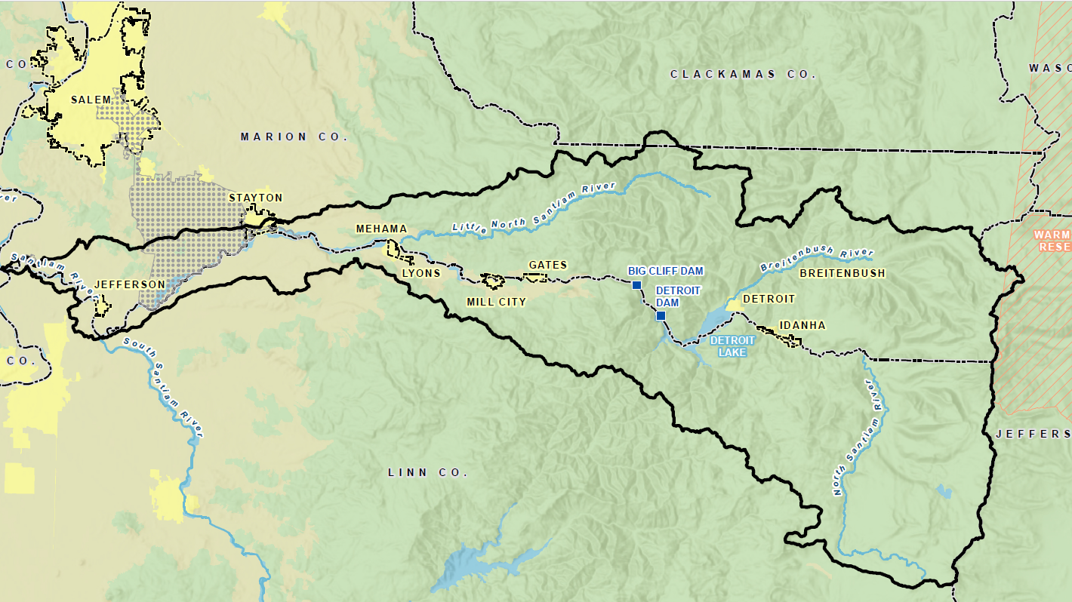

Slide 5
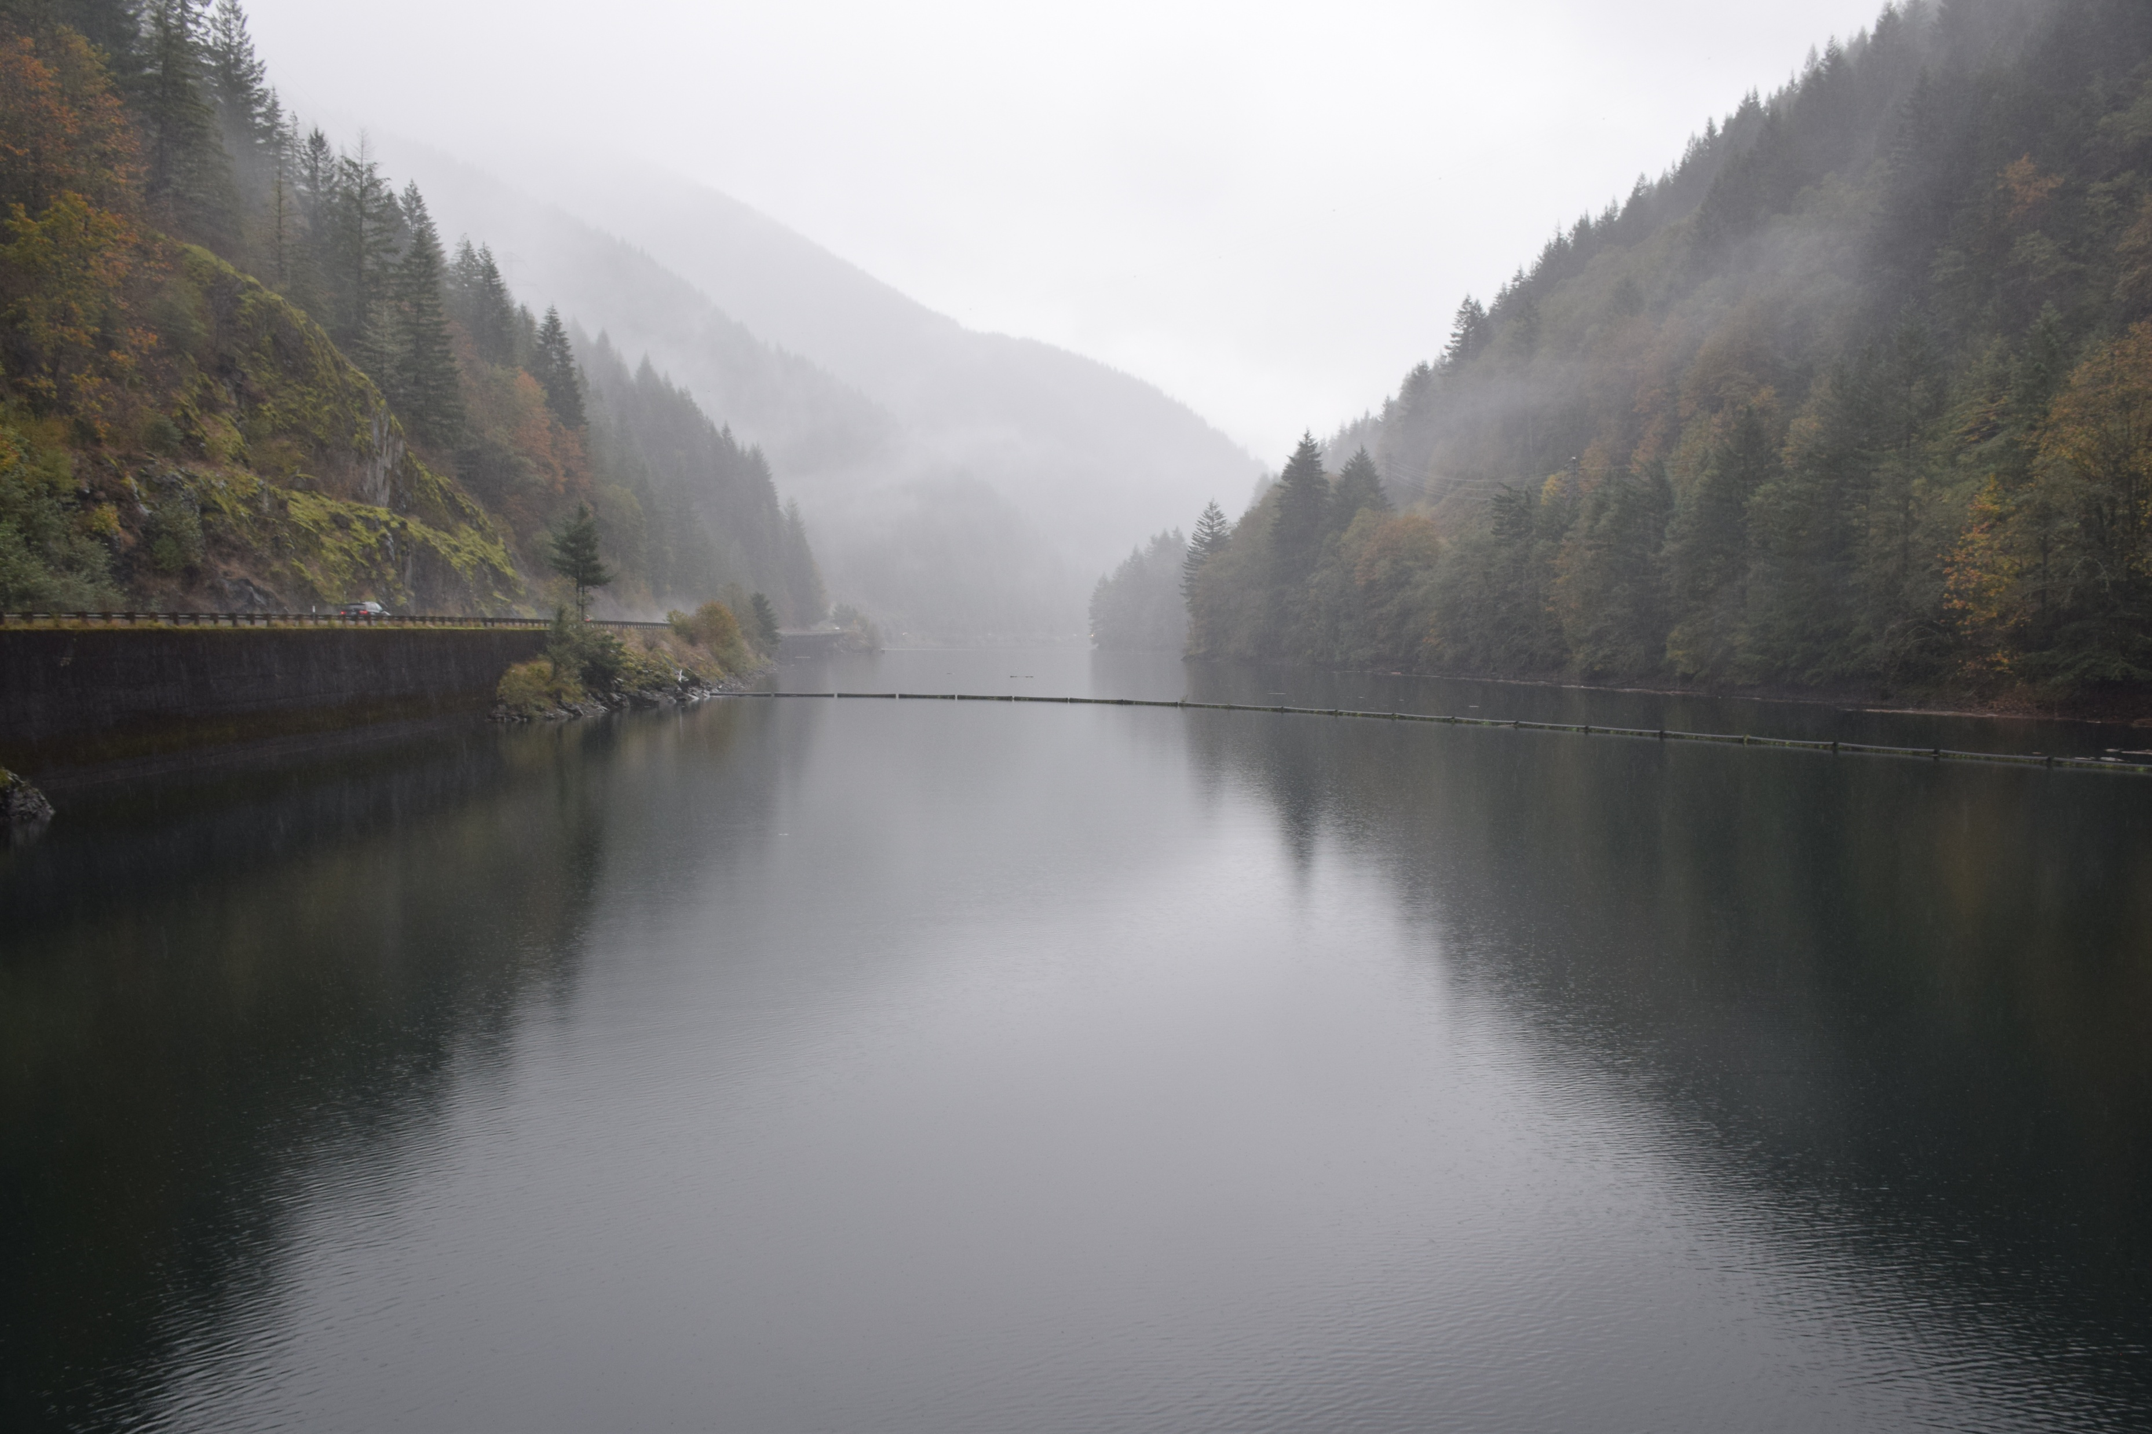
Drought Contingency Plan (DCP) Overview
Completed in 2017, approved in 2018
Bureau of Reclamation WaterSMART grant
Santiam Water Control District
Goal: long-term resilience to droughts to minimize impacts on communities, local economies, and critical natural resources

Slide 6
DCP Elements
Drought monitoring
Vulnerability assessment
Mitigation actions
Response actions
Operational and administrative framework
Update process

Slide 7
Stakeholder Interests
Water providers
Agriculture
Forestry
Ecosystems
Hydropower
Recreation
Public agencies
Flood control

Slide 8
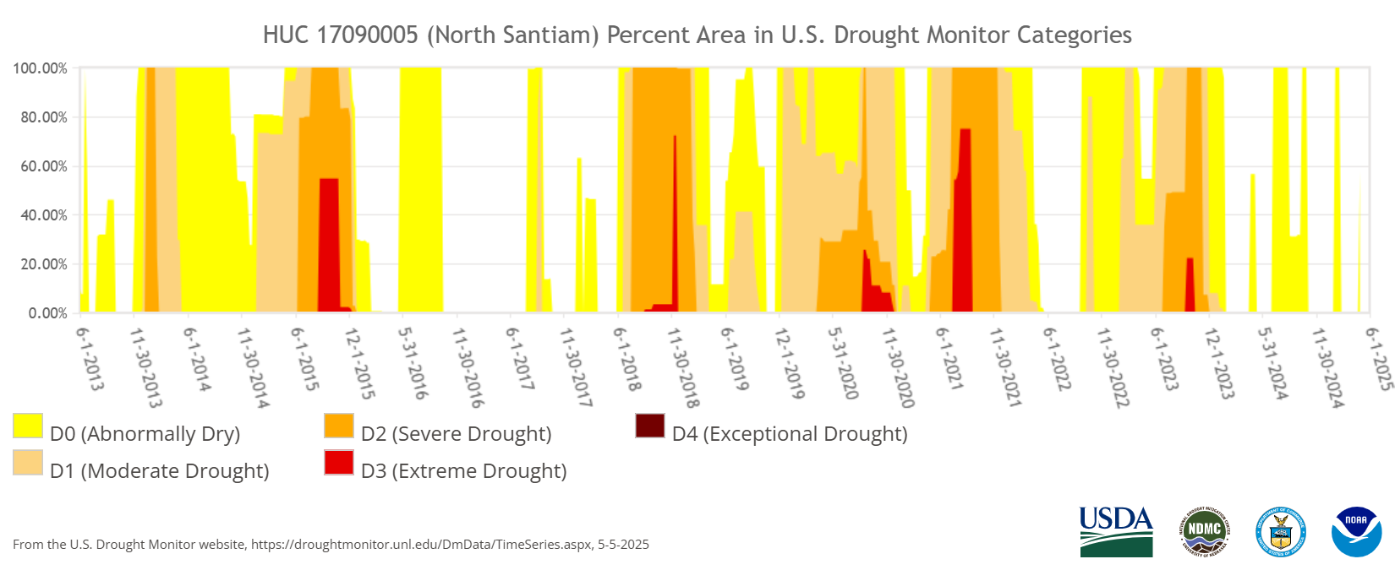
DCP Update
Recommended every 5 years
Completed projects and new data
Feedback and lessons learned

Slide 9
Pandemic
Wildfires
Heat Dome
Ice Storms

Slide 10
Element 1: Drought Monitoring

Slide 11
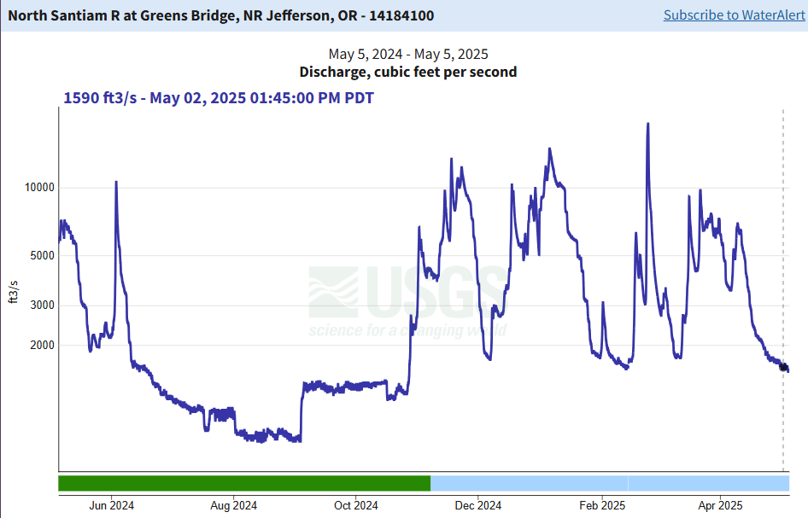
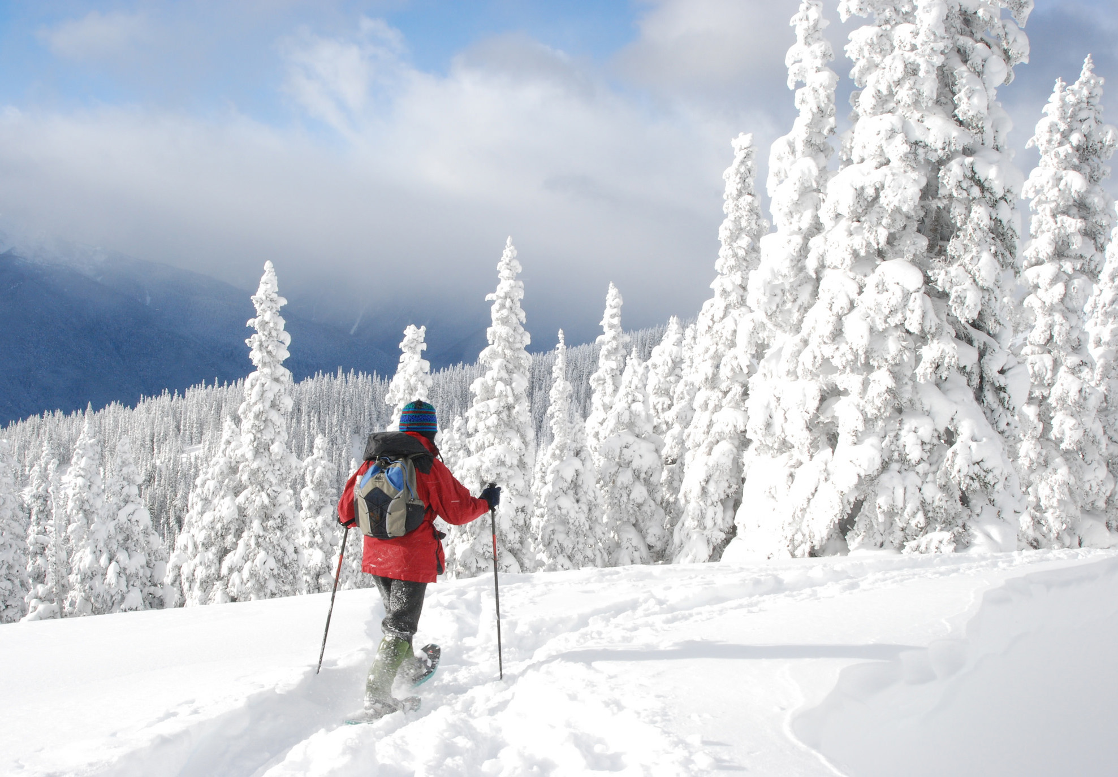
Monitoring Indicators
Air temperature
Precipitation
Snowpack
Reservoir levels
Streamflow

Slide 12
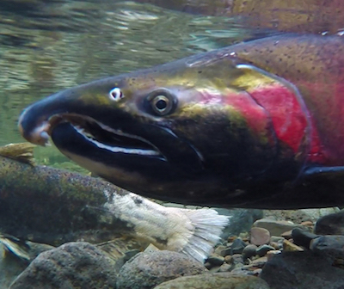
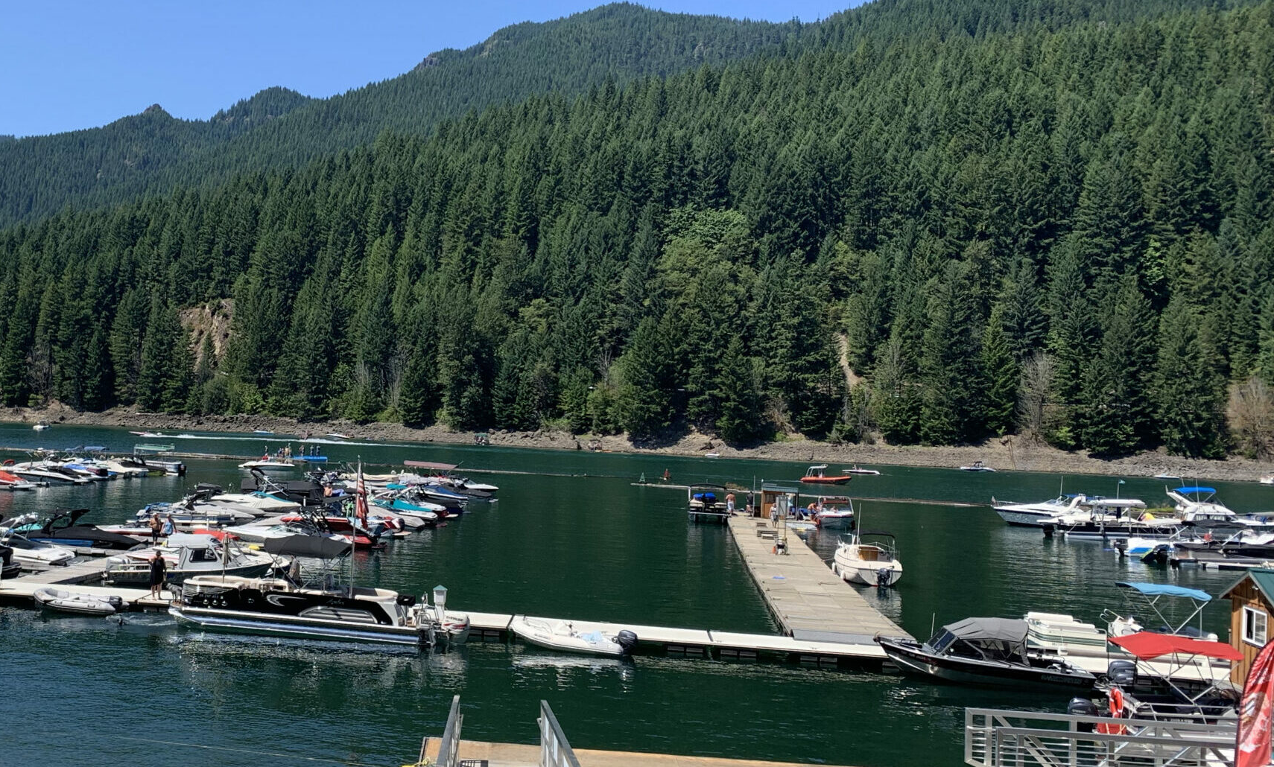
Monitoring Indicators cont’d
Stream temperature
Wildfire hazard
Boat ramps
Salem water availability
US Drought Monitor

Slide 13
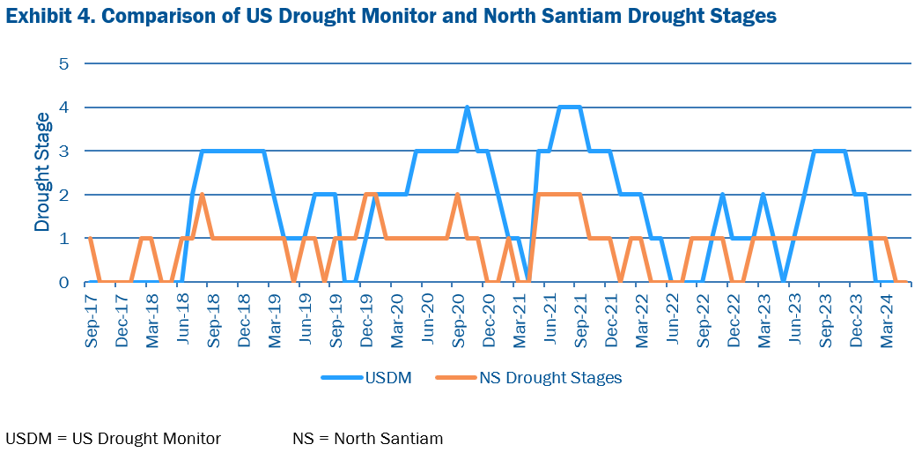
US Drought Monitor

Slide 14
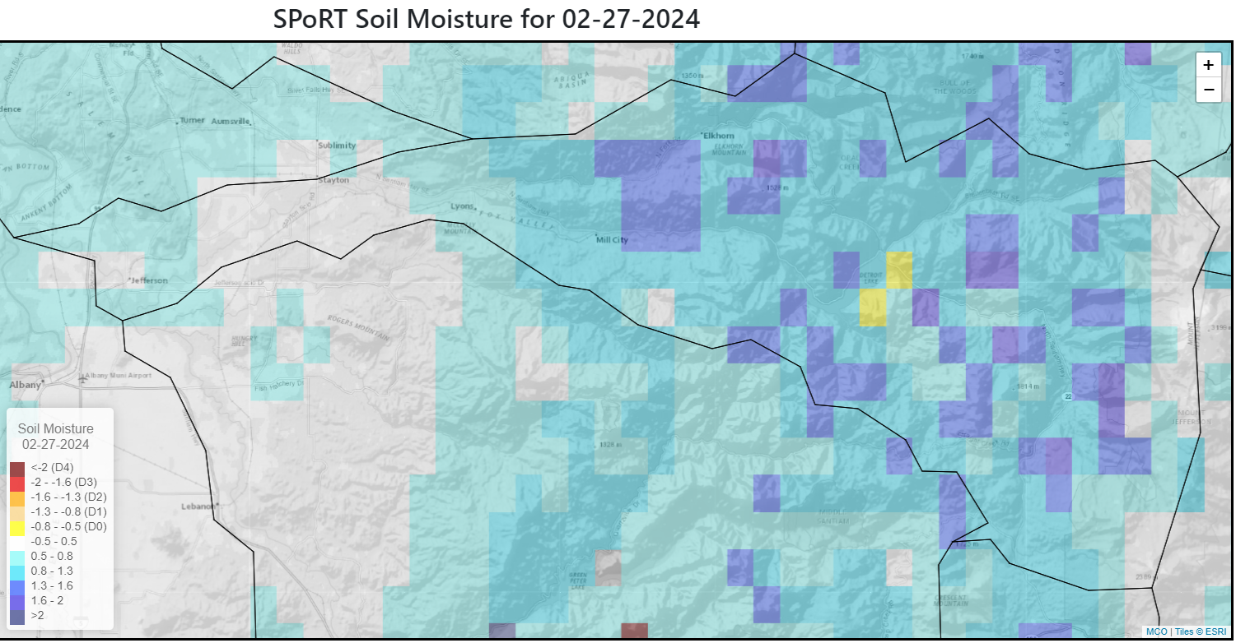
Monitoring Framework Updates
Link to maps: https://drought.climate.umt.edu/?name=NorthSantiam
More stream temperature locations
Seasonal thresholds

Slide 15
Element 2: Vulnerability Assessment

Slide 16
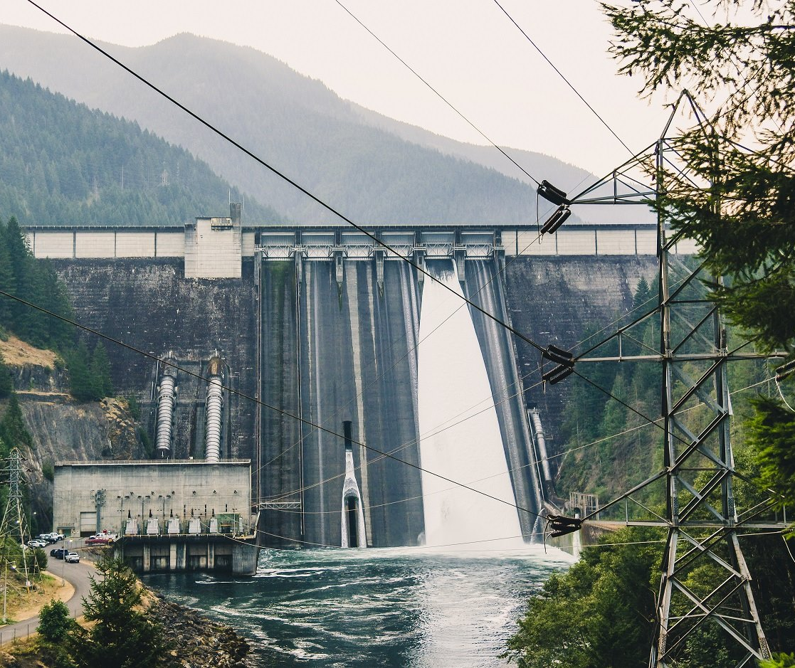
Underlying Causes of Vulnerability
Single source of water
No backup or interconnections
Intake limitations
Junior water rights
Reservoir operations

Slide 17
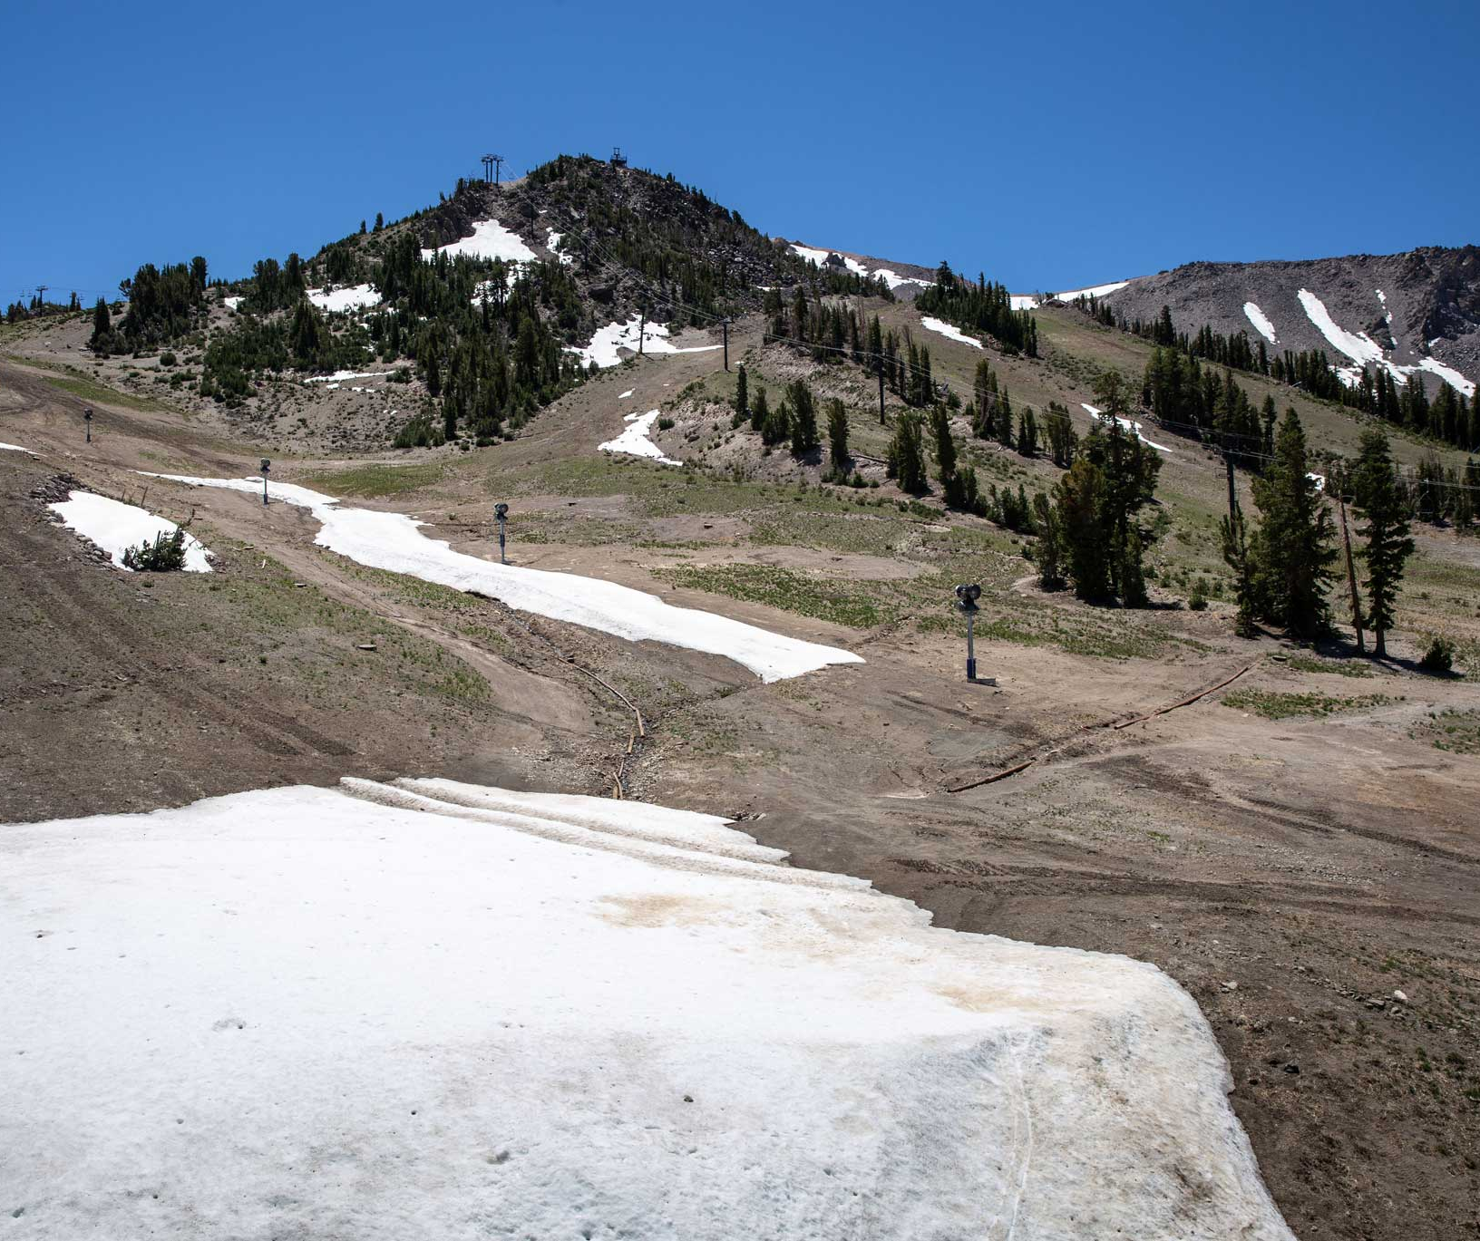
Future Conditions
Stored water reallocation
Biological Opinion and EIS implementation
Population growth
Infrastructure projects
Climate change

Slide 18
Climate Projections: Marion County

Slide 19
Oregon Climate Projections
Increase in consecutive days without rain
Seasonal droughts 11-33% longer and 40% more severe by 2100
Snow water equivalent declines of 25% across Oregon by 2050

Slide 20
Current Conditions
HIGH
Muni water use – Salem
Consequences:
Public health and welfare
Watershed health
Economic impact
Muni water use – Jefferson
Muni water use – Aumsville
Muni water use – Stayton
Muni water use – Lyons-Mehama; Gates
Muni water use – Detroit, Idanha
Instream natural resources
Fire suppression (multi-sector)
Upland natural resources
Commercial irrigation
(Muni) commercial/indus. use
Water dependent recreation
CONSEQUENCES
Sensitivity:
Alternative water source
Capacity to adapt
Regulatory constraints
Non- commercial irrigation
Individual domestic use
Hydropower
Other irrigation/ watering
LOW
HIGH
SENSITIVITY

Slide 21
Element 3: Mitigation

Slide 22
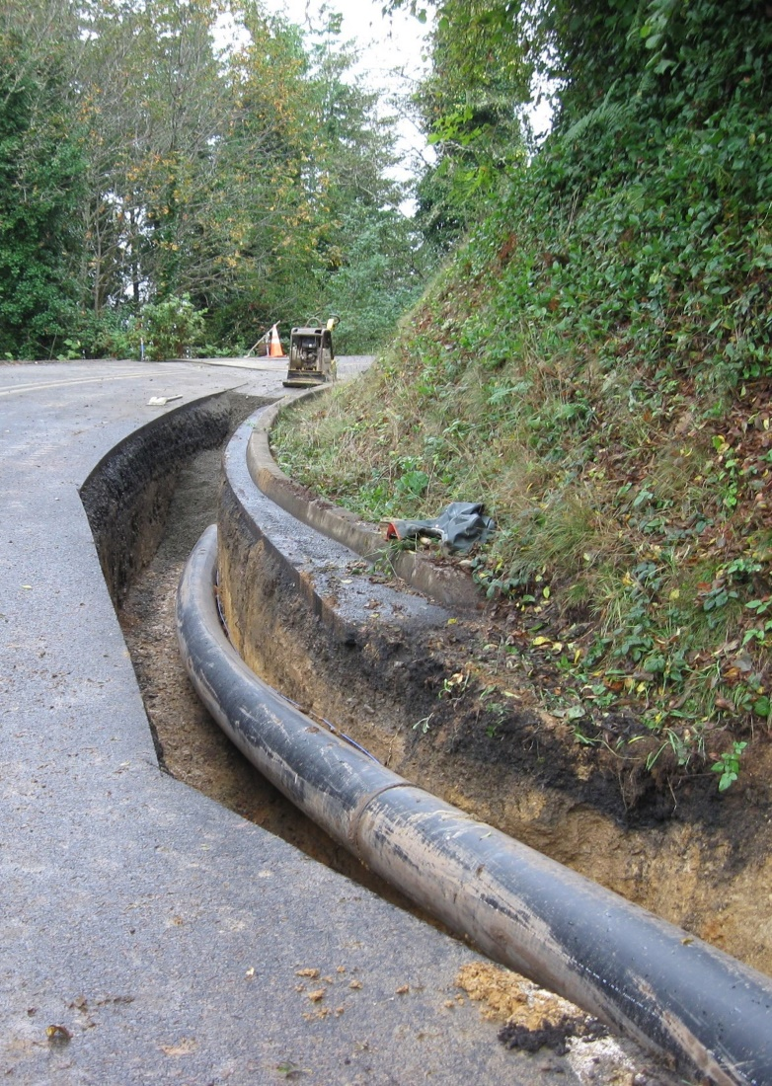
Mitigation Actions
Natural system resilience
Infrastructure efficiency
Collective efforts and consistent messaging
Funding and preparing for response

Slide 23
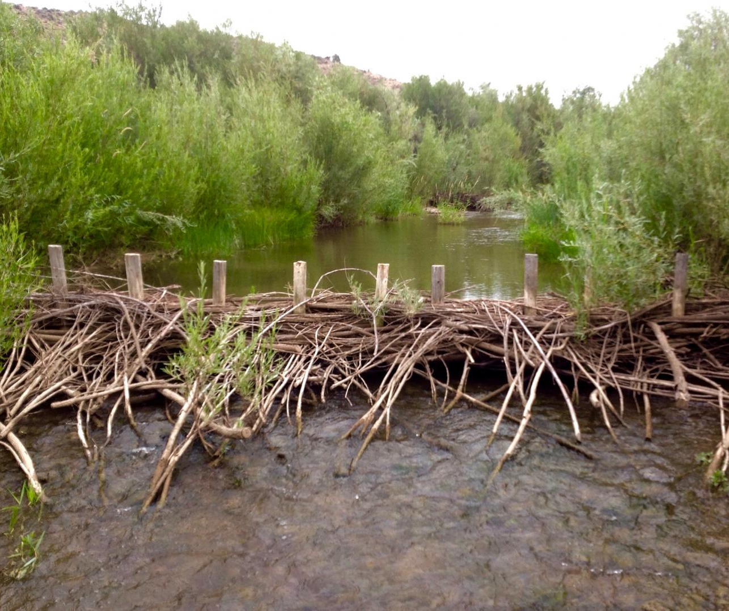
Examples of Mitigation
Diversion improvements
Alternate water sources
Leak detection and repair
SCADA systems
Habitat enhancement
Water right planning

Slide 24
Element 4: Response

Slide 25
Response Action Goal
Collaborative, voluntary, watershed-wide basis
All sectors participate
Regardless of vulnerability
Reduce impacts to communities, economies, and natural resources
The watershed is in Stage X drought.
We all rely on one watershed.
Here’s how drought is affecting the watershed.
Please use water wisely. Here’s how:

Slide 26
Types of Response Actions
Public outreach
Monitoring and evaluation
Water rights management
Water conservation
Emergency response

Slide 27
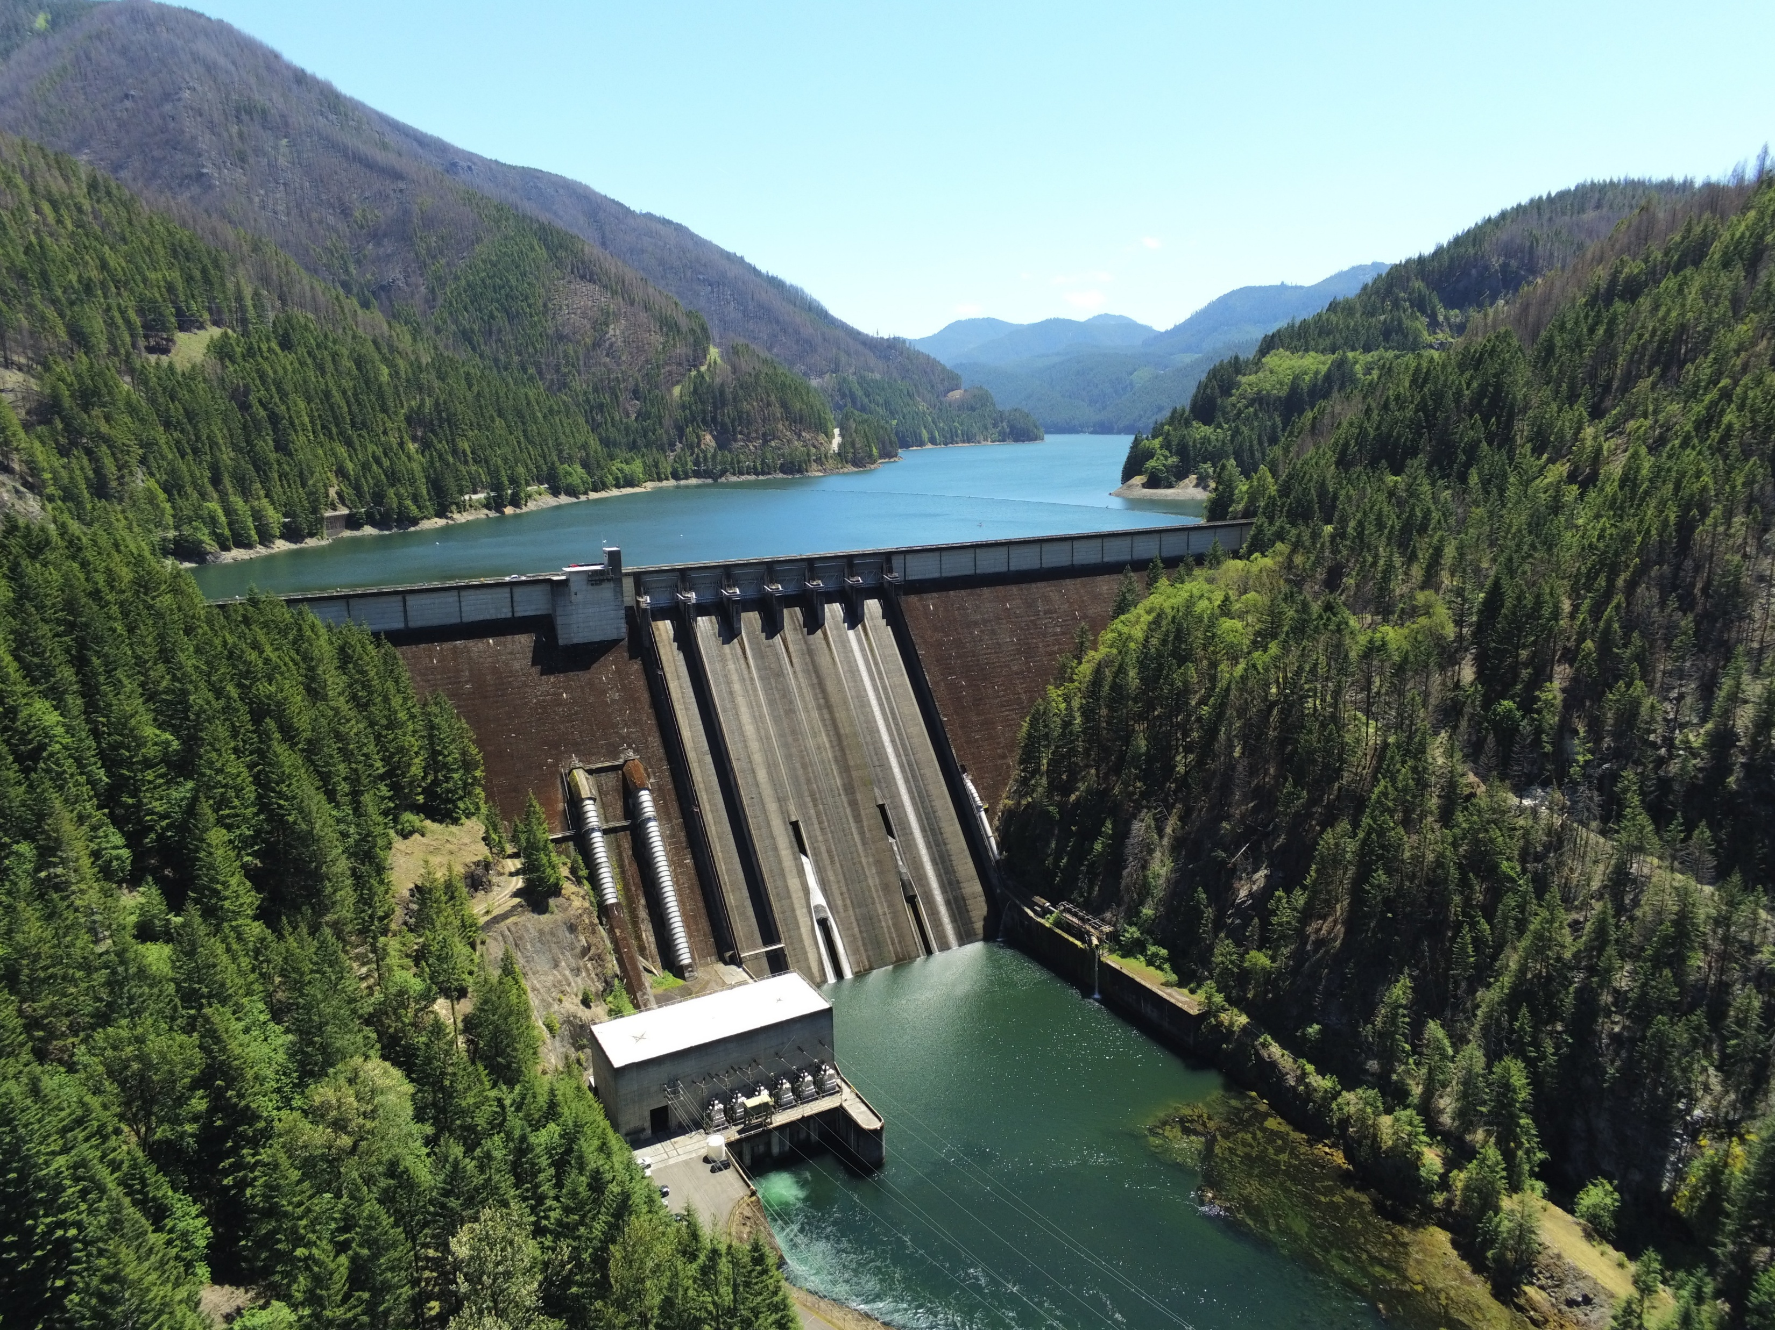
New Issues Identified
Lack of impact tracking
Governor-declared drought emergency
Fire recovery
FIRO at Detroit Reservoir

Slide 28
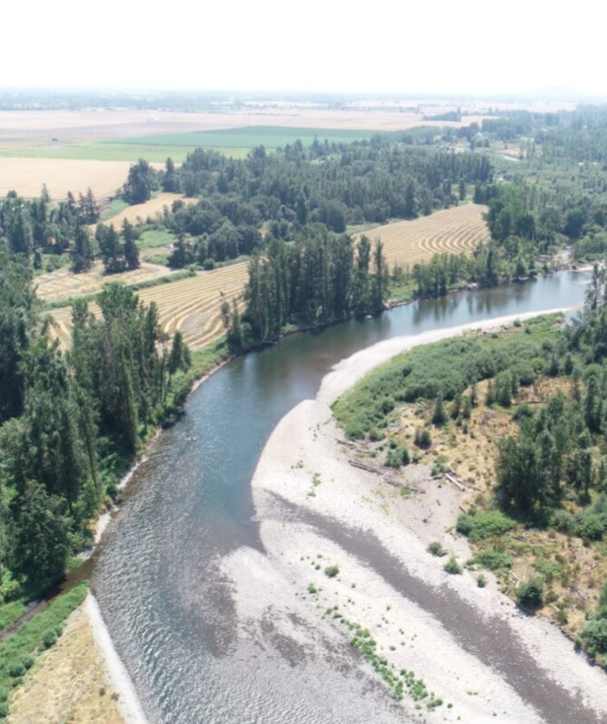
Proposed Changes
Water rights management tools applicability
Include funding sources
Update messaging and outreach materials

Slide 29
Element 5: Operational and Administrative Framework

Slide 30
Original Framework

Slide 31
Planning Element Groups
Monitoring Group
Mitigation Group
Response Group
DCP Update Group

Slide 32
Response and Drought Declaration Recommendations

Slide 33
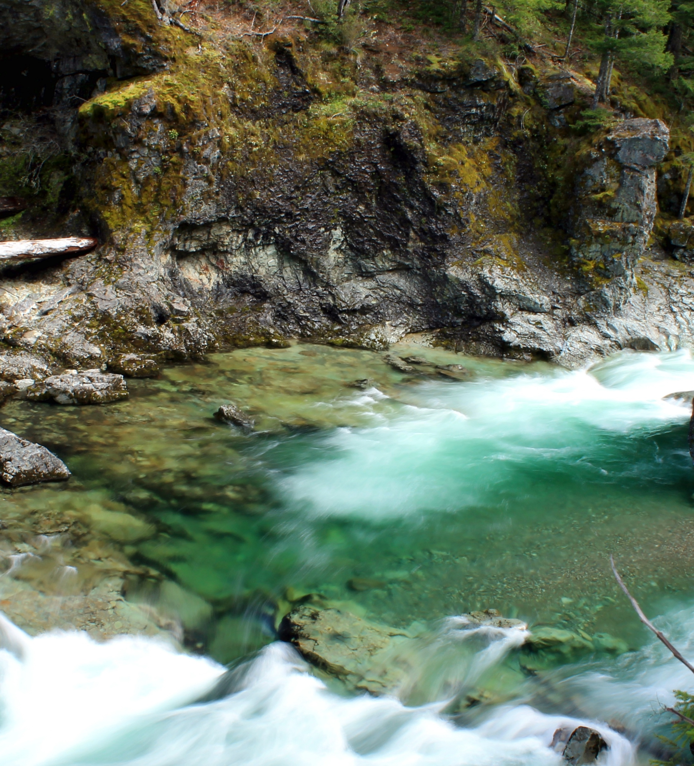
Improvements
Streamline!
Integrate with existing efforts
Council of Water Leaders
Partners of the North Santiam
Sedcor
Soil and Water Conservation District
Annual schedule

Slide 34
Annual Schedule: Non-Drought Conditions
Annual
Meeting on progress
Update contact list
Review outreach templates
Quarterly
Check status of mitigation actions
Update website
Notes for future updates
Monthly
Drought stage monitoring and reporting

Slide 35
Schedule During Drought
Monthly
Response group
Assess conditions and need for drought declaration
Biweekly/weekly
Drought monitoring and reporting
Outreach
Implement response actions
Track effectiveness
Post-drought
Convene and evaluate response
Notes for future updates

Slide 36
Key Takeaways

Slide 37
Key Takeaways
Relevant drought metrics vary by watershed
Consider underlying vulnerabilities
Work together
Strengthen mitigation and response
Less overwhelming
More likely to be accomplished
What works for you?
Infrastructure
Regulatory
Natural systems

Slide 38
Thank you! Questions?
Leah Cogan
lcogan@gsiws.com
971-200-8529

