Slide 1

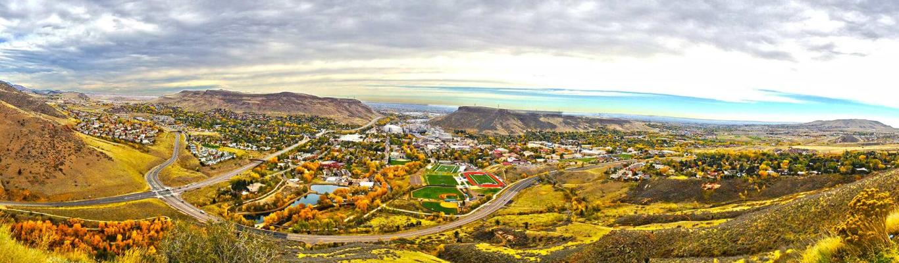
Using Water Quality Modeling to Improve Wildfire Resiliency
Libby McKenna
5/8/25

Slide 2
Wildfire Impacts on Water Quality
Filling Data Gaps with Modeling
Model Verification with Bench Testing
Demonstration of Model Dashboard
Outline

Slide 3
Wildfire Background

Slide 4
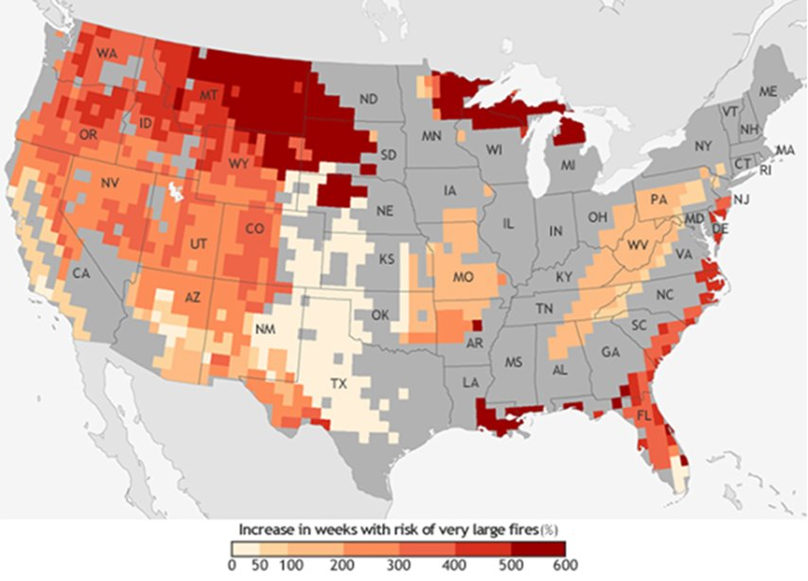
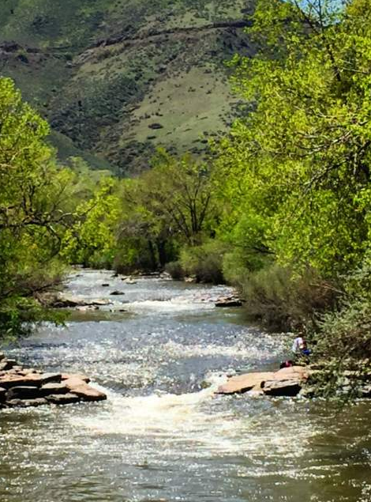
Building Resiliency for Wildfires
Driver: Ensure resiliency to fires
  Wildfire risk is increasing throughout the area
  Several large fires have impacted water supplies in the front range over the last 20 years
Case study: City of Golden
  Pristine water from Clear Creek
  Low alkalinity
  Low TOC and turbidity
Notes:
In parts of the country, they're looking at wildfires a lot. We know it has a significant impact on water quality and what you need to do with your treatment. But a lot of these techniques apply for other extreme events as well. If you’re prepared for wildfires, you’re prepared for other things too.
Wildfire risk incr. for golden, have pristine water, pressing to know how to deal w/challenging wq from wildfire
We know that wildfires result in an increase in turbidity, nutrients and metals which are all the things the facility wants to be prepared for, but this facility doesn’t have the historical water quality data to know what will happen during those events because they’ve had a pristine water source.

Slide 5
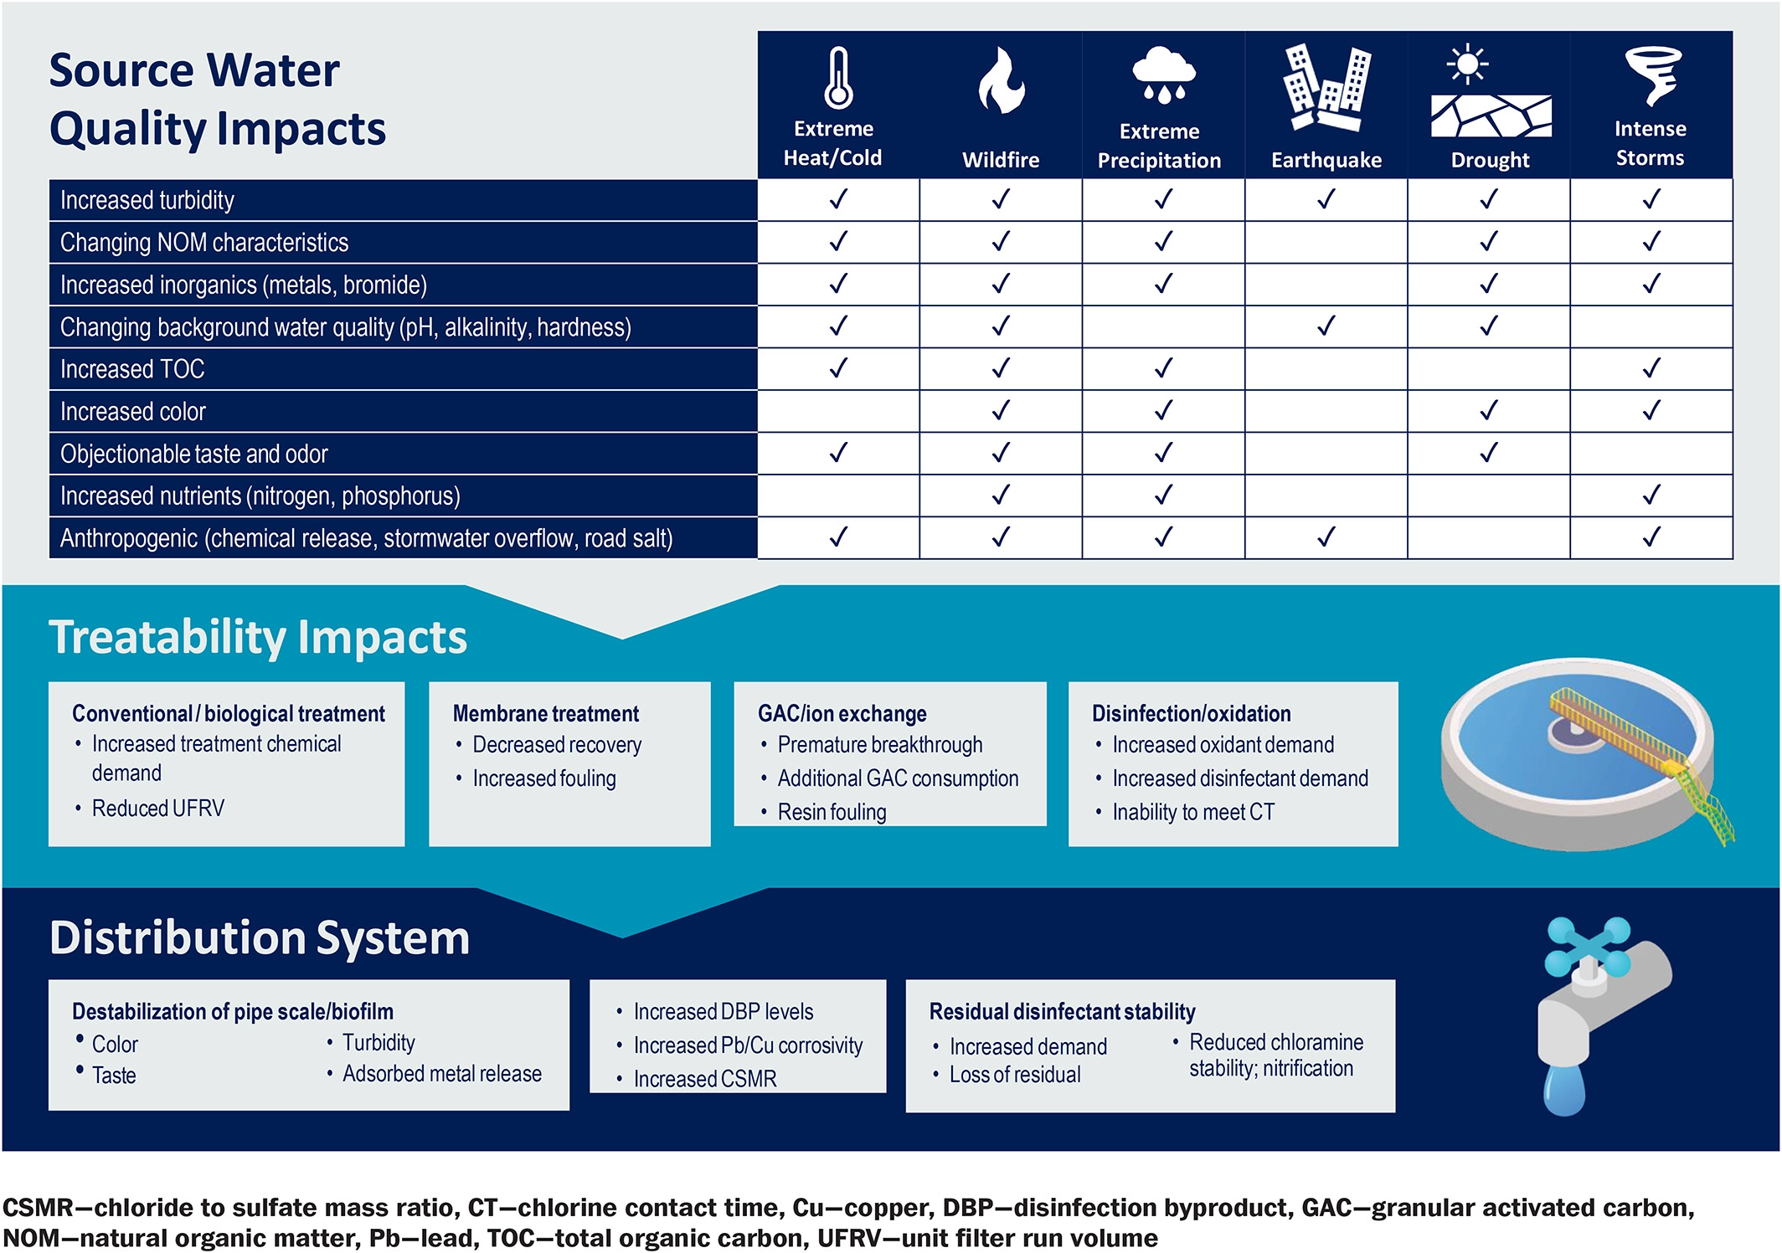
Preparing for wildfires also prepares utilities for other events
Page, S., Brandhuber, P., Dixit, F., Fennell, B., Goodwill, J.E. and Vlad, S. (2022), Extreme Events Increase Operational and Planning Complexity. J AWWA, 114: 78-82.
https://doi.org/10.1002/awwa.1925
Notes:
How will golden handle increased TOC, turbidity?
Turns out if you can optimize for the WQ impacts form a fire, you’ll probably be ok for other nat disasters
Changes in the wq params could impact treatability. Golden is a conventional wtp. If they get high toc and turb, there might be incr chemical demand to remove those.
Other plants might see increased fouling on their membranes or ix/GAC media
Might see impacts in DS. For golden, increased toc could mean in creased dbps.
Changed wq could also result in changes to corrosion or maybe T&O issues

Slide 6
What water quality should we plan for?
Estimated WQ Post-Wildfire for CO
Parameter | Challenging | Extreme*
pH/Alkalinity | Small increase | -
Turbidity | 6-15x | 640 NTU (249x)
DOC/TOC | 1.3-2x | 71 mg/L (10x)
Dissolved Manganese | 2.7-8.6x | 2.2 mg/L (156x)
Total Manganese | 6-25x | 110 mg/L (153x)
Nitrate | 2-3x | 12 mg/L (14x)
Total Phosphorus | 1.5-2.4x | 0.07 mg/L (9x)
Dissolved Iron | 1-1.6x | 0.2 mg/L (3x)
Total Iron | 2-14x | 32 mg/L (52x)
Challenging condition could happen long-term
  Usually need a plan to treat water in this range
Extreme condition may never happen, or may only happen with acute rainfall events
  Likely shut off plant intake if observed
Variability due to landscape and source water type
* Highest value observed in literature review
Notes:
Is any plant prepared to treat for turb 249x normal operating params? Or even just 15x? This is where modeling comes in. we usually don’t even have the wq to test this.
This lit came from CO fires. Extreme fires – not everyone will see, but it has happened.
Challenging: reasonable
Extreme: prepared to shut off intake. Just shut it off. All these values didn’t come from a single fire, came from lit review
Depends on the burned landscape too (disclaimer)

Slide 7
Filling Data Gaps with Modeling and Bench Testing

Slide 8
Modeling: How and Why?
Historical Data
Notes:
Use historical data to feed model. Why? to see if the model fits our data, then predict future treatment outcomes. ALSO, can help us narrow down what to test. In this case, bench testing
Use model to inform what real-world testing should be investigated (what looks most interesting from model results? What should be verified?)
2) Can then use bench testing to re-feed model. Does our model fit with these new results? Do we need to adjust the model?
Use bench scale results to verify model
Thought bubble: why? To add to slide
How can I plan for something ive never seen before

Slide 9
Modeling: How and Why?
?
Historical Data
Model
Why:
Predict future treatment outcomes
Narrow down testing scenarios
Notes:
Use historical data to feed model. Why? to see if the model fits our data, then predict future treatment outcomes. ALSO, can help us narrow down what to test. In this case, bench testing. “how can I plan for something the plant’s never seen?”
Use model to inform what real-world testing should be investigated (what looks most interesting from model results? What should be verified?)

Slide 10

Modeling: How and Why?
?
Historical Data
Model
Bench Scale Testing
Why:
Gather real-world data
Easier than testing at full-scale
Why:
Does the model still work with new data?
Adjust model to make better predictions
Notes:
Can then use bench testing to re-feed model. Does our model fit with these new results? Do we need to adjust the model?
Use bench scale results to verify model
Thought bubble: why? To add to slide
How can I plan for something ive never seen before

Slide 11
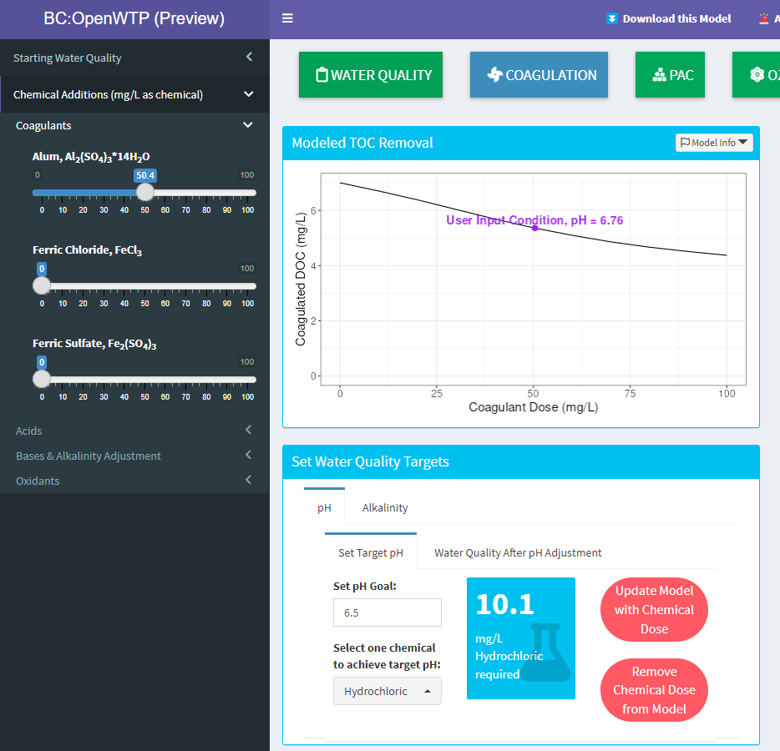
Water Process Modeling
Goals
  Screening tool for various pretreatment chemical operations
  Narrows down where to begin with full-scale treatment
  Provides initial performance prediction without data
Benefits
  Quick results
  Can model water quality that you don’t have (e.g., high organics)
Notes:
In this case:
Screen for new treatment operation
Where to begin at full or bench scale
Predict performance for a process or WQ you don’t have data for yet

Slide 12
Model Setup
Models
Inputs/Constraints
Outputs
  Coagulation TOC removal
    Edwards 1997
  Acid/Base Chemistry
  Challenging raw water quality
    Historical data
    Bench-scale testing
    Literature review
  TOC removal regulatory requirements
    Stage 1 DBP rule
  Post-coagulation TOC
  Required coagulant dose
  Required caustic dose
  Coagulated pH/alkalinity
Notes:
Models used: acid-base equilibrium chemistry model for understanding chemical impact on pH/alk
TOC rem
This facility doesn’t have historical data for an extreme fire event, so an extensive literature review was conducted to see how fires have impacted other water sources and bench scale testing was performed to get a better understanding of the treatment requirements. Some of the samples were spiked with ash to mimic the impact on water quality in the event of a fire.
And we are targeting the TOC removal required by the Stage 1 DBP rule.
For TOC removal, we used the Edward’s model which uses empirical data to represent the central tendencies of TOC removal.
And the output that we are looking for is the required coagulant dose, required caustic dose, Coagulated pH/Alkalinity, solids production, and chemical and solids costs.

Slide 13
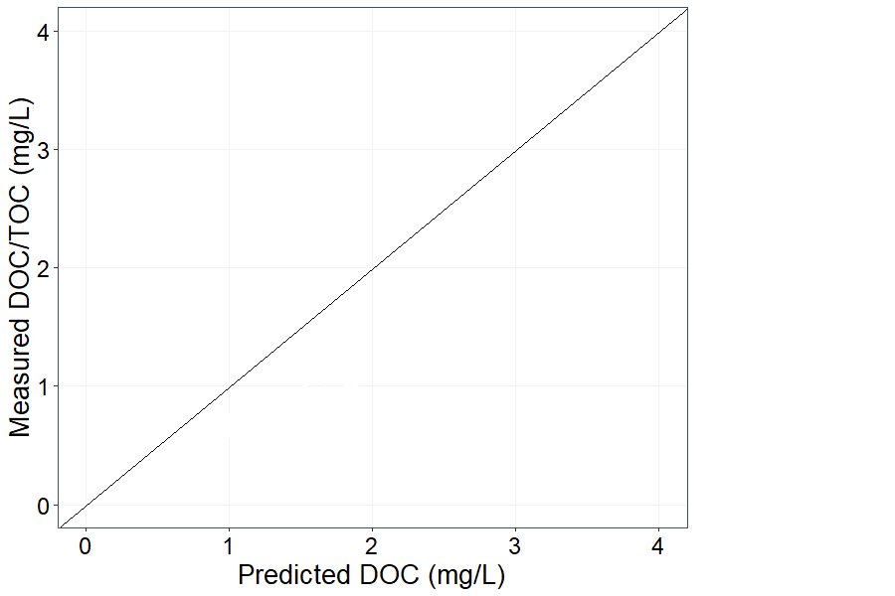
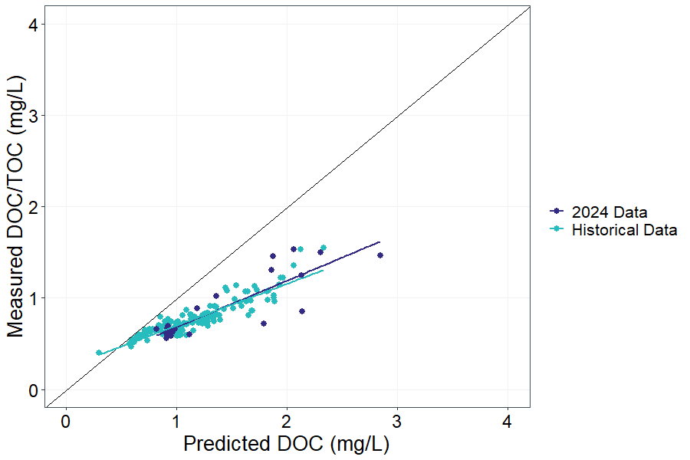
Compare model predictions to historical data
Right side is more amenable to treatment
Right side is more amenable to treatment
Historically, water is “easier to treat” than the central tendency
Notes:
Can see model isn’t a good fit for historical data/predicting historical performance w/o fitting, but is it a good fit for ash-impacted waters? Need to do bench testing to get this data
Ed not good for historical, but good for ash.
Can look at historical data – doc always low. Model not good prediction. But shows water is easy to treat

Slide 14
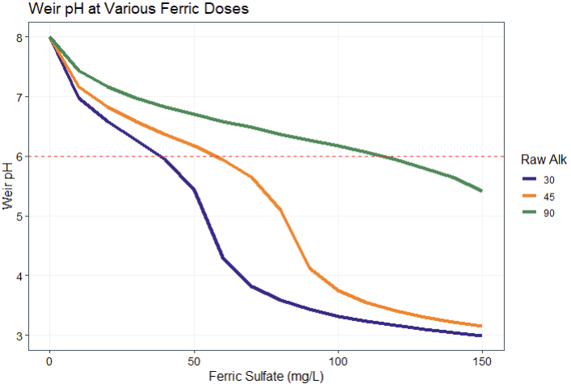
High coagulant doses expected to have large impact on pH
Settled Water pH at Various Ferric Doses
Caustic may be needed before coagulation to allow higher ferric doses.
Ash may increase alkalinity, but there’s limited data to know by how much
Raw Water Alkalinity
Settled Water pH
Notes:
Used historical pH/alk to understand how high coag doses would impact settled water pH/alk
Conclusions: at bench scale, will likely need to dose more than 60 mg/L of ferric to meet TOC rem goal
Increased to 90 when soaked ask in water. Realistic? Expected to get more alk from ash, low alk, high toc hard to treat
Golden’s alk so low, even with increased alk, might not be enough to buffer higher coag doses to remove toc turb

Slide 15
?
Historical Data
Model
Bench Scale Testing
Notes:
Use info from modeling to conduct tests. Specifically, we know what chems and alk to start with

Slide 16
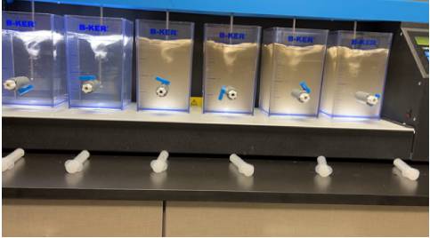
Bench Testing
Goals
  Evaluate treatment with ash impacted waters
  Develop water quality data for modeling
Benefits
  Test wider range of conditions than observed at full scale
  Faster results than full scale
  Safer than full scale
Notes:
Model gave us which chemicals to use

Slide 17
Bench Testing:
Ash Spiking
Source Water Characterization
Parameter | Units | Clear Creek | Ash Spiked | Increase Factor
pH |  | 7.36 | 8.2 | 1.1
Alkalinity | mg/L CaCO3 | 43.6 | 89.1 | 2
Turbidity | NTU | 1.5 | 76 | 51
Fe-T | mg/L | 0.1 | 0.23 | 2.3
Mn-T | mg/L | 0.104 | 0.205 | 2
Fe-D | mg/L | 0.03 | 0.02 | -
Mn-D | mg/L | 0.068 | 0.017 | -
TOC | mg/L | 1.3 | 4.3 | 3.3
DOC | mg/L | 0.91 | 3.23 | 3.5
UV254 (filtered) | cm⁻¹ | 0.025 | 0.16 | -
Zeta potential | mV | -27.9 | -24.5 | -
Ammonia | mg/L | 0.021 | 0.213 | -
Nitrite | mg/L | 0.001 | 0.022 | 22
Nitrate | mg/L | 0.148 | 0.484 | 3.3
Bromide | ug/L | 58 | 83 | 1.4
Ash harvested from recent nearby fire
Ash spiked directly into source water to create challenging water quality
Ash spiking method from WRF 5168 study
  10 g/L ash
  Mix for 1 hour
  Settle for 24 hours
  Decant
Notes:
The ash spiking isn’t necessarily representative of what we would see from a wildfire, but it gives us a water with high organics and turbidity that should have similar characteristics to the water after a fire.
Impart organics from ash.
Settling – simulates reservoir. All before it gets to plant
Going to show you the results of these bench testing results in the context of model
Actual results
looked at Correlating DOC with zeta (yes correlation. No for turb)
Fuond higher coag doses needed to max doc removal
Sulfuric acid not needed – coag

Slide 18
Bench Testing:
Jars
Range of ferric sulfate
Added polymer to some jars
Caustic not needed due to alkalinity from ash
Notes:
Actual results
looked at Correlating DOC with zeta (yes correlation. No for turb)
Fuond higher coag doses needed to max doc removal
Sulfuric acid not needed – coag

Slide 19
?
Historical Data
Model
Bench Scale Testing
Notes:
Use bench scale results to fit model, or in this case

Slide 20
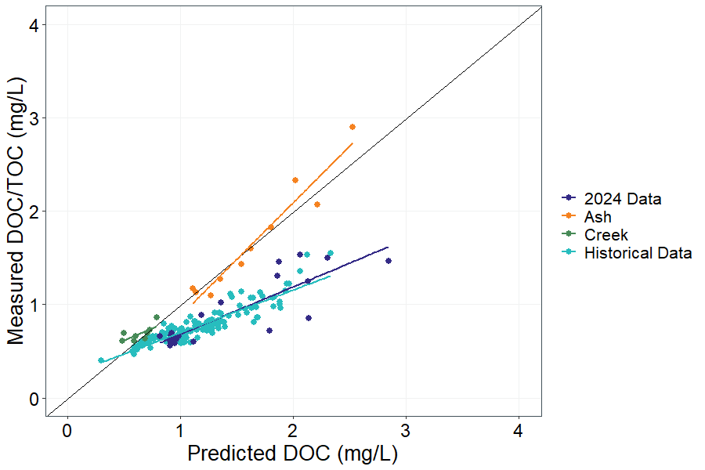
Compare bench scale testing to model
Ash-spiked water fell on the 1:1 line
  “Harder” to treat than usual
  Model provides good prediction
Notes:
the ash spiked samples evaluated during bench scale testing are a fairly good fit along the central tendencies. Meaning the model should be a good predictor of DOC removal in the event of a fire.
Harder to remove DOC than what plant is used to.
Add Edwards eq. know toc rem is fn of all these parameters. Hard to analyze, too many variables. How well does model perform? Plant does better than model.
Know that character of organics is important, hard to capture. CAN capture toc, ph etc, correct those to understand character of organics
Show highest raw toc was ~2

Slide 21
Model coagulation TOC removal
(target Settled Water Alkalinity >20 mg/L)
Raw DOC (mg/L) | Raw Alkalinity (mg/L) | Raw pH | Min. Ferric Dose (mg/L)* | Caustic Dose (mg/L) | Settled Water pH | Final DOC (mg/L) | TOC removal Required | Actual TOC Removal
3.2 | 30 | 7.5 | 60 | 22 | 6.6 | 2.0 | 35% | 37.5%
 | 45 | 7.5-8.5 | 50 | 1.5 | 6.2 | 2.0 | 35% | 37.5%
*Minimum ferric dose required for TOC removal
Notes:
Modeled scenarios with what we saw with jars, but low alk

Slide 22
Model coagulation TOC removal
(target Settled Water Alkalinity >20 mg/L)
Raw DOC (mg/L) | Raw Alkalinity (mg/L) | Raw pH | Min. Ferric Dose (mg/L)* | Caustic Dose (mg/L) | Settled Water pH | Final DOC (mg/L) | TOC removal Required | Actual TOC Removal
3.2 | 30 | 7.5 | 60 | 22 | 6.6 | 2.0 | 35% | 37.5%
 | 45 | 7.5-8.5 | 50 | 1.5 | 6.2 | 2.0 | 35% | 37.5%
5 | 30 | 7.5-8.5 | 110 | 40 | 6.6 | 2.7 | 45% | 46%
 | 45 | 7.5-8.5 | 80 | 15 | 6.2 | 2.6 | 45% | 48%
8 | 30 | 7.5 | 110 | 40 | 6.6 | 4.3 | 45% | 46%
 | 45 | 7.5-8.0 | 80 | 14 | 6.2 | 4.3 | 45% | 46%
*Minimum ferric dose required for TOC removal
Notes:
This is an excerpt of the data (range alk 6-8, range alk, range ferricl). First row is what we actually tested using jars, and show that the results were a good fit with model
Need caustic to support
What ferric doses and caustic doses do we actually need? Used model.
If not good fit, would have fit to bench data.
Use model to determine coagulant required for TOC removal
Fit model to historical or bench-scale data when possible
Use model to determine whether pH/alkalinity adjustment is needed

Slide 23
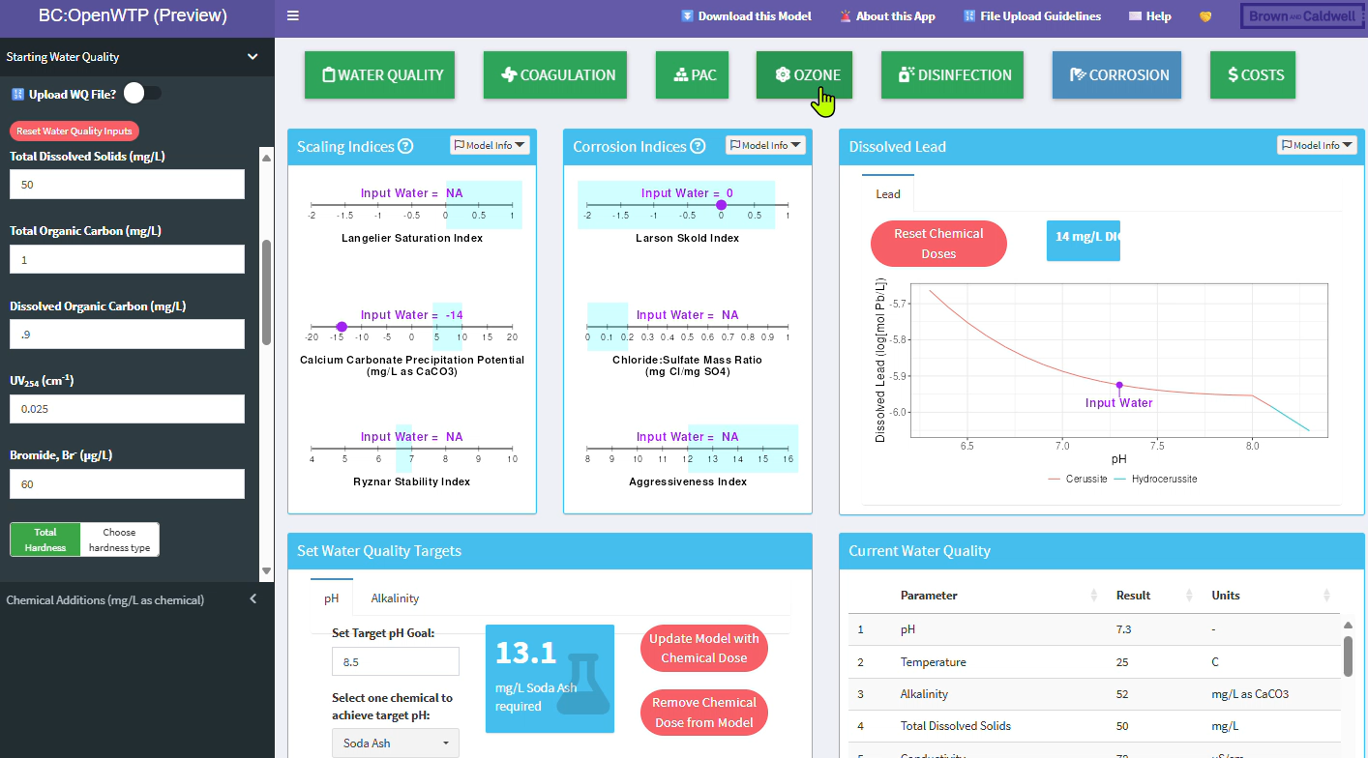

For screening level predictions, use the free BC:OpenWTP app
bit.ly/BCOpenWTP
Notes:
This is a quick overview of that dashboard. You can input the raw water TOC and DOC
And input your coagulant dose to see what the resulting pH, Alkalinity, and DOC
We can bump up raw water DOC and alum dose even further. The dashboard can also look at chemical cost projections by inputting dose, cost, and flow.

Slide 24
Modeling Conclusions
Historical treatment data can help develop a good model for theoretical scenarios
Model helped narrow down bench testing scenarios
Verified model with bench scale testing and gained better understanding of how the WTP will respond during wildfire
Notes:
From this evaluation we developed a wildfire action plan. A few of the key recommendations from this action plan are to increase monitoring in case of an event to know what changes occur in the water quality.
Use bench scale testing to better understand the impact of the event
And to use BC:OpenWTP to predict trends. For this project we created a dashboard that allows operators to adjust raw water quality and chemical dosing for screening level predictions.

Slide 25



  Laurie Sullivan, PE
  Western Drinking Water Practice Leader
  Sierra Johnson, PE
  Environmental Engineer
  Karmin Hinojos
  Process mechanical engineer
Acknowledgements
Notes:
Acknowledge at end – is there a template? Might require a bio?

Slide 26


Try BC:OpenWTP!
Try the free web app!
bit.ly/BCOpenWTP
Are you an R user? Install the R package directly in your RStudio:
install.packages
("tidywater")
View or contribute to the source code on GitHub:
Contact the development team with questions or feedback:
Sierra Johnson: sjohnson2@brwncald.com
Libby McKenna: lmckenna@brwncald.com
Notes:
So try it out!
On the screen we have a QR codes to preview the OpenWTP Dashboard, as well as a link to our source code and the function to download the code directly to Rstudio.
This information is also available in the handout available to take with you.

Slide 27

Thank you.
Questions?

Slide 28


Slide 29
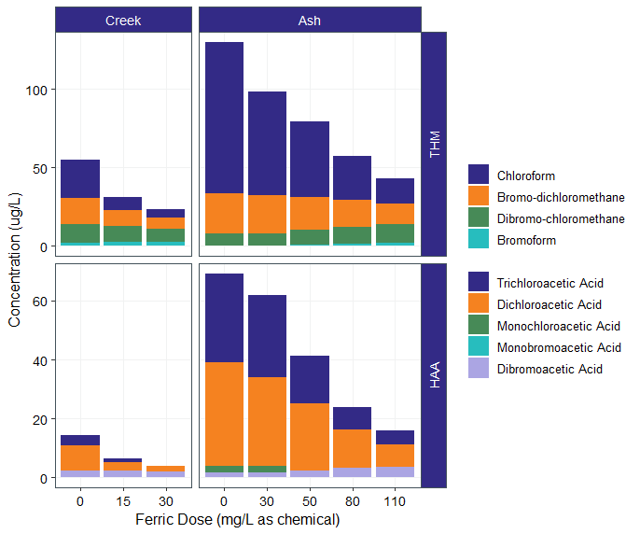
Ash-spiked waters formed higher DBPs, especially chloroform
Uniform formation conditions:
  1 mg/L chlorine residual
  24 hour hold time
  Not representative of distribution system
Mostly chlorinated (not brominated) species
0 25 50 0 50 83 133 183
Ferric Doses (as product)
Notes:
Note that the starting point is a dose of 0 – raw water.

Slide 30
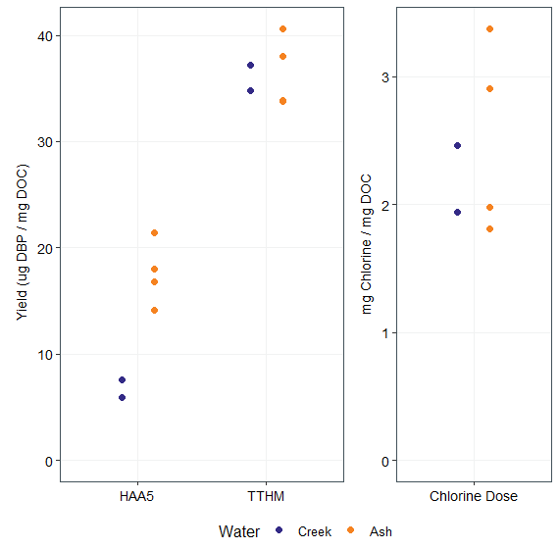
HAA5 yield increases with ash spiking
TTHM yield and chlorine demand do not
Yield = DBP / DOC
  Normalized view of how “reactive” the organics are
TTHM yield was the same
  Low TOC will control TTHM formation
HAA5 yield was higher with ash spiking
  Could cause problems even if TOC removal is met. Likely okay because Golden has low HAA5 results typically.
Additional testing with simulated distribution system will give better indication of concentrations

Slide 31
Water Quality Changes Impacts on Treatment
Increase sampling of raw water parameters to capture concentration peaks during snowmelt and short-duration spikes during rain events
Higher coagulant doses (+10 mg/L alum on average)
Higher oxidant demand results in higher chlorine doses.
SOURCE WATER
COAGULATION
FILTRATION
DISINFECTION
FLOCCULATION
SEDIMENTATION
Increased nutrient loading causes increased T&O due to algae growth
Higher polymer doses to increase settleability
Filters affected by increased turbidity and NOM, leading to higher head loss and shorter filter runs. Recommendations include using deeper bed filters with larger media and ensuring adequate backwash water and waste storage.
Increased solids may improve flocculation, but be prepared to handle higher solids loads and potential settling in flocculation tanks.
Automated sludge removal recommended to manage increased solids production.

Slide 32
Step 1: Estimate required chemical doses
Use model to determine coagulant required for TOC removal
  Fit model to historical or bench-scale data when possible
Use model to determine whether pH/alkalinity adjustment is needed
Repeat calculations for other chemical types (eg, permanganate, chlorine)
Minimum ferric dose required to meet regulatory TOC removal requirements
Raw DOC (mg/L) | Raw Alkalinity (mg/L as CaCO₃) | Ferric Dose (mg/L as product) | Caustic Required? | Weir pH | Weir Alkalinity (mg/L as CaCO₃)
2.5 | 45 | 50 | - | 6.5 | 30
3.2 | 45 | 83 | - | 6.1 | 18
5 | 45 | 117 | Yes | 6.0 | 14
Notes:
This is an excerpt of the data (we actually tested hundreds of scenarios)

Slide 33
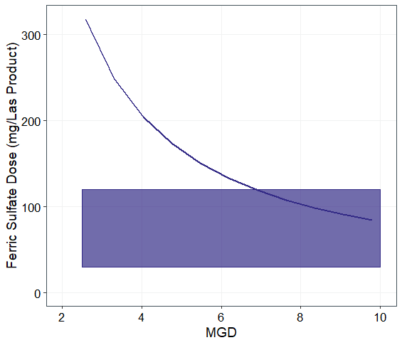
Step 2: Compare doses to plant capacity
Chemical feed pumps
Line is maximum pump capacity
Band is range of doses from step 1
Plant must maintain flows < 6 MGD during highest TOC event
Notes:
Rectangles are the ranges predicted from the previous slide

Slide 34
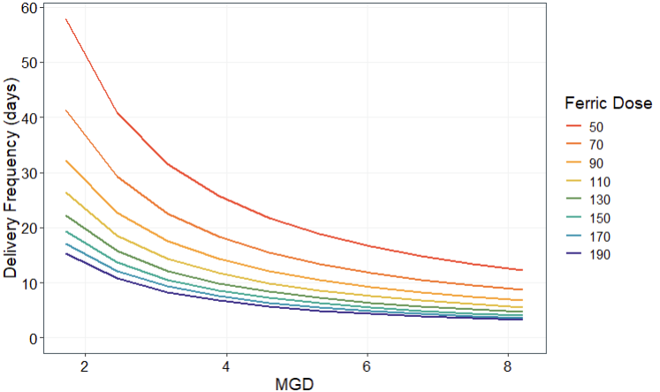
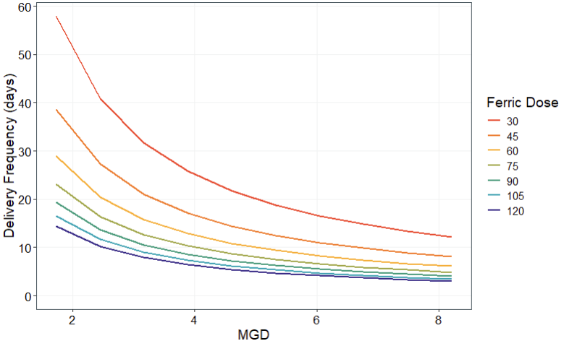
Step 2: Compare doses to plant capacity
Chemical Storage
At flows <6 MGD and high chemical doses, ferric must be delivered ~weekly
Ferric Dose as Product

Slide 35
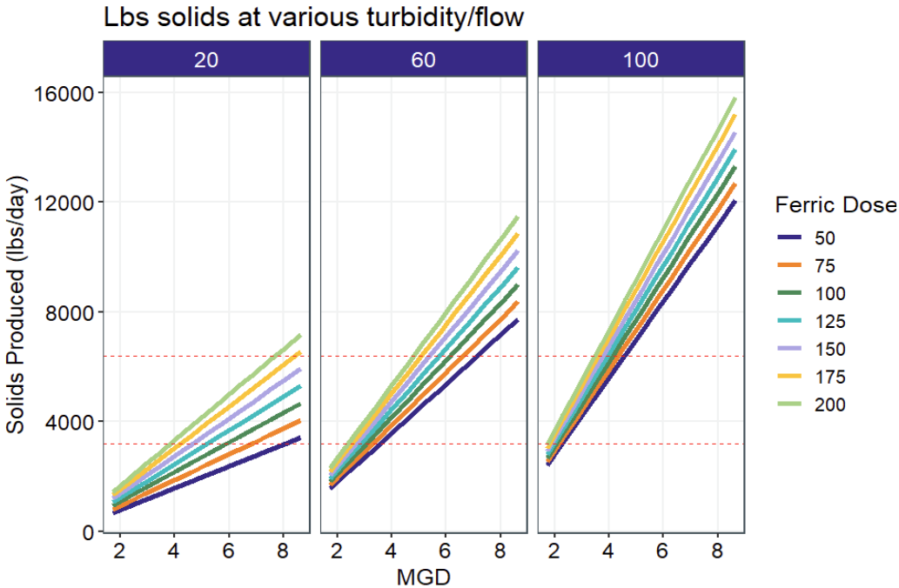
Step 3: Evaluate Residuals Handling
Belt Press Capacity
High turbidity will exceed belt press capacity even at 4 MGD
Mitigation options:
  24/7 belt press operation
  Shut off plant intake at >60 NTU, use raw water ponds for settling to decrease turbidity
  Utilize sludge box to store excess residuals
Ferric Dose as product
At 1 or 2 runs per day

Slide 36
Literature Review Sources
Literature Review Sources
Source | Location | Data provided
“The Impacts of Forest Fires on Drinking Water Quality” (Gill 2004) | Hayman Fire (2002) - Colorado | WQ data pre- and post-wildfire Data collected for two years post-wildfire
“The Role of Precipitation type, intensity and Spatial Distribution in Source Water Quality after Wildfire” (Murphy et al 2015) | Fourmile Canyon Fire (2010) – Colorado | WQ data specific to storms upstream and downstream of wildfire impacted area. Data collected for 3 years post-wildfire
“Water Quality Response to a High-Elevation Wildfire in the Colorado Front Range” (Mast et al 2015) | Fern Lake Fire (2012) - Colorado | High elevation fire provides WQ data pre- and post-wildfire Data collected weekly for 2 years post-wildfire
“Drinking Water Treatment Response Following a CO Wildfire” (Hohner et al 2016) | High Park Fire (2012) - Colorado | WQ data pre- and post-wildfire Data collected biweekly & monthly for 1 year post-wildfire Rainstorm samples collected and treated with alum

Slide 37
Literature Review Sources
Literature Review Sources
Source | Location | Data provided
“Wildfire Impacts on DW Treatment Process Performance: Development of Evaluation Protocols & Management Practices” (Hohner et al 2018) | High Park Fire (2012) - Colorado | WQ data 3 years post-wildfire Data collected biweekly during snowmelt and monthly Provides design recommendations for preparation of wildfires
“Incident Action Checklist-Wildfire” – (EPA 2015) | - | Provides action items to prepare, respond, and recover from a wildfire.
“Mitigate Wildfire Impacts on Drinking Water Quality and Operations” (Tran et al. 2021) | California | Summarizes the impacts of wildfires and provides action items to prepare, respond, and recover from a wildfire.

Slide 38
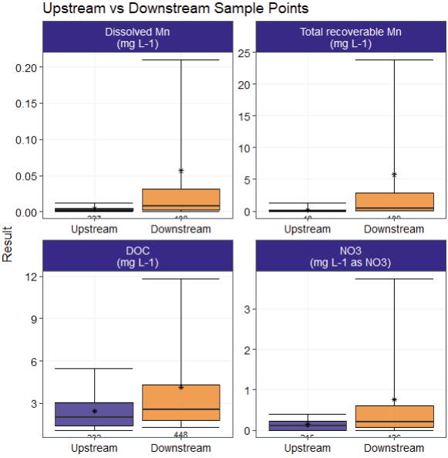
Fourmile Canyon Fire (2010)
(Murphy et al 2015)
A 2,370ha fire burned 23% of the Fourmile Creek watershed.
Data collected for 3 years after wildfire and compared to sample points upstream of burned watershed.
Maximum concentrations observed:
  Diss. Mn. = 2.2 mg/L
  Total Mn. = 106 mg/L
  DOC = 71.1 mg/L
  NO3 = 12.4 mg/L

Slide 39
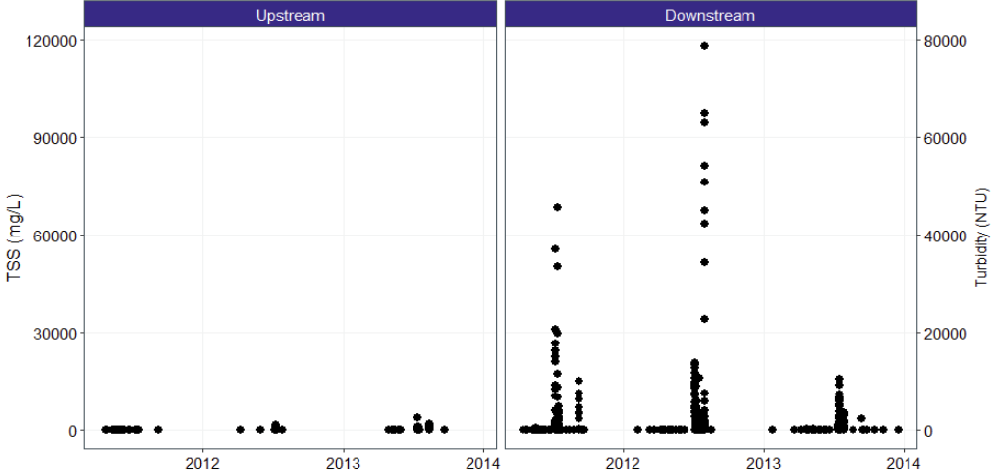
Fourmile Canyon Fire (2010)
TSS concentrations reached a maximum of 120,000 mg/L when rainfall intensity was >30 mm/hr (TSS = 1.5x Turbidity)
Annual sediment yields were magnified by storm events.

Slide 40
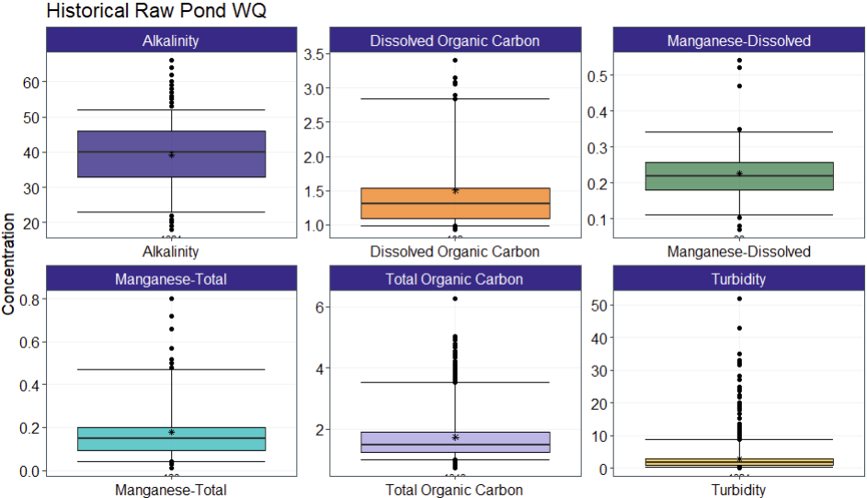
Golden’s Historical Raw Water Quality

Slide 41
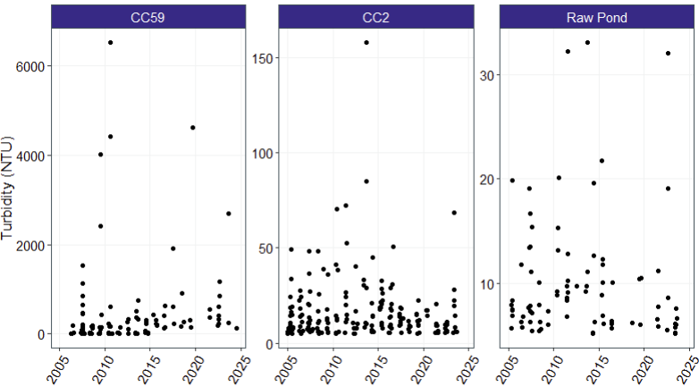
All Storm Sampler Data “CC59”
Highest turbidity levels recorded:
  Creek - 6520 NTU
  CC2 – 158 NTU
Golden has not treated higher than 50 NTU through the plant

Slide 42
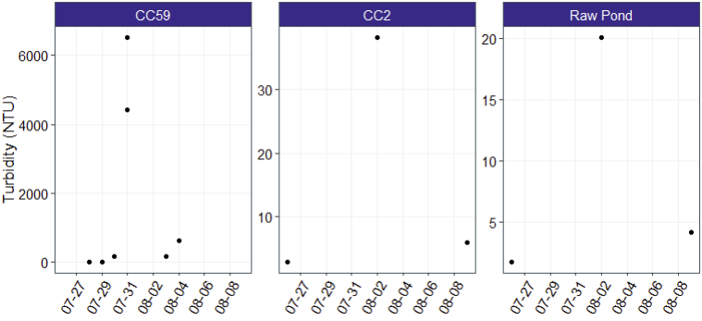
Storm Sampler Data – Turbidity Close-up
Peak turbidity lasted ~ 30 minutes in the creek (sampler only measures above 100 NTU)
High turbidity value recorded in raw pond 2 days later

Slide 43
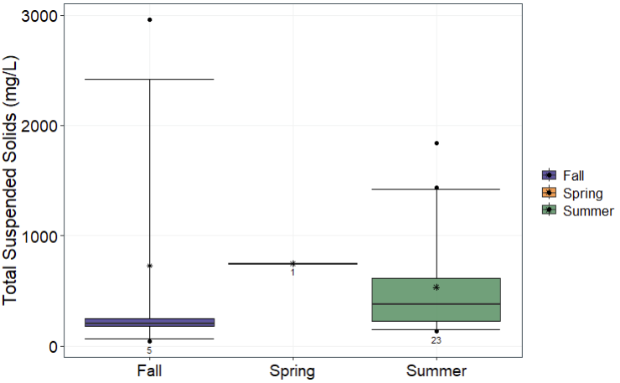
Storm Sampler Data - TSS
Literature review of TSS samples found factors of increase ranging from 6-40x.
Fourmile Canyon Fire recorded up to 120,000 mg/L.

Slide 44
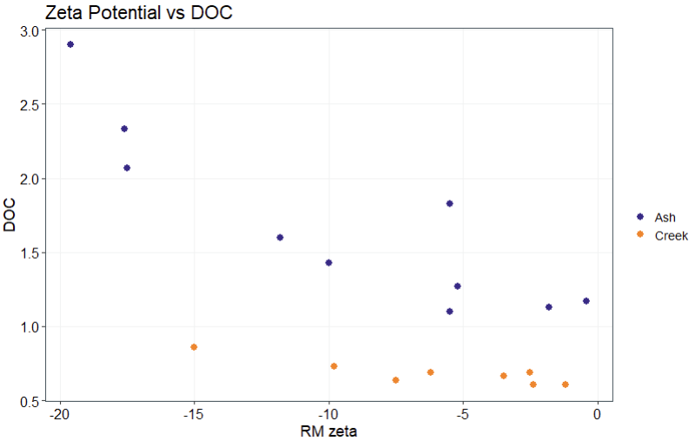
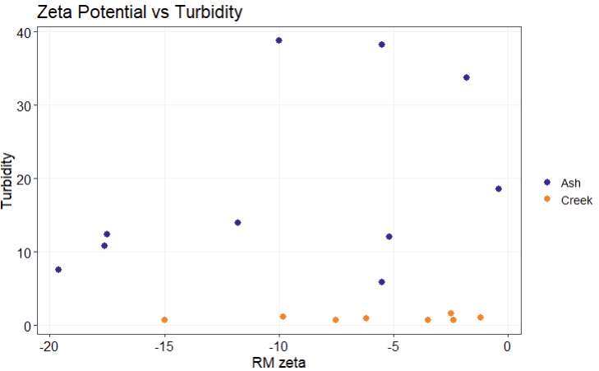
DOC removal correlates with zeta potential
Turbidity – no correlation?
Zeta potential of approx. -5 maximizes DOC removal
Three batches of jars – inconsistent turbidity?

Slide 45
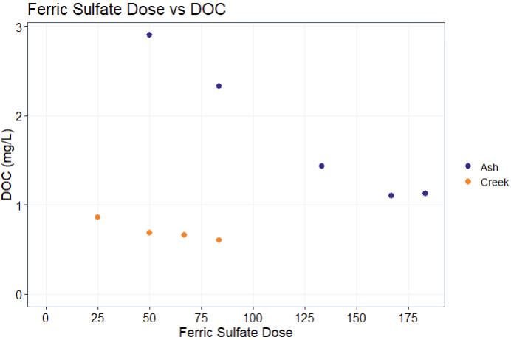
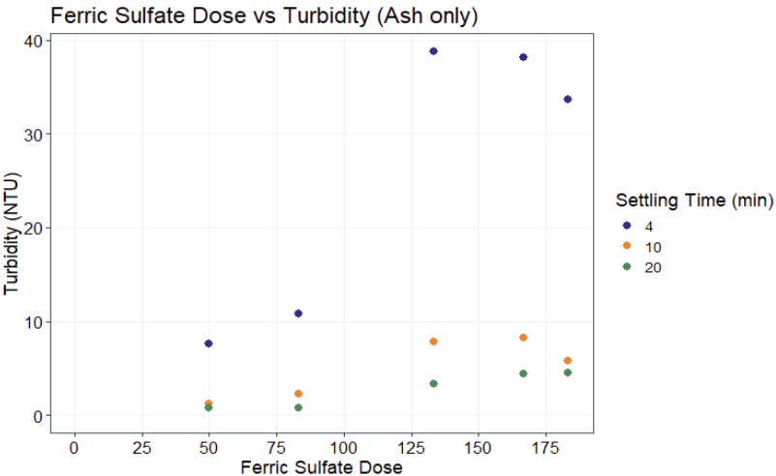
Higher coagulant doses maximize DOC removal but reduce turbidity removal
Lab observed good settling in jars
Lab observed poor settling in jars
Notes:
Settling time doesn’t directly translate between jars and full-scale
4 min in jar matches plant (based on surface overflow rate) but isn’t 4 minutes in the plant

Slide 46
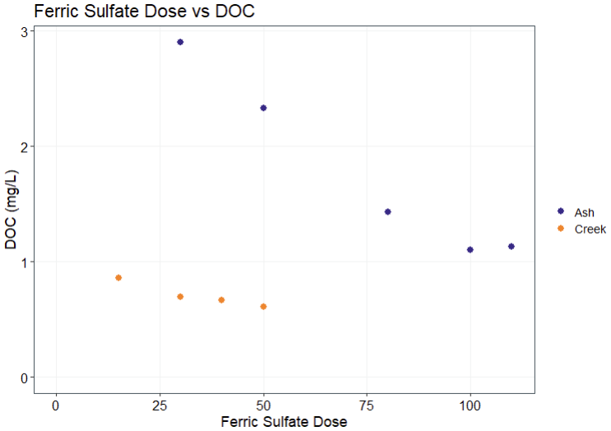
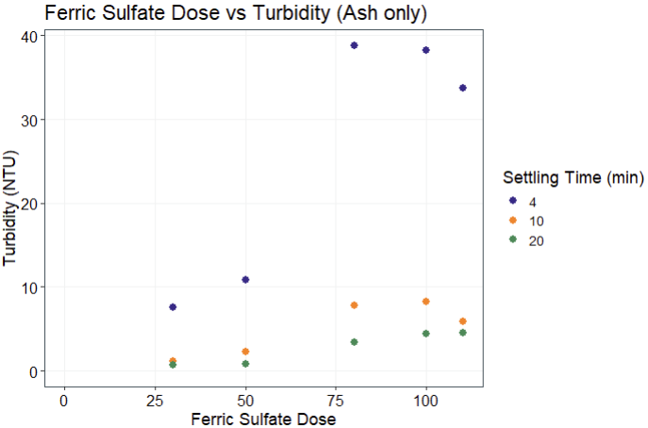
Higher coagulant doses maximize DOC removal but reduce turbidity removal
Lab observed good settling in jars
Lab observed poor settling in jars
Ferric dosed “as chemical”
Notes:
Settling time doesn’t directly translate between jars and full-scale
4 min in jar matches plant (based on surface overflow rate) but isn’t 4 minutes in the plant

Slide 47
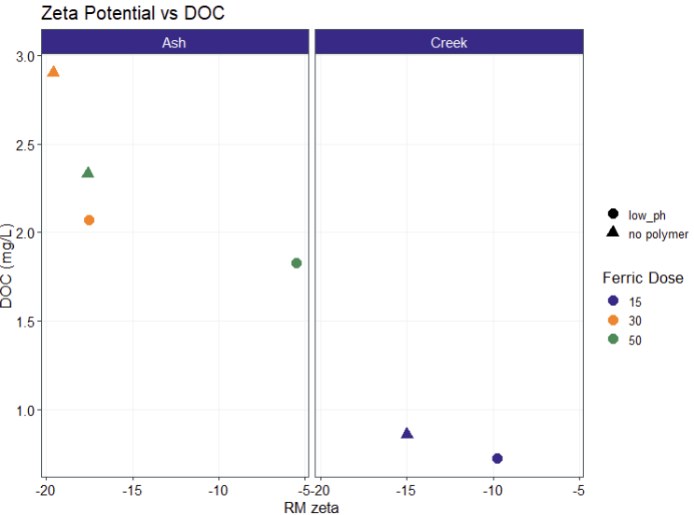
Adding sulfuric acid to lower pH increases DOC removal and lowers zeta
  Zetapotential is a good indicator for DOC removal, even with pH changing
  Impact of pH control on turbidity removal was inconclusive
  Lower ferric doses result in equivalent DOC removal with sulfuric added

Slide 48
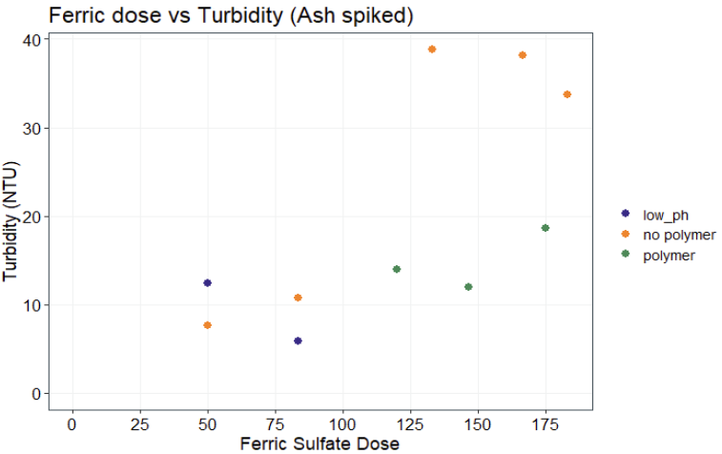
Polymer addition improves turbidity removal
  Inconclusive for DOC
  Testing limited to 1 mg/L because of acrylamide polymer
  Recommend testing higher doses for increased turbidity removal and possible impact on zeta (and DOC) at higher coagulant doses

Slide 49
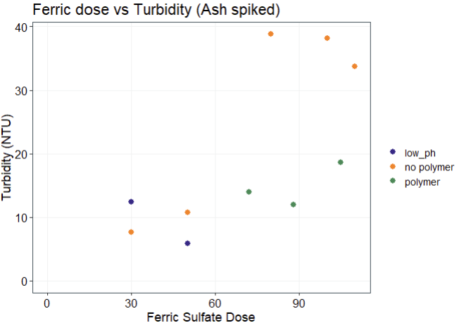
Polymer addition improves turbidity removal
  Inconclusive for DOC
  Testing limited to 1 mg/L because of acrylamide polymer
  Recommend testing higher doses for increased turbidity removal and possible impact on zeta (and DOC) at higher coagulant doses
Ferric dosed “as chemical”

Slide 50
Recommended follow up testing
Identify different polymer and test higher doses. Recommend reaching out to local utilities and identifying what polymers they are using.
Run more low alum doses to get a comprehensive turbidity and zetapotential curves
Simulated distribution system testing for estimates of DBP formation

