Slide 1
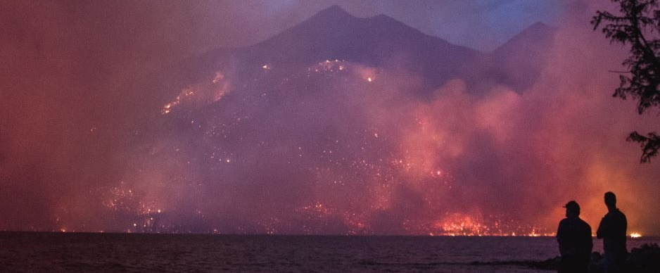
Tyler Bird, PE
William Becker, PhD, PE
Wildfires and Impacts to Water Quality/Treatment
Preparing for the Future
Notes:
Howe Ridge Fire across Lake McDonald in Montana’s Glacier National Park (August 12, 2018)

Slide 2
Wildfire Overview and General Trends
Lessons Learned from High Park Fire – Fort Collins, Colorado
Treatment Considerations
Recommendations and Conclusions

Slide 3
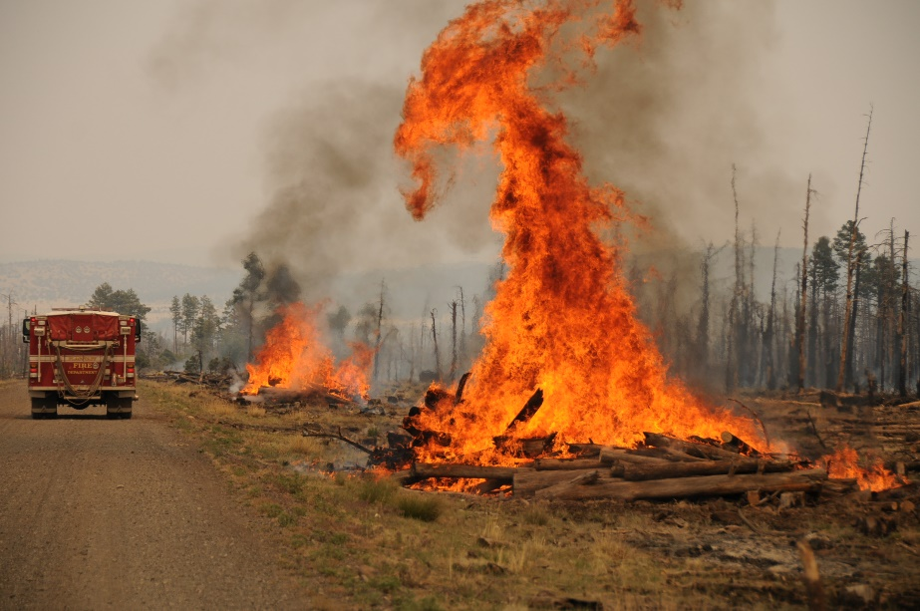
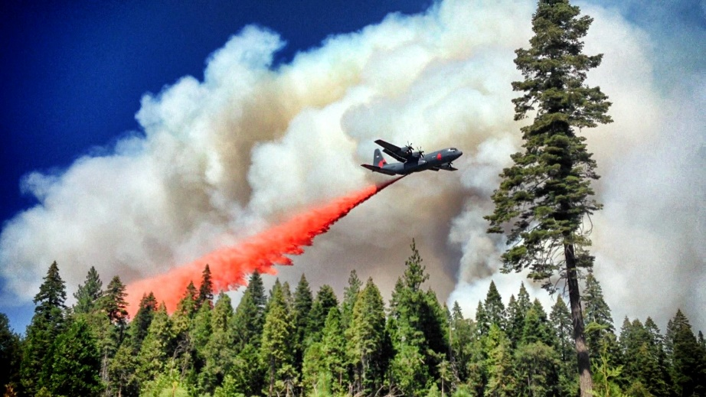
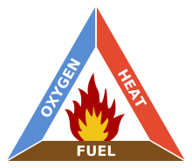
Wildfire
Any uncontrolled fire of combustible vegetation in rural areas
420-million-year history
Intrinsic result of nature’s atmosphere, land cover, geology, and weather
Notes:
Atmosphere = O2, land cover = plants, geology = volcano, weather = lightning. Fire triangle: Wildfires occur when all the necessary elements of a fire triangle come together in a susceptible area: an ignition source is brought into contact with a combustible material such as vegetation, that is subjected to enough heat and has an adequate supply of oxygen from the ambient air. Usually grasses/herbaceous environments more suspectable because forested areas are shaded (and thus cooler) and are more humid within the understory, so it’s harder to combust.
420-million-year history in fossil records

Slide 4
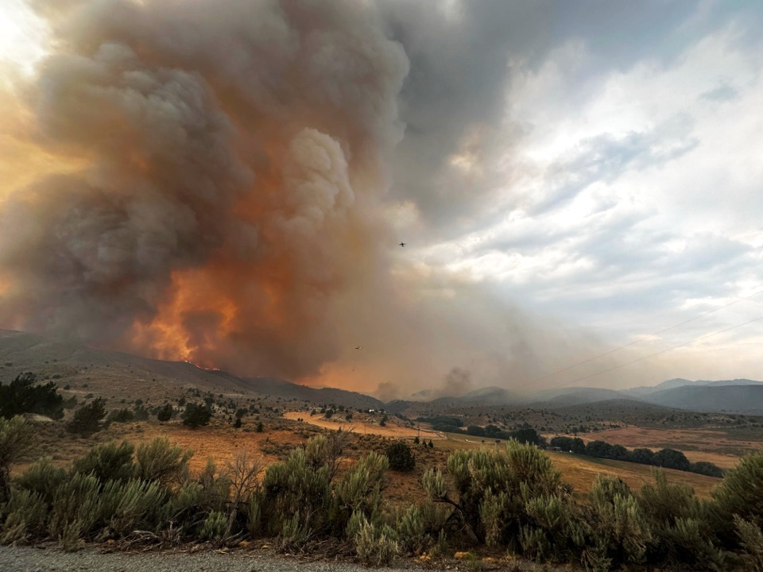
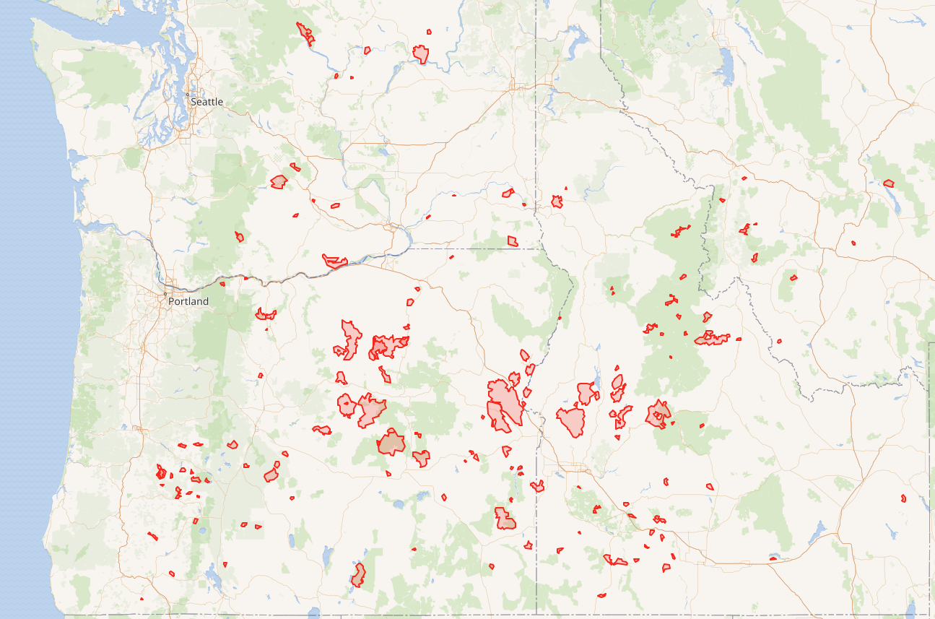
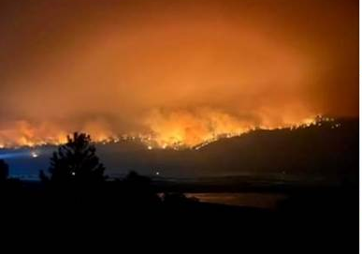
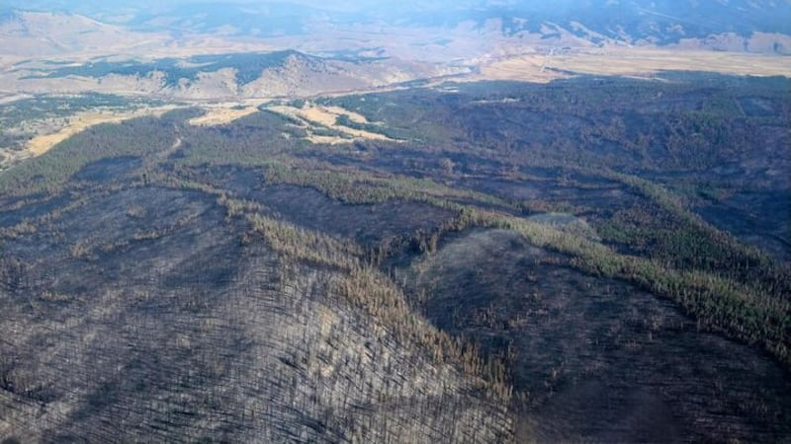
2024 PNW Wildfires
2024 Durkee Fire, Baker County, Oregon
(~ 300,000 acres burned)
From 2024_Wildfire_Map
(163 fires in 2024 with total of 3.2M acres burned)
2024 Wapiti Fire, Grandjean, Idaho
(~ 130,000 acres burned)
2024 Lava/Boulder Fire, Cascade, Idaho
(~100,000 acres burned)
Notes:
2024 was a rough year. Discuss first hand experience with increase in fires in recent years. Extremely bad air quality numerous fires. Resulting in burned out areas
https://en.wikipedia.org/wiki/2024_Idaho_wildfires#/map/0
62 fires in 2024 in Idaho that burned more than 1,000 acres
76 fires in 2024 in Oregon that burned more than 1,000 acres
25 fires in 2024 in Washington that burned more than 1,000 acres
This fire potential was partially due to the two previous winters being wet, leading to a large amount of extra brush and plants to grow.[

Slide 5
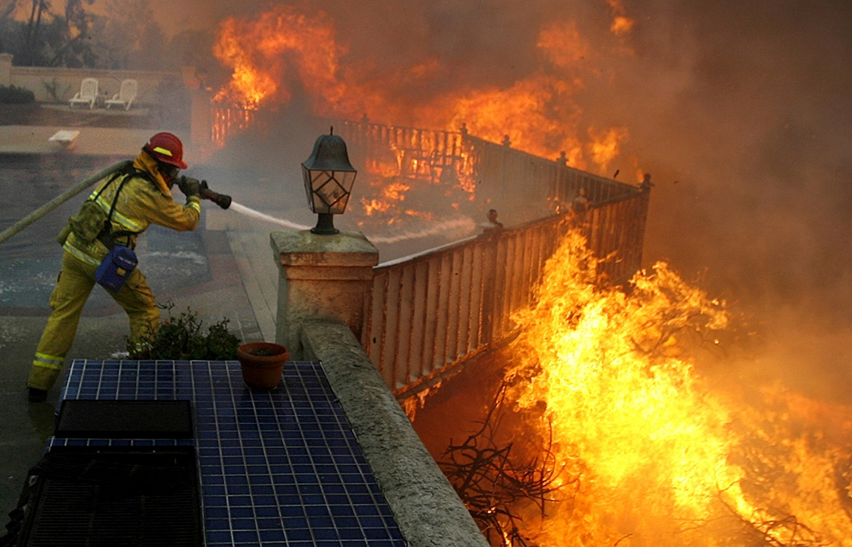
What Influences Wildfire Trends
Rising temperatures
Weather patterns
Pest populations⁽¹⁾
Land management practices
Urban / wildlife interface
Wildfire Suppression Paradox
Source: National Institute of Standards and Technology (NIST)
(1) For more information on Federal research on bark beetle affects on western forests, visit the Rocky Mountain Research Station page at
https://www.fs.fed.us/rmrs/projects/bark-beetles-tree-chemistry-and-wildfires
Notes:
Urban interface. As humans have moved closer to forestlands, increased fire suppression practices have reduced natural fires and led to denser vegetation, resulting in fires that are larger and more damaging when they do occur (Figures 1.5 and 1.2k) (Ch. 6: Forests, KM 1). Where homes are built near or among lands prone to wildland. It’s more of a set of conditions than a geographic place. Topography, hydrology, flammability of structures, and vegetation distribution, lot size, and road construction. Pine bark beetle: Killed millions of acres of trees in western U.S. Trees like lodgepole pine chemically altered after beetle attacks (drier). Shorter time / temperature to ignition. Needles of spruces contain less moisture during beetle attack (
Weather patterns:
Wet periods increase future fuel production
Dry periods create conditions for ignition of that fuel
El Nino – Band of warm ocean water in Pacific every 4 years. In North America, affects between October and March, drier than average conditions in Pacific Northwest and Rocky Mountains.

Slide 6
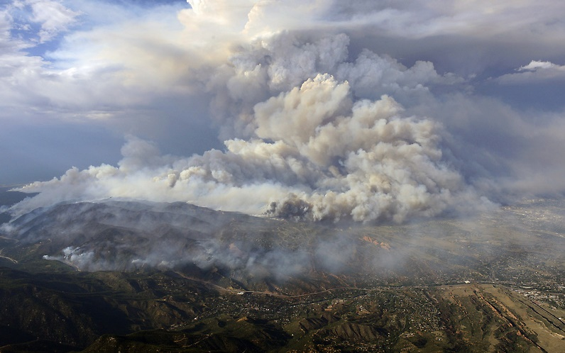
Wildfire Impacts to Water Quality and Treatment:
Fort Collins, Colorado Case Study
Notes:
Combine with any impacts on watershed, water quality, and treatment.
And now that we have a general introduction into wildfire causes and trends, I am will talk about a case study in Colorado, their impact on the work we do, and how we can design water systems for wildfire.

Slide 7
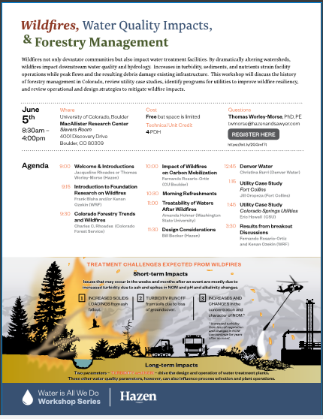

High Park Fire Case Study from 2018 WRF Wildfires Workshop at CU Boulder
Led by Jill Oropeza with City of Fort Collins and Hazen
Notes:
Second case study is not in slides

Slide 8
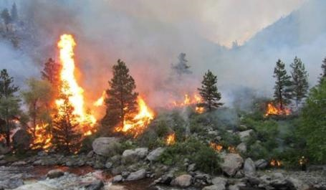
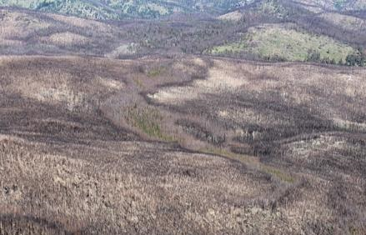
City of Fort Collins
Case Study
Fort Collins WTP
High Park Fire 2012
Fire impacts
Post-fire response
Lessons learned
(Oropeza, 2018 Wildfire Workshop CU Boulder)

Slide 9
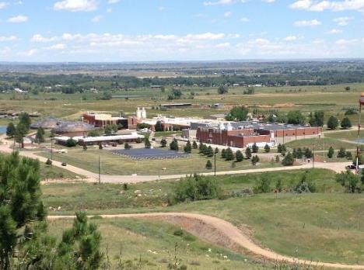
Fort Collins Water Treatment Facility
87 mgd facility; annual daily avg 25 mgd; ~50 mgd peak
Dual source water supply (Horsetooth Reservoir and Poudre River Watershed)
Conventional Treatment - alum coagulation with chlorine disinfection
Serves a population of ~129,000
Key industries – Tech companies, breweries, healthcare
(Oropeza, 2018 Wildfire Workshop CU Boulder)

Slide 10
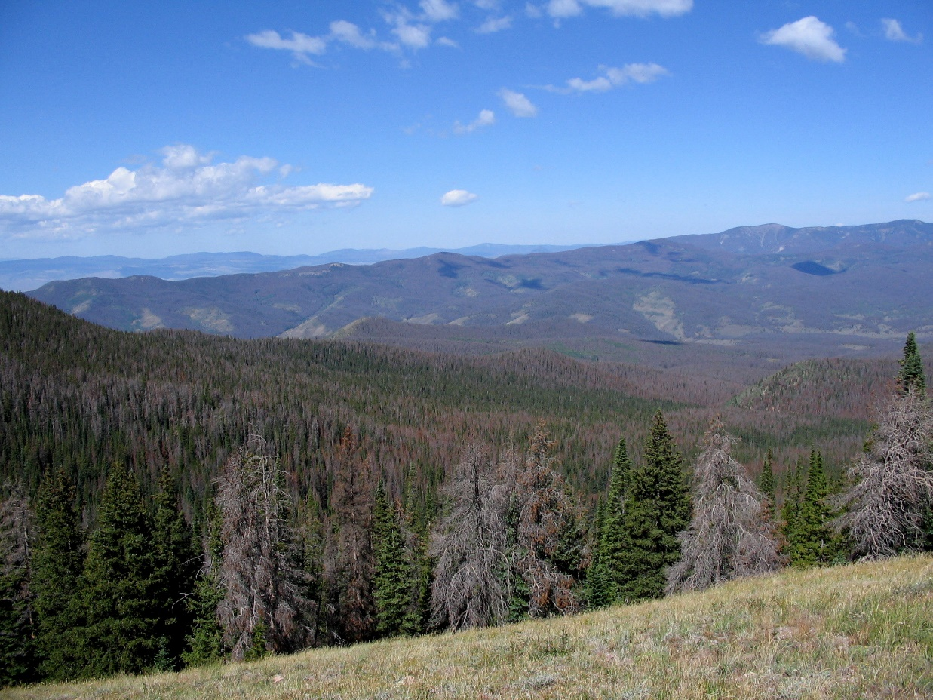
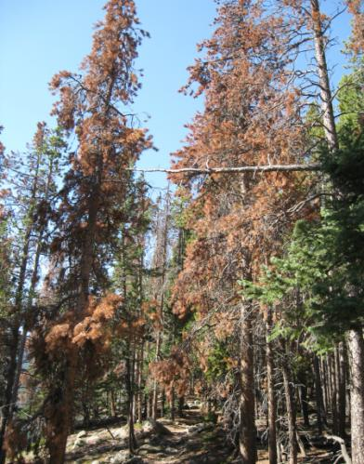
Pre-Fire Drought Conditions in May 2012
Forests stressed by drought
High mortality rate due to insect infestation
Low snowpack / runoff year
(Oropeza, 2018 Wildfire Workshop CU Boulder)
Notes:
Can see the pine bark beetle damage

Slide 11
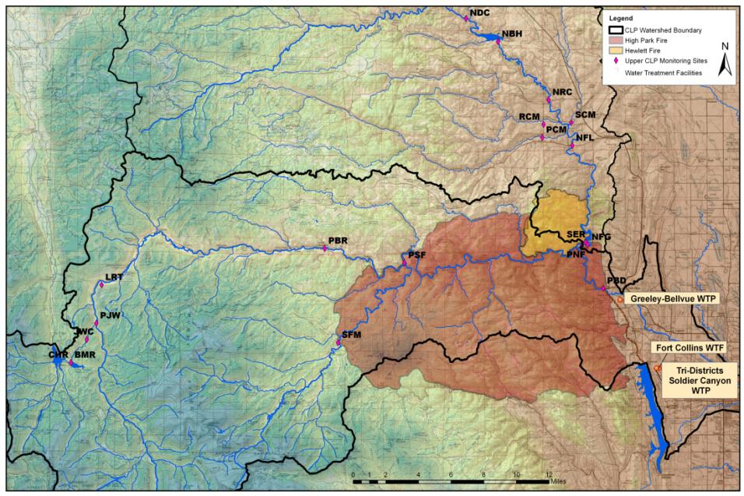
June 9th – July 2nd, 2012
87,000 acres burned
Mixed severity
Fort Collins Intake Facility
(Oropeza, 2018 Wildfire Workshop CU Boulder)
Notes:
Shows the extent of the HPF and the Hewlett fire in relation to the CoFC Poudre Intake. It also impacted water supplies for CoG and Tri-Districts. Pink sites are monitoring locations – above, within and downstream of the burn area.
The fire did not directly impact the physical concrete intake structure.
Direct supply line results in a different set of challenges than experienced if impact was to reservoir

Slide 12
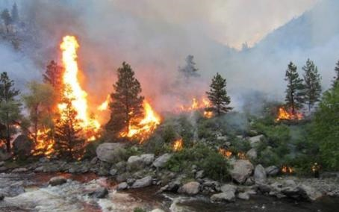
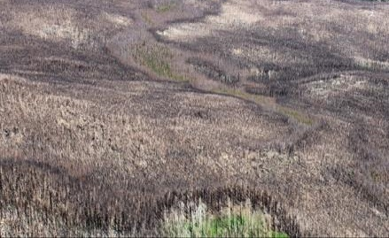
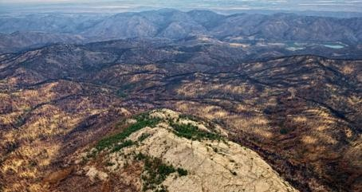
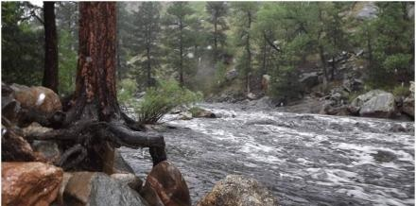
(Oropeza, 2018 Wildfire Workshop CU Boulder)
Notes:
HPF ignited on June 9, 2012 and spread very quickly to over 87,000 acres. In a matter of 23 days, this fire dramatically altered the landscape and impaired the ability of the Poudre Watershed to function as it had before.
Watersheds do the following:
Collect and channel water while buffering peak flows.
Provides natural filtration through soil and vegetation interaction. Sediment trap
Store water in rivers, lakes, groundwater, soil.
Support ecosystem (wildlife, habitat)
Carbon storage and nutrient cycling (through plant photosynthesis)

Slide 13
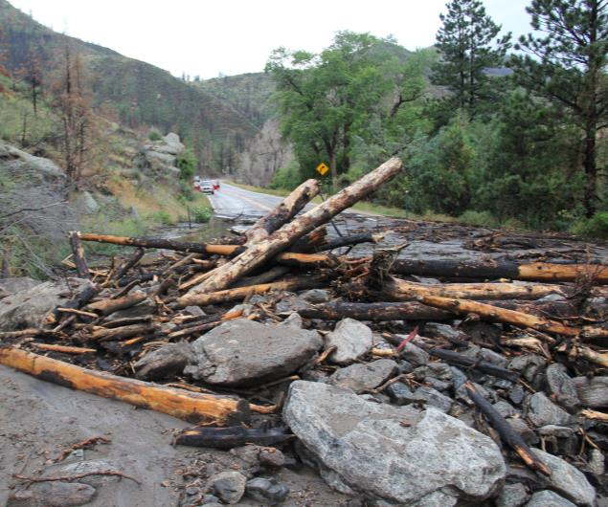
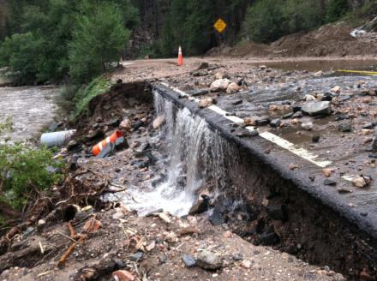
Created Conditions for Flash Flooding
Subsequent rain events produced highly turbid flash floods
Impacted aquatic resources, personal property, public infrastructure, public safety.
Resulted in rapid and dramatic water quality changes.
(modified from Oropeza, 2018 Wildfire Workshop CU Boulder)
Notes:
Even small, localized rain events produced significant flash floods and debris flows, and the impacts affected the aquatic resources, damaged personal property and public infrastructure, and posed a threat to public safety. Most on our minds in the Water Utilities and rapid and dramatic impact that these storm events had on water quality.

Slide 14
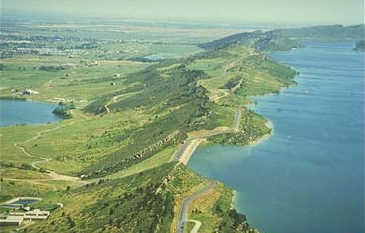
City of Fort Collins Immediately Responded with ZERO Drinking Water Violations
Switched to 100% alternate reservoir supply:
  Poudre River supply pipeline shut down for 100 days following fire
  T&O concerns in reservoir supply due to long, hot summer
The biggest risk was impairment of both supplies
Photo of Soldier Canyon Dam
on Horsetooth Reservoir
(modified from Oropeza, 2018 Wildfire Workshop CU Boulder)
Notes:
We were able to continue meeting the drinking water quality standards; however, challenges would have been much bigger if both supplies were concurrently impaired

Slide 15
Poudre River Intake source water quality pre- and post- High Park wildfire
Water Quality Parameter | Pre-fire Routine Monitoring | Post-fire Unburned Reference Site | Post-fire Routine Monitoring | Post-fire Rain Events
Turbidity (NTU) | 3.6 | 4.4 | 35 | 321
TOC (mg/L) | 4.8 | 4.2 | 4.9 | 11.8
SUVA₂₅₄ (L/mg-m) | 2.7 | 3.3 | 3.3 | 4.5
Total Phosphorus (mgP/L) | 0.02 | 0.01 | 0.06 | 0.38
Total Nitrogen (mgN/L) | 0.29 | 0.27 | 0.66 | 1.61
Notes:
Raw source water quality pre-and post-wildfire. Water quality for an unburned reference site is also shown.
¹Pre-fire water quality is shown for the water intake during routine monitoring (Hohner et al., 2016).
²Post-fire samples were also collected following rainstorms.
³ Rainstorm samples were analyzed for the dissolved fraction due to high particulate matter
Specific UV Absorbance: UV-54/DOC. Higher SUVA yields potentially higher DBP formation (higher aromatic and humic substances in DOC)

Slide 16
  Raw Water Quality Impacts
Turbidity: Not all turbidity is created equal!
Ash vs Sediment:
  River WQ recovers more quickly with sediment
  Higher coagulant dose needed for ash
  Higher DBP-FP with ash
(modified from Oropeza, 2018 Wildfire Workshop CU Boulder)
Notes:
Ash is much harder to remove; higher alum dose required; sediment settles out quickly
- ash has higher DBP-FP
River water quality recovers much more quickly when sediment than when ash
Sediment clogs pipelines – alert system is crucial. Pipeline shutdown at 100 NTU to prevent clogging.
Turbidity Graphs – illustrate the new conditions; a very flashy river with rapid changes in water quality (as just shown)
Turbidity spikes due to sediment delivery and re-suspension of stored riverbank sediments
Construction of new pre-sedimentation basin at FCWTP to provide flexibility in delivery options and maximize settling times

Slide 17
Post-Fire Response
1
Understanding Water Quality Impacts
2
Treatment & Operational Responsiveness
3
Fire Effects Mitigation
4
Outreach/ Communication
(Oropeza, 2018 Wildfire Workshop CU Boulder)
Notes:
Worked simultaneously in each area – each required significant staffing commitments. Not going to talk about Communications, but this was a critical element of all post-fire response activities from start to finish.

Slide 18
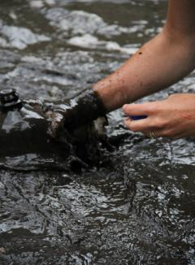
Post-Fire Response
1
Understanding Water Quality Impacts
2
Treatment & Operational Responsiveness
3
Fire Effects Mitigation
4
Outreach/ Communication
Real time instrumentation
High resolution depiction of variability
Track events / integrate warning systems
Storm event sampling
Worst-case scenario water quality
Track watershed recovery
Research & Collaboration
Fire impacts on Taste & Odors
Fire impacts on TOC & DBPs
Impacts of riverbank sediments
Treatment effectiveness
(modified from Oropeza, 2018 Wildfire Workshop CU Boulder)
Notes:
To continue meeting our objective as a safe drinking water provider, we must build a new understanding of the system: what is happening & where?
Evaluate and understand new conditions – develop solutions to manage
Real time instrumentation - turbidity graph – what is response time, what is magnitude of WQ changes expected? (system responds to storms and water releases)

Slide 19
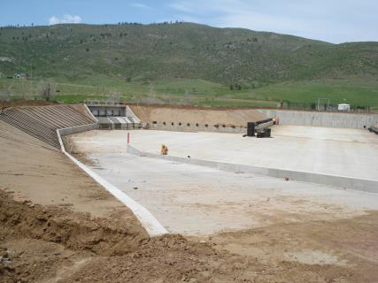
Post-Fire Response
1
Understanding Water Quality Impacts
2
Treatment & Operational Responsiveness
3
Fire Effects Mitigation
4
Outreach/ Communication
Early Warning Capabilities
Identify how do we know when “bad water” is coming.
Estimate how long impacts last.
Increased Pre-Sed Capacity
Reduce Turbidity
4.5 months design to completion
60 MGD
3 MG basin capacity
(modified from Oropeza, 2018 Wildfire Workshop CU Boulder)
Notes:
NTU issues here to stay for awhile; need way to avoid damage
Semi-automatic shut down procedure for the Poudre River Pipeline
It must occur somewhat slowly to avoid water hammer and the potential of bursting our pipeline.
Requires travel to the intake facility – ~30 minute drive from the WTF
Warning system keeps us from getting large sediment loads into the pipeline.
Learned that although the FCWTF could manage turbidity levels between ~100 NTU with our ability to blend, the sediment dropped out in the pipelines, causing significant operational issues.

Slide 20
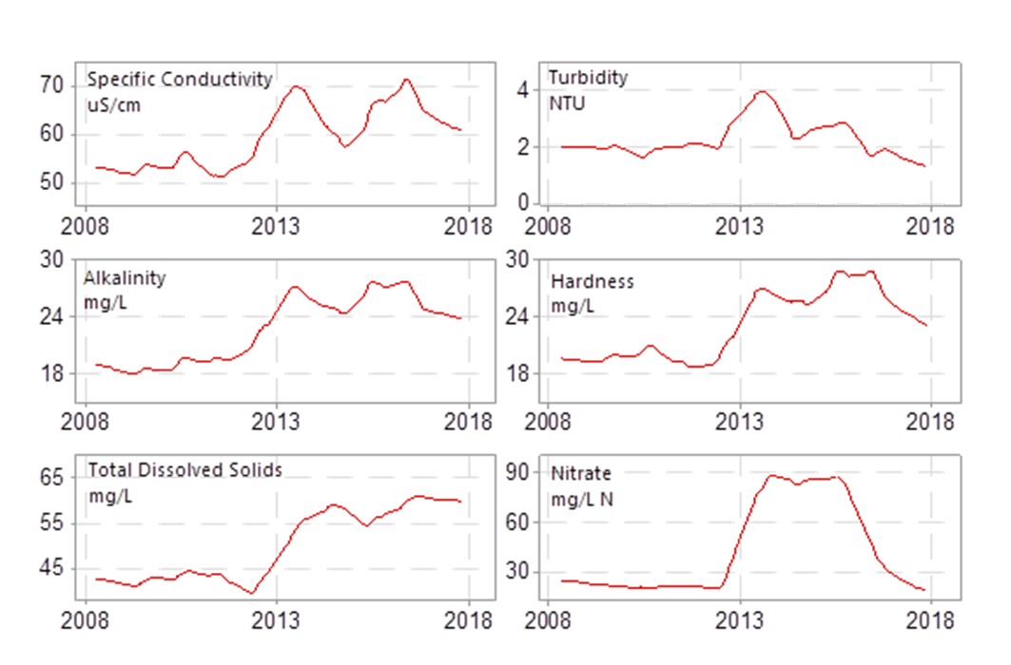
  Lessons Learned
  Watershed WQ monitoring is crucial for operations.
  Pre-sed basin needed to protect pipeline and reduce impacts to WTP (100 NTU threshold)
  Dissolved nutrients (NH3, NO3, PO4) remained elevated for 2-5 years
  After 5 years, some water quality changes where still visible
(modified from Oropeza, 2018 Wildfire Workshop CU Boulder)

Slide 21
  Preparing for the Next Wildfire
Acquired auto-sampler for sampling during storm events
Monitor removal efficiency of pre-sedimentation basin
Pilot testing of fire-impacted water – new polymers & treatment optimization for NTU and ash
Staff trained to perform Flavor Profile Analysis
Investigating ways to increase an/or maximize existing solids drying capacity
(modified from Oropeza, 2018 Wildfire Workshop CU Boulder)

Slide 22

Treatment Considerations
Facilities can be designed to handle wildfire water quality impacts. The question is what additional treatment should be installed and when?
Contaminants of concern
Process selection considerations and guidelines
Recommendations

Slide 23
Contaminants of Concern
Particles
NOM
Nutrients
Chemicals
  Surrogate for microbial contaminants
  Interferes with disinfection
  Overwhelm clarification processes
  Impacts filter run time
  Residuals production
  Exerts disinfectant demand
  Precursor to DBPs
  Source of color, tastes and odors
  Increases solubility of pollutants and heavy metals
  Controls optimum coagulant dose for most waters
  Filter clogging algae
    Toxic algal byproducts
    Taste and odor problems
    Increased NOM
    Release of iron and manganese
  Pesticides
  Herbicides
  Fire fighting foams

Slide 24
Water Quality Parameters that drive WTP process selection
Turbidity
  Surrogate for pathogens
NOM
  Precursor to DBPs
  Color
Algae
  Taste and odors
  Cyanotoxins
  Precursor to DBPs
Drive process selection
Set optimum coagulant dose
Impact residuals handling requirements

Slide 25
Conventional Treatment Approach
Convert dissolved substances into particulate form (e.g. NOM, iron, manganese) and remove particles

Slide 26
Guidelines: Average WQ
Process selection diagram from Valade, Becker, & Edzwald , J of Water Supply: Research and Technology,- Aqua, Vol. 58 (6) 424-431

Slide 27
Guidelines: Max WQ
Process selection diagram from Valade, Becker, & Edzwald , J of Water Supply: Research and Technology,- Aqua, Vol. 58 (6) 424-431

Slide 28

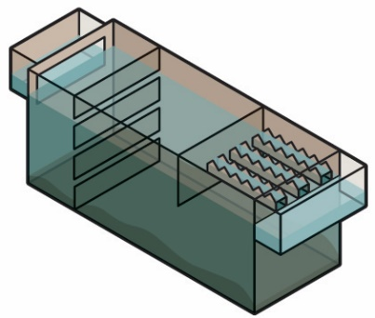
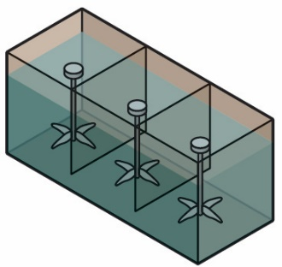
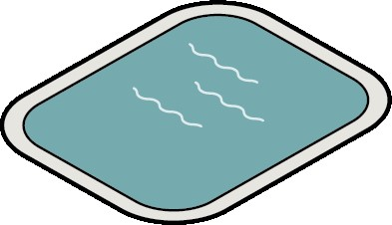
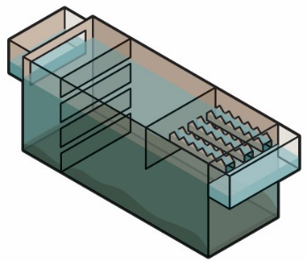
Considerations for Process Selection/Optimization
Pre-Sedimentation
Coagulation
Flocculation
Clarification
Consider when raw water turbidity exceeds 100 NTU for extended periods
Include bypass
Include algal control measures
Monitor coagulant demand and pH
Ensure chemical storage and feed pumps can deliver higher doses
Polymer feed may be used for ash
Operational controls and zeta potential optimization
Monitor mixing energy to prevent floc shear
Install a means of removing silty solids
Use large conventional basins to manage large amounts of solids
Ensure solids can be removed easily
If high turbidity is not expected to reach intake, consider DAF for control algae
Notes:
Talk about clarification options depending on raw water supply

Slide 29
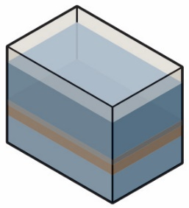
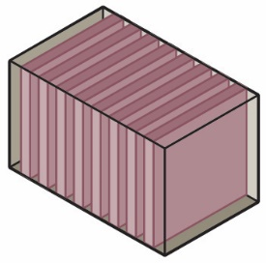
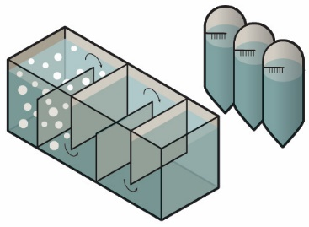
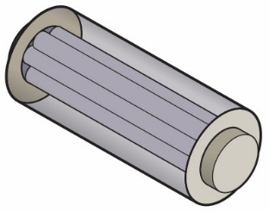
Considerations for Process Selection/Optimization
Media Filtration
Membranes
Disinfection
Advanced treatment
Consider deep-bed dual media filters with larger media that can store more solids
Consider GAC in place of anthracite
Provide enough water and storage for backwashing multiple filters
Do not use if raw water is subject to firefighting foams
For existing membrane plants, consider adding PAC to absorb foams upstream of membranes
Higher levels of NOM may lead to DBP issues
Maximize removal of NOM
Consider alternative disinfectants such as UV or ozone
Smoky taste and odors may occur
Nutrient release may cause algal blooms
Consider advanced treatment such as:
PAC
Post filter GAC
Ozone/biofiltration
UV/AOPs

Slide 30
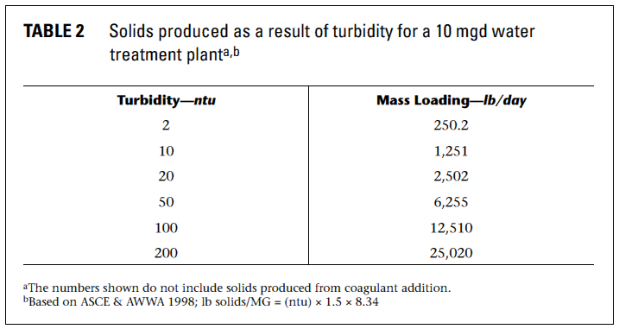
Residuals Handling
Plan for increased sediment run-off post wildfires
Consider ability to switch to an alternative source or install a pre-sedimentation basin to minimize risk
Excessive solids production may overwhelm system

Slide 31
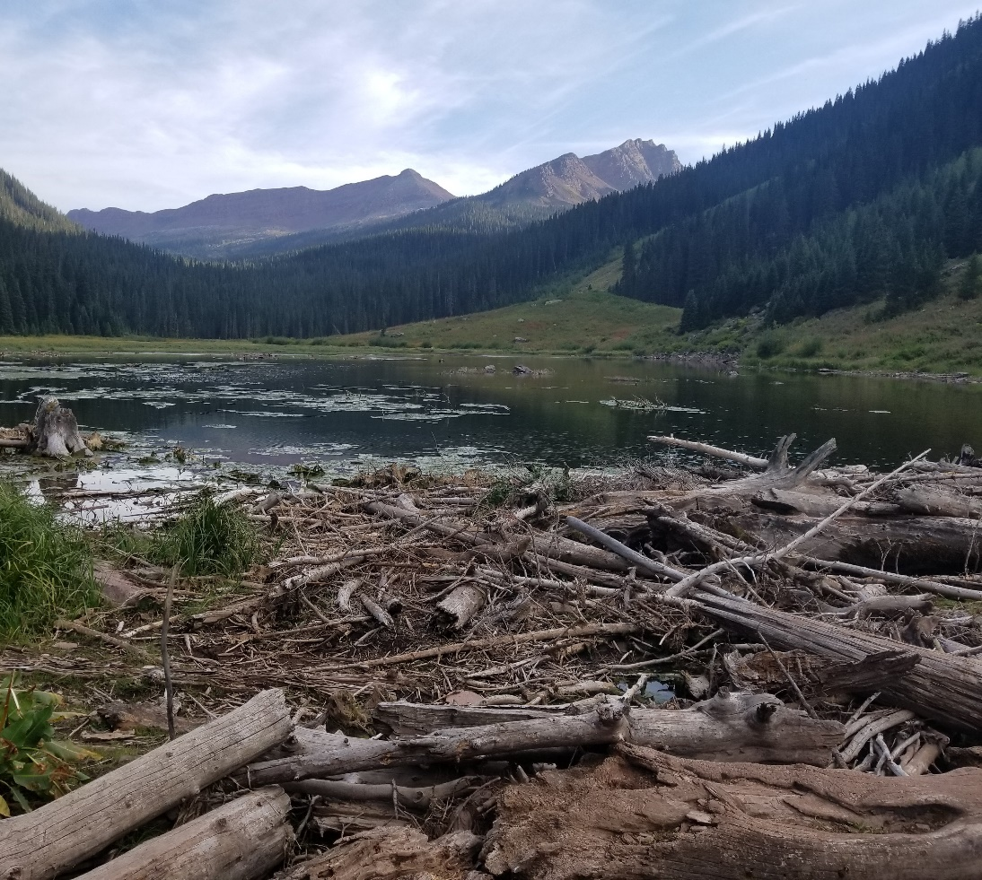
Treatment Recommendations
Adjust treatment operations for higher coagulant demand, particularly following runoff events.
Consider investing in:
  Increasing monitoring
  Expanding water storage capacity
  Exploring additional supplies
  Pre-sedimentation basins
Evaluate capacity of residuals handling system and consider improvements that may be required
Notes:
**Small, single source systems, who have less flexibility with water supplies and treatment operations may be at the greatest risk

Slide 32
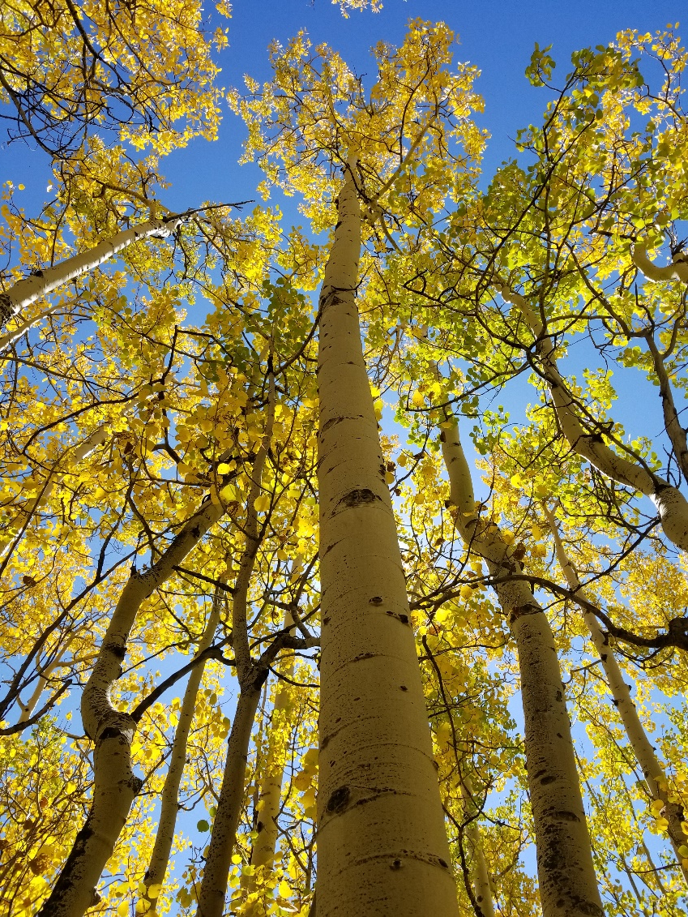
Overall Conclusions
Forest fires can be part of a healthy forest renewal cycle
Climate change and fire prevention are making forest fires worse and more severe in the west
Treatment options can minimize impact to utilities

Slide 33
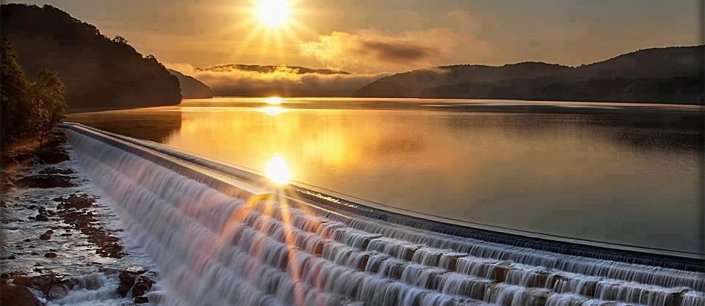
Thank You!
Tyler Bird
tbird@hazenandsawer.com

Slide 34
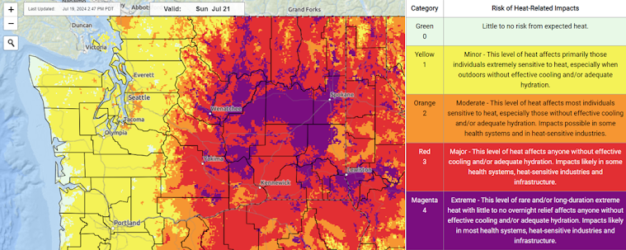
Air and Carbon Effects of Wildfires
PM impacts on human health
Worldwide, wildfires estimated to cause 1.5M+ smoke-related premature deaths each year
Atmospheric and weather feedback
Fire process converts carbon from land-locked to atmosphere
Carbon sequestration opportunity? Only if removal is not permanent.
2018 U.S. Climate Assessment: Effect of wildfires on climate = “low confidence”
Archive from wassmoke.blogspot.com/2024/07
Notes:
Aerosals and particulates temporarily reducing solar energy transfer to earth’s surface. If you’re interested, I encourage you read the latest national climate assessment section on wildfires.
https://www.preventionweb.net/news/new-study-more-15-million-die-each-year-wild/bush-fire-pollution#:~:text=New%20study%3A%20more%20than%201.5,from%20wild%2Fbush%20fire%20pollution&text=Landscape%20fires%20are%20an%20increasing,threat%20fuelled%20by%20climate%20change.

Slide 35
Wildfire Suppression Paradox
Notes:
Reduced small fire quantity can result in the buildup of combustible materials that may be “overdue” to natural burning.
In 1933, the federal government created the Civilian Conservation Corps, which put thousands of men to work building fire breaks and fighting fires. In 1935, the Forest Service established the so-called 10 a.m. policy, which decreed that every fire should be suppressed by 10 a.m. the day following its initial report.
Until around 1970, federal land managers remained obsessed with controlling large fires. But during the 1960s, scientific research increasingly demonstrated the positive role fire played in forest ecology. This led in the early 1970s to a radical change in Forest Service policy—to let fires burn when and where appropriate. It began with allowing natural-caused fires to burn in designated wilderness areas. From this the "let-burn" policy evolved, though it suffered a setback in the wake of the 1988 Yellowstone fires. Since around 1990, fire suppression efforts and policy have had to take into account exurban sprawl in what is called the wildland-urban interface. Another issue the Forest Service now faces is that fires have grown in size and ferocity over the last 25 years. The fire-fighting budget has grown to about 50 percent of the agency’s entire budget, which limits funds available for land management activities such as land restoration and forest thinning that could aid in fire suppression.
https://foresthistory.org/research-explore/us-forest-service-history/policy-and-law/fire-u-s-forest-service/u-s-forest-service-fire-suppression/#:~:text=In%201933%2C%20the%20federal%20government,day%20following%20its%20initial%20report.

Slide 36
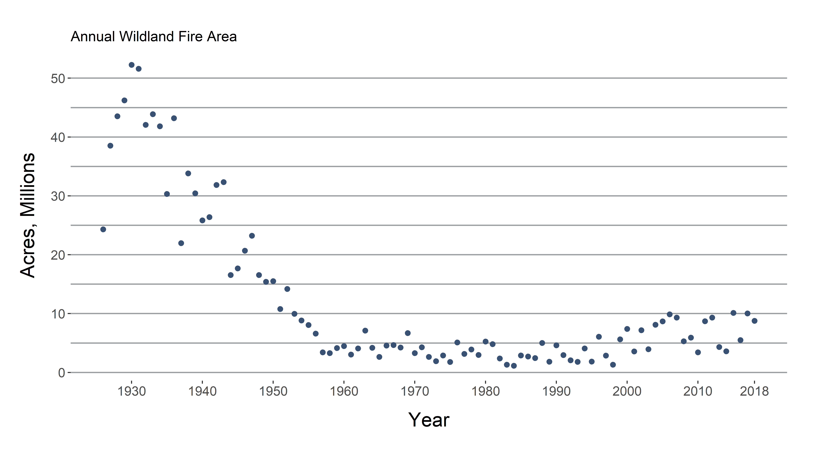
U.S. Wildfire Acreage Burned, 1926 - Present
Source: National Interagency Fire Center
(https://www.nifc.gov/fireInfo/fireInfo_stats_totalFires.html)
Notes:
Before middle of 20th century, most forest managers believed fires should be suppressed at all times. By 1935: “all wildfires were to be suppressed by 10 a.m. the morning after they were spotted.” Fire lookout towers during WW2. Educational campaigns in 1940s (smokey the bear). Policy change in the 1960s, no new giant sequoia in California, realized fire was essential to life cycle. 196 Wilderness Act.

Slide 37
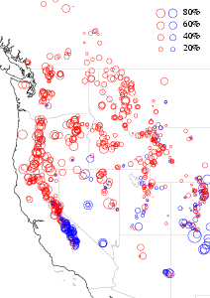
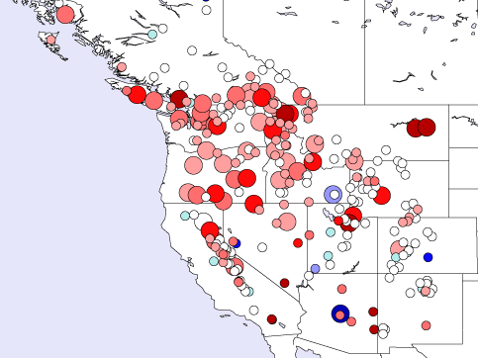
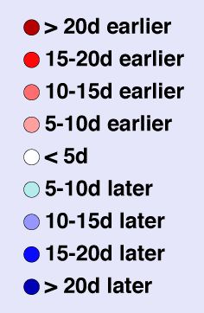

Climate Change in the Western US
Earlier
Runoff
Stewart et al., 2004
Shorter Snow Season
(16 d less in CA, NV (1951-1996))
Longer Fire Season
Reduced
Snowpack
Mote, 2003
(Rhoades, 2018 Wildfire Workshop CU Boulder)
Notes:
Observed Climate Records show clear and dramatic changes in temperature and precipitation in Western Forests
Changes have implications for streamflow, but also for fire seasons
Most of our water is derived from snow, so reduced snowpack has implications for the amount and timing of streamflow
Increased temperatures have advanced snowmelt and peak runoff by weeks to a month (2.8 months longer in Western US)
Globally has increased 19%
Shorter snow season = longer fire season
Colorado:
2017 was 3rd warmest year in 123 year records in Colorado
2017 Longest Hot Season on record (> 27 oC / 80 oF)
10 Feb to 27 Nov = 289 day (vs 215 previous)
Temporal centroid (CT) is center of streamflow mass during snowmelt (Q50)
Stewart, Cayan, and Dettinger, 2004
Observed Data 1948-2000
Across the west, we are seeing changes like these with shifts of 2-3 weeks in the date when half of the water has flowed by for the water year.
In general this has been attributed to reduced precipitation as snow (e.g. warmer temperatures). The issue of the day has become storage – e.g. dams.

Slide 38
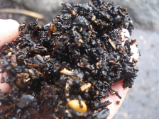
  Raw Water Quality Impacts Cont…
Nutrients:
    Dissolved nutrients (NH₃, NO₃, PO₄) remained elevated for 2-5 years
    Useful indicators of watershed recovery
TOC:
    No clear fire response in background concentrations
    Peak conc. still correlates with snowmelt runoff that largely originates above burn area
(modified from Oropeza, 2018 Wildfire Workshop CU Boulder)

Slide 39
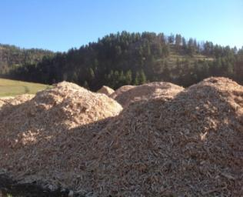
Post-Fire Response
1
Understanding Water Quality Impacts
2
Treatment & Operational Responsiveness
3
Fire Effects Mitigation
4
Outreach/ Communication
Post-Fire Restoration & Emergency Hillslope Stabilization
USFS Burned Area Emergency Response (BAER)
NRCS Emergency Watershed Protection (EWP) Program
Aerial Wood Shred Mulching
(Oropeza, 2018 Wildfire Workshop CU Boulder)
Notes:
We (Utilities; not just WPD) engaged in this process with Larimer CO, Greeley, FC.
After initial recommendations, still lots of science needs for helping to prioritize (all, some, high, low), design specs,
Resource sharing, cooperative agreements (IGA’s) expedite work
Utilities need access to scientific literature, subject matter experts and more than that, opportunities to understand specifics of our system
City managed inspection process – what was ordered got delivered and applied to spec. All of the related work was a HUGE commitment from Utiltiies and stretched limits of staff capacity.

Slide 40
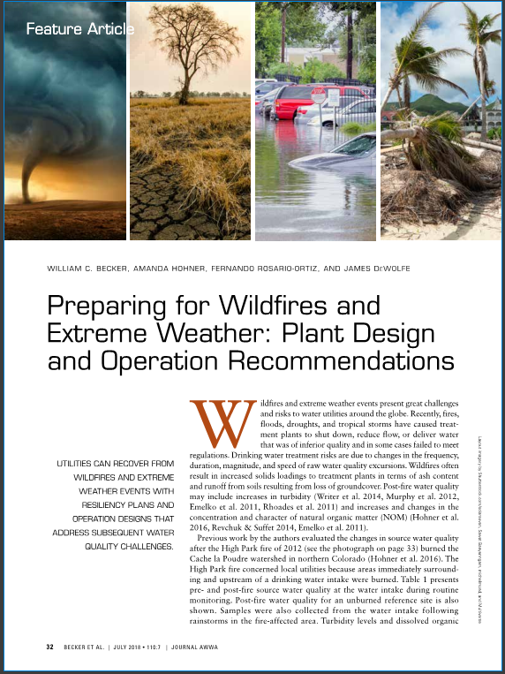
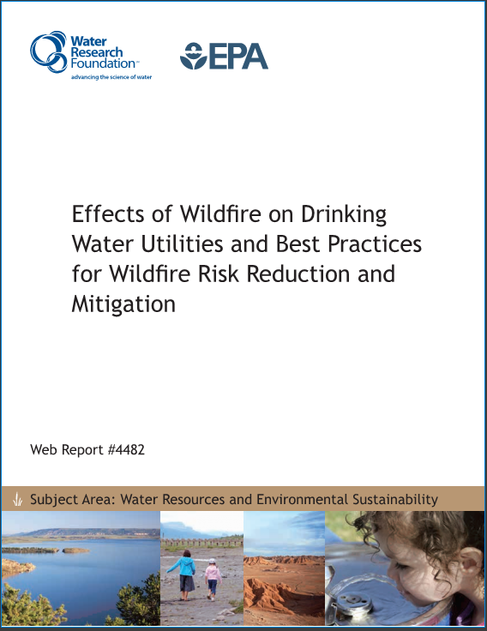
Recommended References
Notes:
Hazen worked with CU Boulder to prepare this journal article.

Slide 41
Watershed Response and Treatment Implications
Increased particle loads
Elevated nutrient levels
Altered dissolved organic matter
Infrastructure problems
Coagulation challenges
Solids handling
Algal blooms
Taste & odor compounds
Coagulation challenges
DBP formation and speciation
(Hohner, 2018 Wildfire Workshop CU Boulder)
Notes:
The water quality response depends on a variety of factors, including watershed specific (hydrology, soil types) and wildfire specific factors (burn severity, proximity to surface waters)
This topic is relatively well studied in the forestry and ecology communities, and from their observations and anecdotal experiences of water utilities, we can consider the implications for water treatment
Increased particle loads can cause serious problems for infrastructure such as pipeline clogging and reservoir dredging

Slide 42
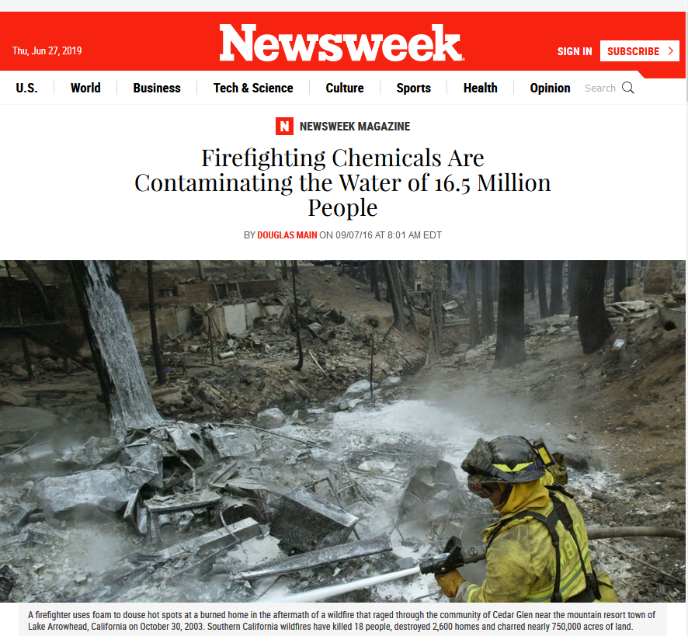
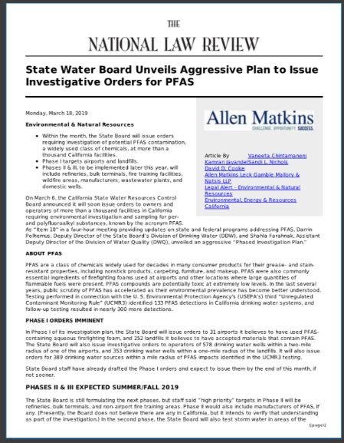

Unknown Water Quality Impacts from Firefighting Foams and Retardants
Firefighting foams typically contain fluorosurfactants based on perfluorooctane sulfonic acid (PFOS) and perfluorooctanoic acid (PFOA)
(https://www.newsweek.com/2016/09/16/firefighting-chemicals-contaminating-water-165-million-people-496229.html)

Slide 43
References
“Wildfires: Burning out”. The Economist, Nov. 17, 2018 ed. Retrieved from https://www.economist.com/graphic-detail/2018/11/17/despite-californias-inferno-global-wildfires-are-fizzling-out. Data Source: Park Williams, Columbia University
USGCRP, 2018: Impacts, Risks, and Adaptation in the United States: Fourth National Climate Assessment, Volume II [Reidmiller, D.R., C.W. Avery, D.R. Easterling, K.E. Kunkel, K.L.M., Lewis, T.K. Maycock, and B.C. Stewart (eds.)]. U.S. Global Change Research Program, Washington, DC, USA, 1515 pp. doi: 10.7930/NCA4.2018. Retrieved from: https://nca2018.globalchange.gov/
Writer, J.H., Hohner, A., Oropeza, J., Schmidt, A., Cawley, K.M. and Rosario‐Ortiz, F.L., 2014. Water treatment implications after the high Park wildfire, Colorado. Journal‐American Water Works Association, 106(4), pp.E189-E199.
Bladon, K.D., Emelko, M.B., Silins, U. and Stone, M., 2014. Wildfire and the future of water supply. Environ. Sci. Technol., 48(16),
Mote, P.W., 2003. Twentieth-century fluctuations and trends in temperature, precipitation, and mountain snowpack in the Georgia Basin-Puget Sound region. Canadian Water Resources Journal/Revue canadienne des ressources hydriques, 28(4), pp.567-585.
Stewart, I.T., Cayan, D.R. and Dettinger, M.D., 2004. Changes in snowmelt runoff timing in western North America under abusiness as usual'climate change scenario. Climatic Change, 62(1-3), pp.217-232.
Becker, W.; Hohner, M.; Rosario-Ortiz, F.; DeWolfe, J. 2018. Preparing for Wildfires and Extreme Weather: Plant Design and Operation Recommendations. Journal AWWA 2018, 110 (7).
Hohner, A.; Webster, J.; Cawey, K.; Rosario-Ortiz, F.; Becker, W. 2018 Wildfire Impacts on Drinking Water Treatment Process Performance; 4590; Water Research Foundation: Denver, CO.
Copies of many of these PDFs are available on SharePoint in the Journal Club folder

Slide 44

  Raw Water Quality Impacts Cont…
  Taste & Odor:
Smoky odors permeate water
PAC addition assists with odor removal
  Riverbank sediments
  Source of nutrients, metals and turbidity
  Persist in system through cycles of deposition and re-suspension
  Potential driver of algal growth
(modified from Oropeza, 2018 Wildfire Workshop CU Boulder)

Slide 45

Contaminants of Concern
Microbial contaminants - pathogens
  fecal coliform
  viruses
  Giardia cysts
  Cryptosporidium oocysts
Total suspended solids (turbidity)
Natural organic matter (total organic carbon)
Nutrients: phosphorus, nitrogen
  Algae and algal byproducts
Pesticides/Herbicides: atrazine, diazinon, etc.
Fire fighting foams

Slide 46


Solids (particles)
Turbidity is a regulated parameter
Surrogate for Giardia and Cryptosporidium
Interfere with disinfection
Residuals production
Overwhelm clarification processes
Impact filter run time
Treatment costs

Slide 47

Natural Organic Matter (NOM)
Complex mixture of organic compounds
Derived from breakdown of animal and plant matter
Made in the water body by algal processes
Concentration varies by source and season

Slide 48
Natural Organic Matter
Why Do We Care?
  NOM is present in all surface waters
  Exerts a disinfectant demand
  Source of color, taste, and odor
  Increases solubility of pollutants and heavy metals
  Carbon source for biofilm growth
  Can affect corrosion
  Fouling of membranes and GAC adsorbers
  Major precursor to THMs and HAAs and other DBPs
  Coagulant demand – NOM controls the optimum coagulant dose for most waters, not turbidity

Slide 49

Nutrients
Promote growth of aquatic vegetation and can trigger algal blooms
  pH swings
  Filter clogging
  Toxic algal byproducts
  Taste and odor problems
  Increase the concentration of NOM
  Bottom waters become anoxic
  Release of iron and manganese
  Treatment costs

